Slide 1
Multi-mode Controller Development for Cross-Flow Hydrokinetic Turbines
Dominic Forbush
Supervisory Committee:
Brian Polagye – Committee Chair, Mechanical Engineering Dept.
Brian Fabien – Mechanical Engineering Dept.
Andrew Stewart – Applied Physics Laboratory
Michael Brett – GSR, Civil and Environmental Engineering Dept.

Slide 2
Agenda
Background
Performance Characterization
Controller Development
Extending to Field Scale
Conclusions
Notes:
Objective: to develop a performance curve for this turbine. A reliable performance curve allows for controls strategies to be accurately simulated and performance generalized to other flow conditions.

Slide 3
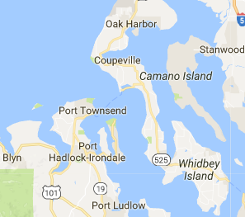
Hydrokinetic Energy
Hydrokinetic energy is the energy contained in fast-moving water flows.
Unlike traditional hydropower, there is no need for a dam.
A hydrokinetic turbine can extract a portion of this energy and convert it electrical energy.
Notes:
Objective: to develop a performance curve for this turbine. A reliable performance curve allows for controls strategies to be accurately simulated and performance generalized to other flow conditions.

Slide 4
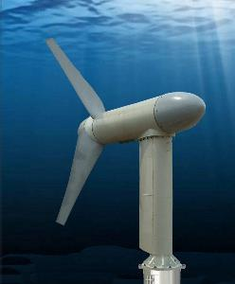
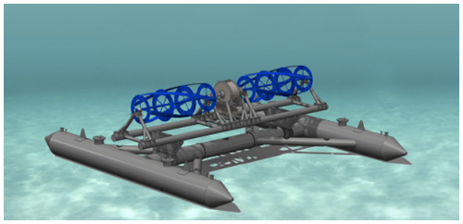
Hydrokinetic Turbines
Hydrokinetic turbines can be broadly subdivided into axial-flow and cross-flow
Grid-scale wind turbines: axial-flow.
Cross-flow turbines have some advantages in hydrokinetic applications
→ Need to address knowledge gap in cross-flow turbine technology
A HammerFest-Strom axial-flow hydrokinetic turbine
Ocean Renewable Power Company’s RivGen® cross-flow hydrokinetic turbine

Slide 5
Governing Equations
Power P available in a moving flow:
P: fluid power (W)
ρ: fluid density (kg/m³)
A: turbine frontal area (m²)
U: free-stream velocity (m/s), a function of time (t).
Governing equation of turbine dynamics:
J: rotational moment of inertia (kg m²)
τ_{h}: hydrodynamic torque (N m)
τ_{c}: total control torque (N m)
: angular acceleration (rad/s²)

Slide 6
Governing Equations
Hydrodynamic torque τ_{h}:
C_{q}: Coefficient of torque
R: Turbine radius (m)
Hydrokinetic-to-rotational power conversion efficiency:
Tip-speed ratio:

Slide 7
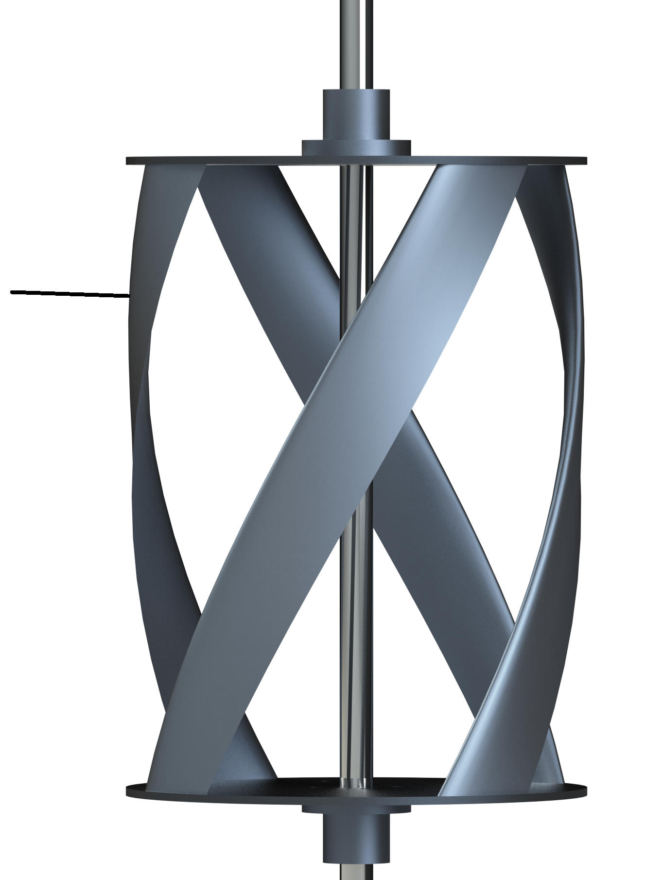
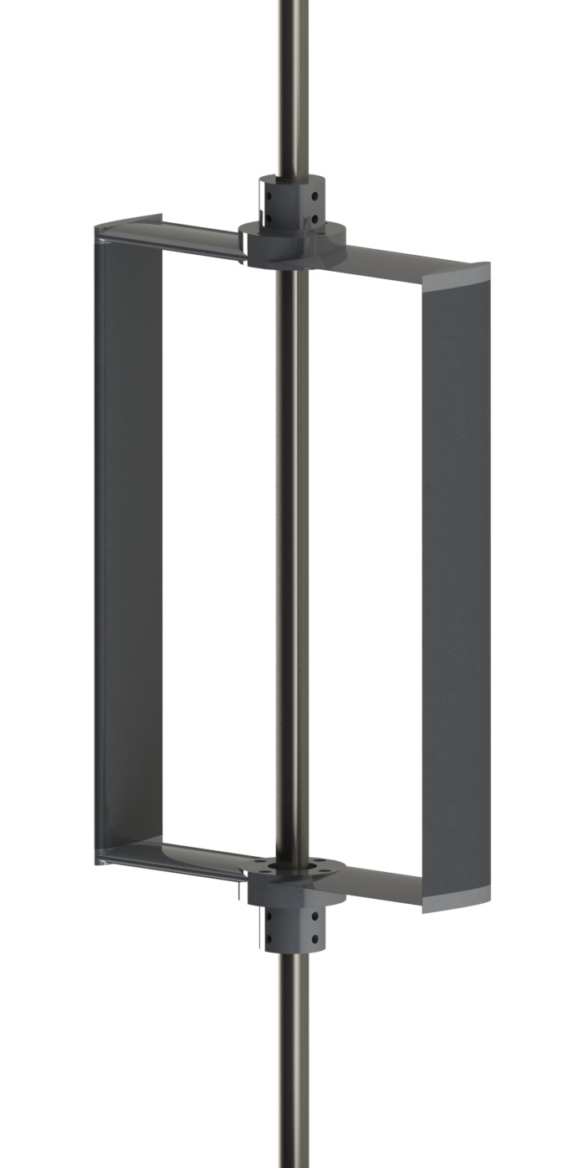
Labeling Conventions
Three data sets are presented
Laboratory scale, four-bladed helical turbine
Laboratory scale, two-bladed straight turbine
Field scale, four-bladed helical turbine

Slide 8
Agenda
Background
Performance Characterization
Controller Development
Extending to Field Scale
Conclusions
Notes:
Objective: to develop a performance curve for this turbine. A reliable performance curve allows for controls strategies to be accurately simulated and performance generalized to other flow conditions.

Slide 9
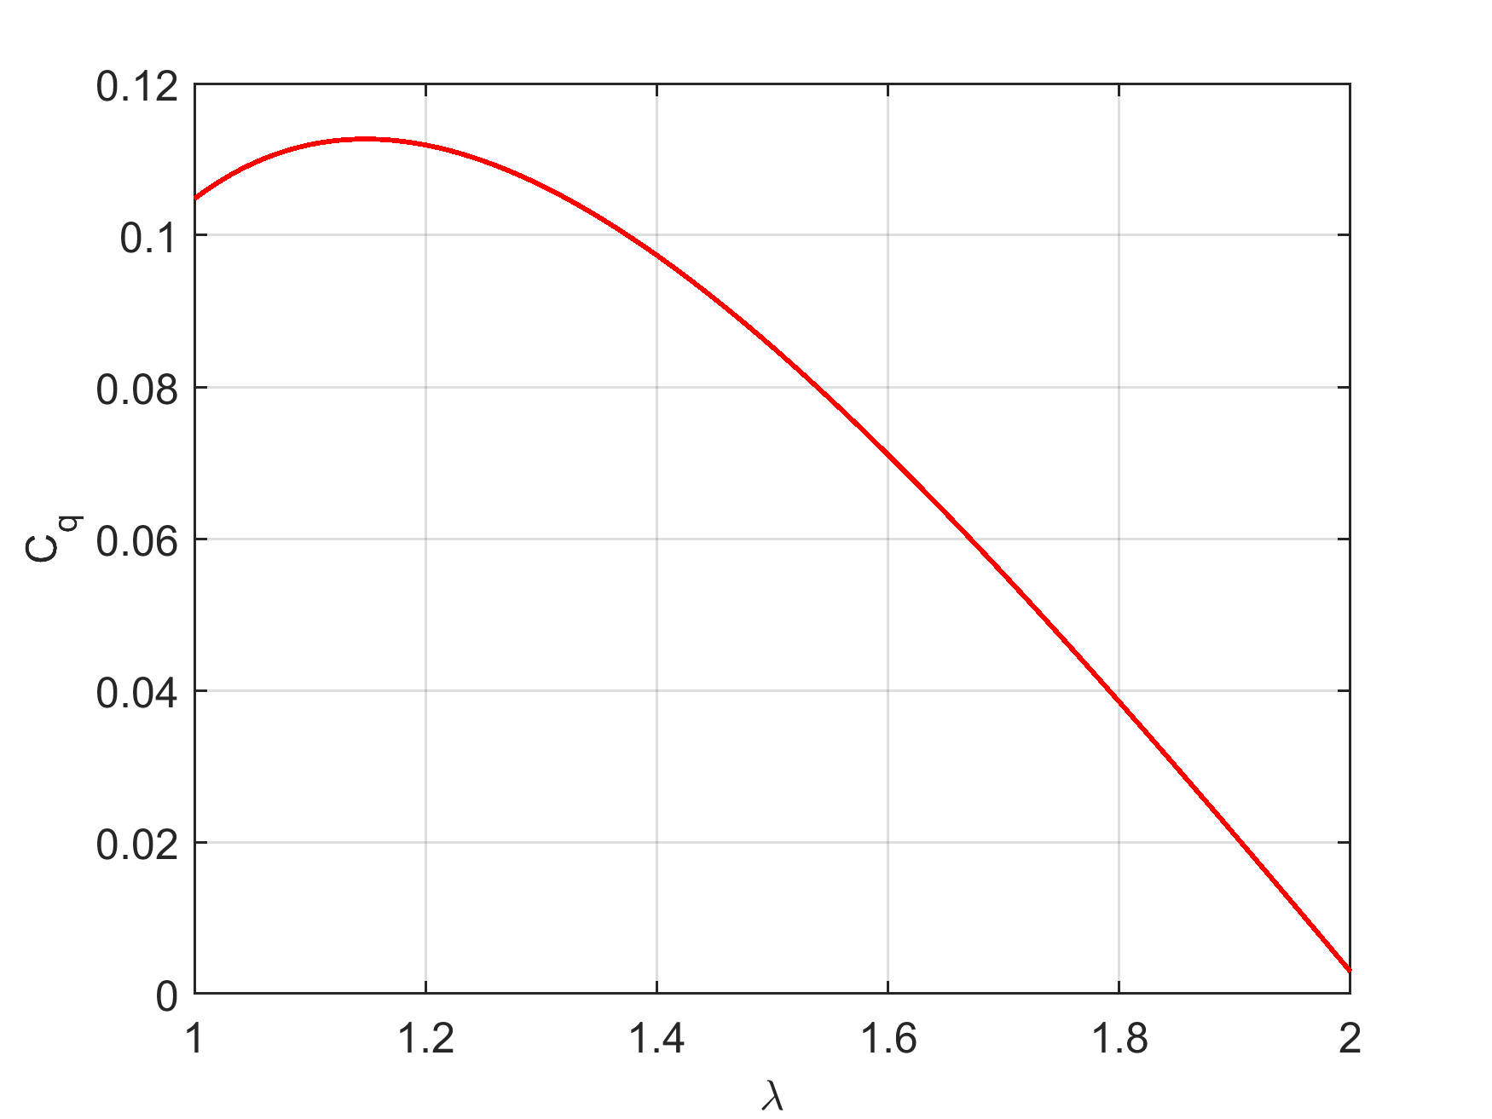
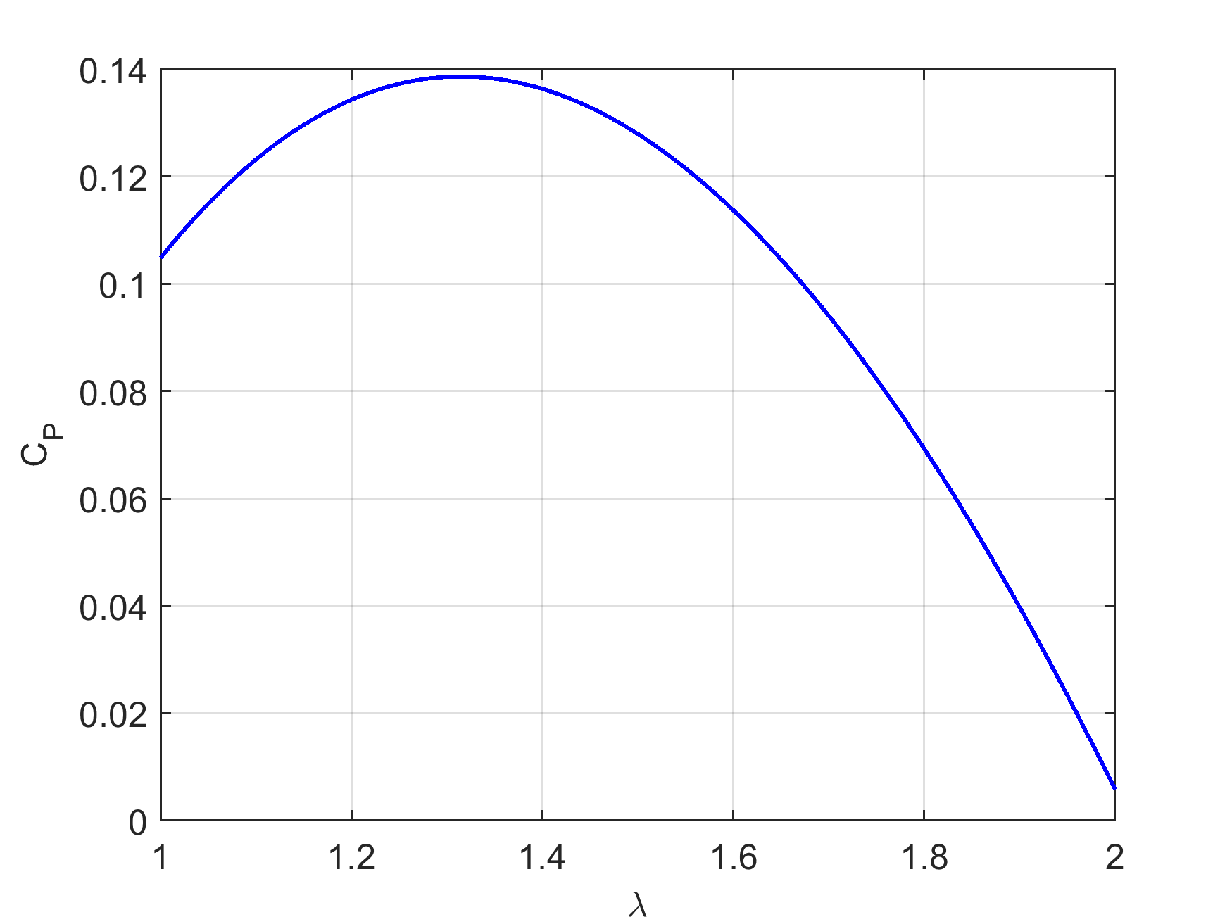
Time-Average Description
Torque coefficient C_{q} is treated as a function of λ alone
Forbush et al., “Performance characterization of a cross-flow hydrokinetic turbine in sheared inflow”
International Journal of Marine Energy. vol. 16, pp. 150-161, 2016.
Low-speed limit of minimum-phase operation
Maximum power point (λ*,C_{P}*)

Slide 10
Phase-Resolved Description
Torque coefficient C_{q} is treated as a function of λ and turbine azimuthal position θ
where

Slide 11
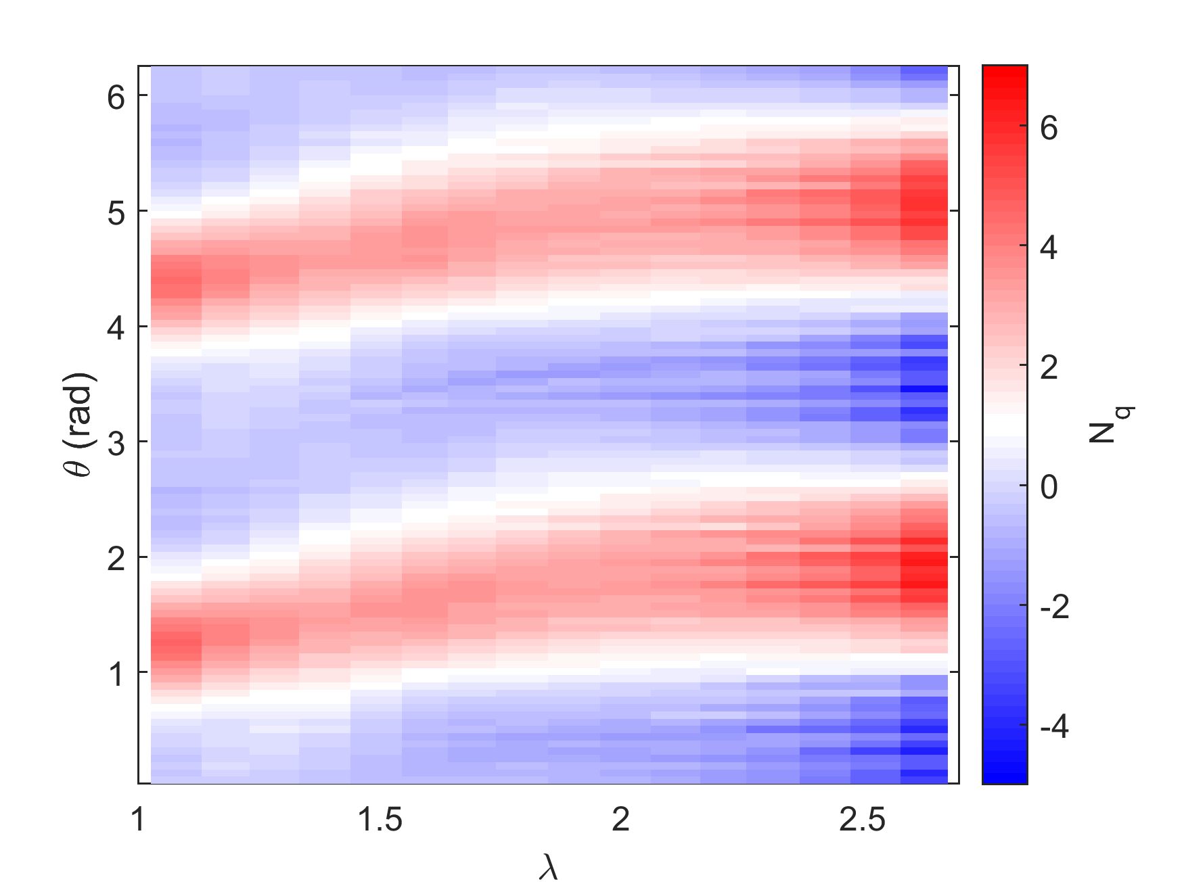
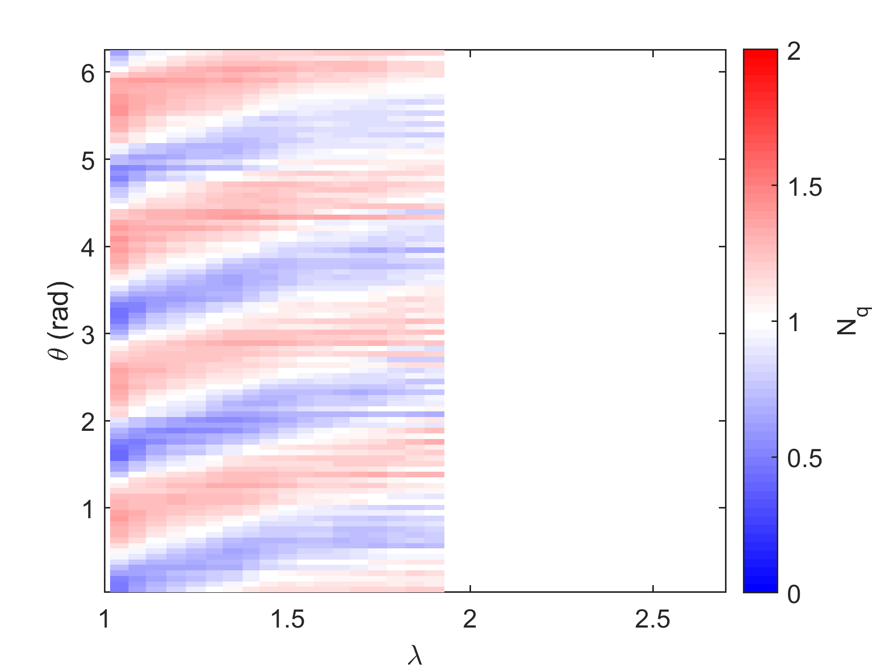
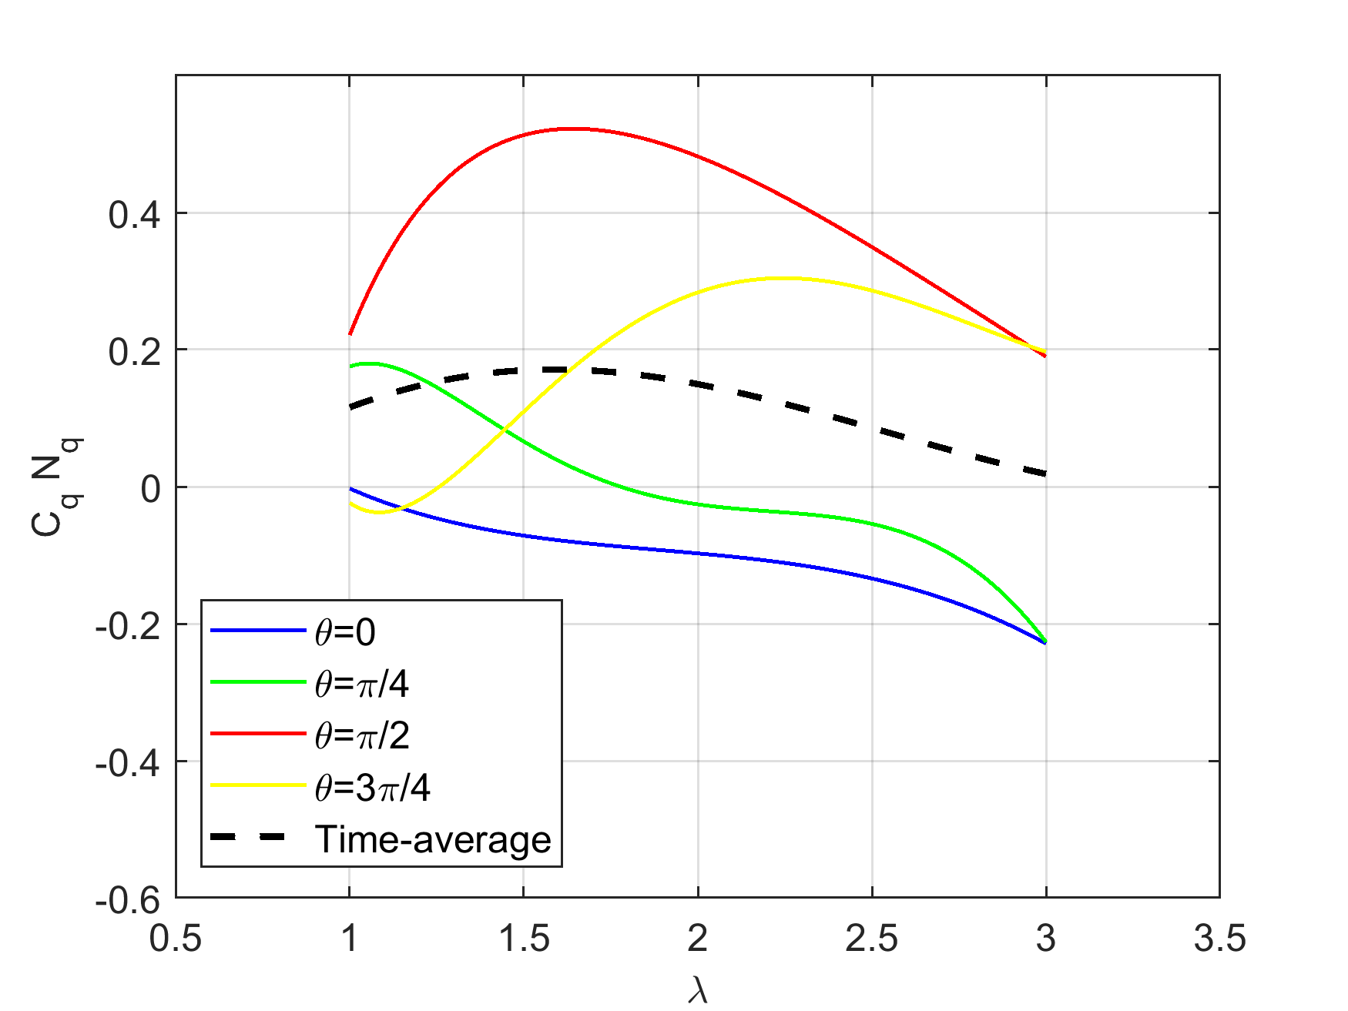
Phase-Resolved Description
Torque coefficient C_{q} is treated as a function of λ and turbine azimuthal position θ
where

Slide 12
Agenda
Background
Performance Characterization
Controller Development
Extending to Field Scale
Conclusions
Notes:
Objective: to develop a performance curve for this turbine. A reliable performance curve allows for controls strategies to be accurately simulated and performance generalized to other flow conditions.

Slide 13
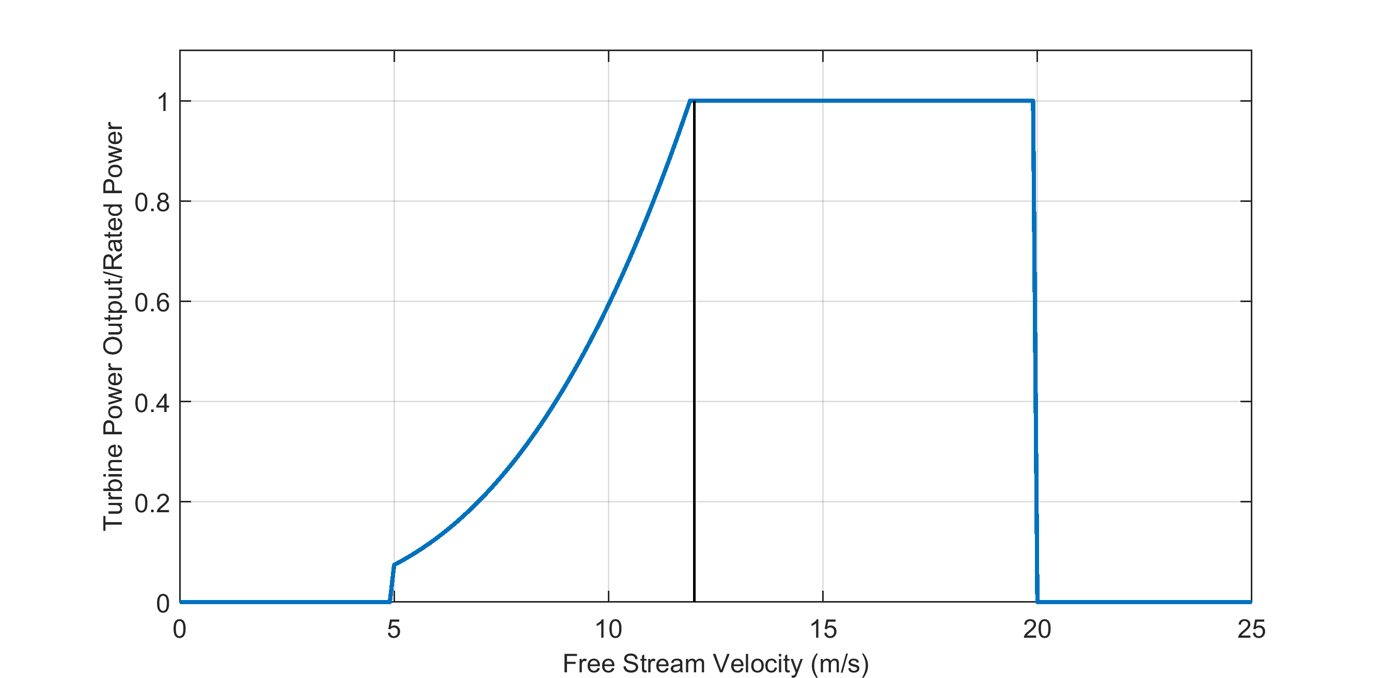
General Control Objectives
Cut-in Speed
Rated Speed
Cut-out Speed
Region 1
Region 2
Region 3
Region 4
But no pitch control!

Slide 14
General Control Objectives
To maximize power capture, a controller should maintain the peak of the performance curve λ* in turbulent inflow

Slide 15
Objectives
Develop a simple, effective Region 2 and Region 3 control law broadly applicable to cross-flow turbines at current technology levels
Transition stably, smoothly, and automatically between objectives
Mitigate intracycle variations when tracking power
Using minimal sensors
Without inflow measurement
Without a phase-resolved turbine model
Without “motoring” the turbine (i.e., τ_{c}>0)
Be device-agnostic

Slide 16
Approach
Non-linear maximum power-point control to obtain Region 2 objectives
Non-linear “model inverse” over-speed control for Region 3 objectives
Mechanical power available at power-take-off
D. Forbush, R. Cavagnaro, B. Polagye, “Multi-mode evaluation of power-maximizing cross-flow turbine controllers,” Int. J. Marine Energy, vol. 20, pp. 80-96, 2017.
D. Forbush, R. Cavagnaro, B. Polagye, “Power tracking control of cross-flow turbines,” In review with the Journal of Renewable and Sustainable Energy.

Slide 17
Approach-Transition
Transition to maintain controller (time-average) stability in unsteady inflow
effective low-speed stability limit of Kω² control
low-speed stability limit of P/ω control,
equilibrium point of Kω² control

Slide 18
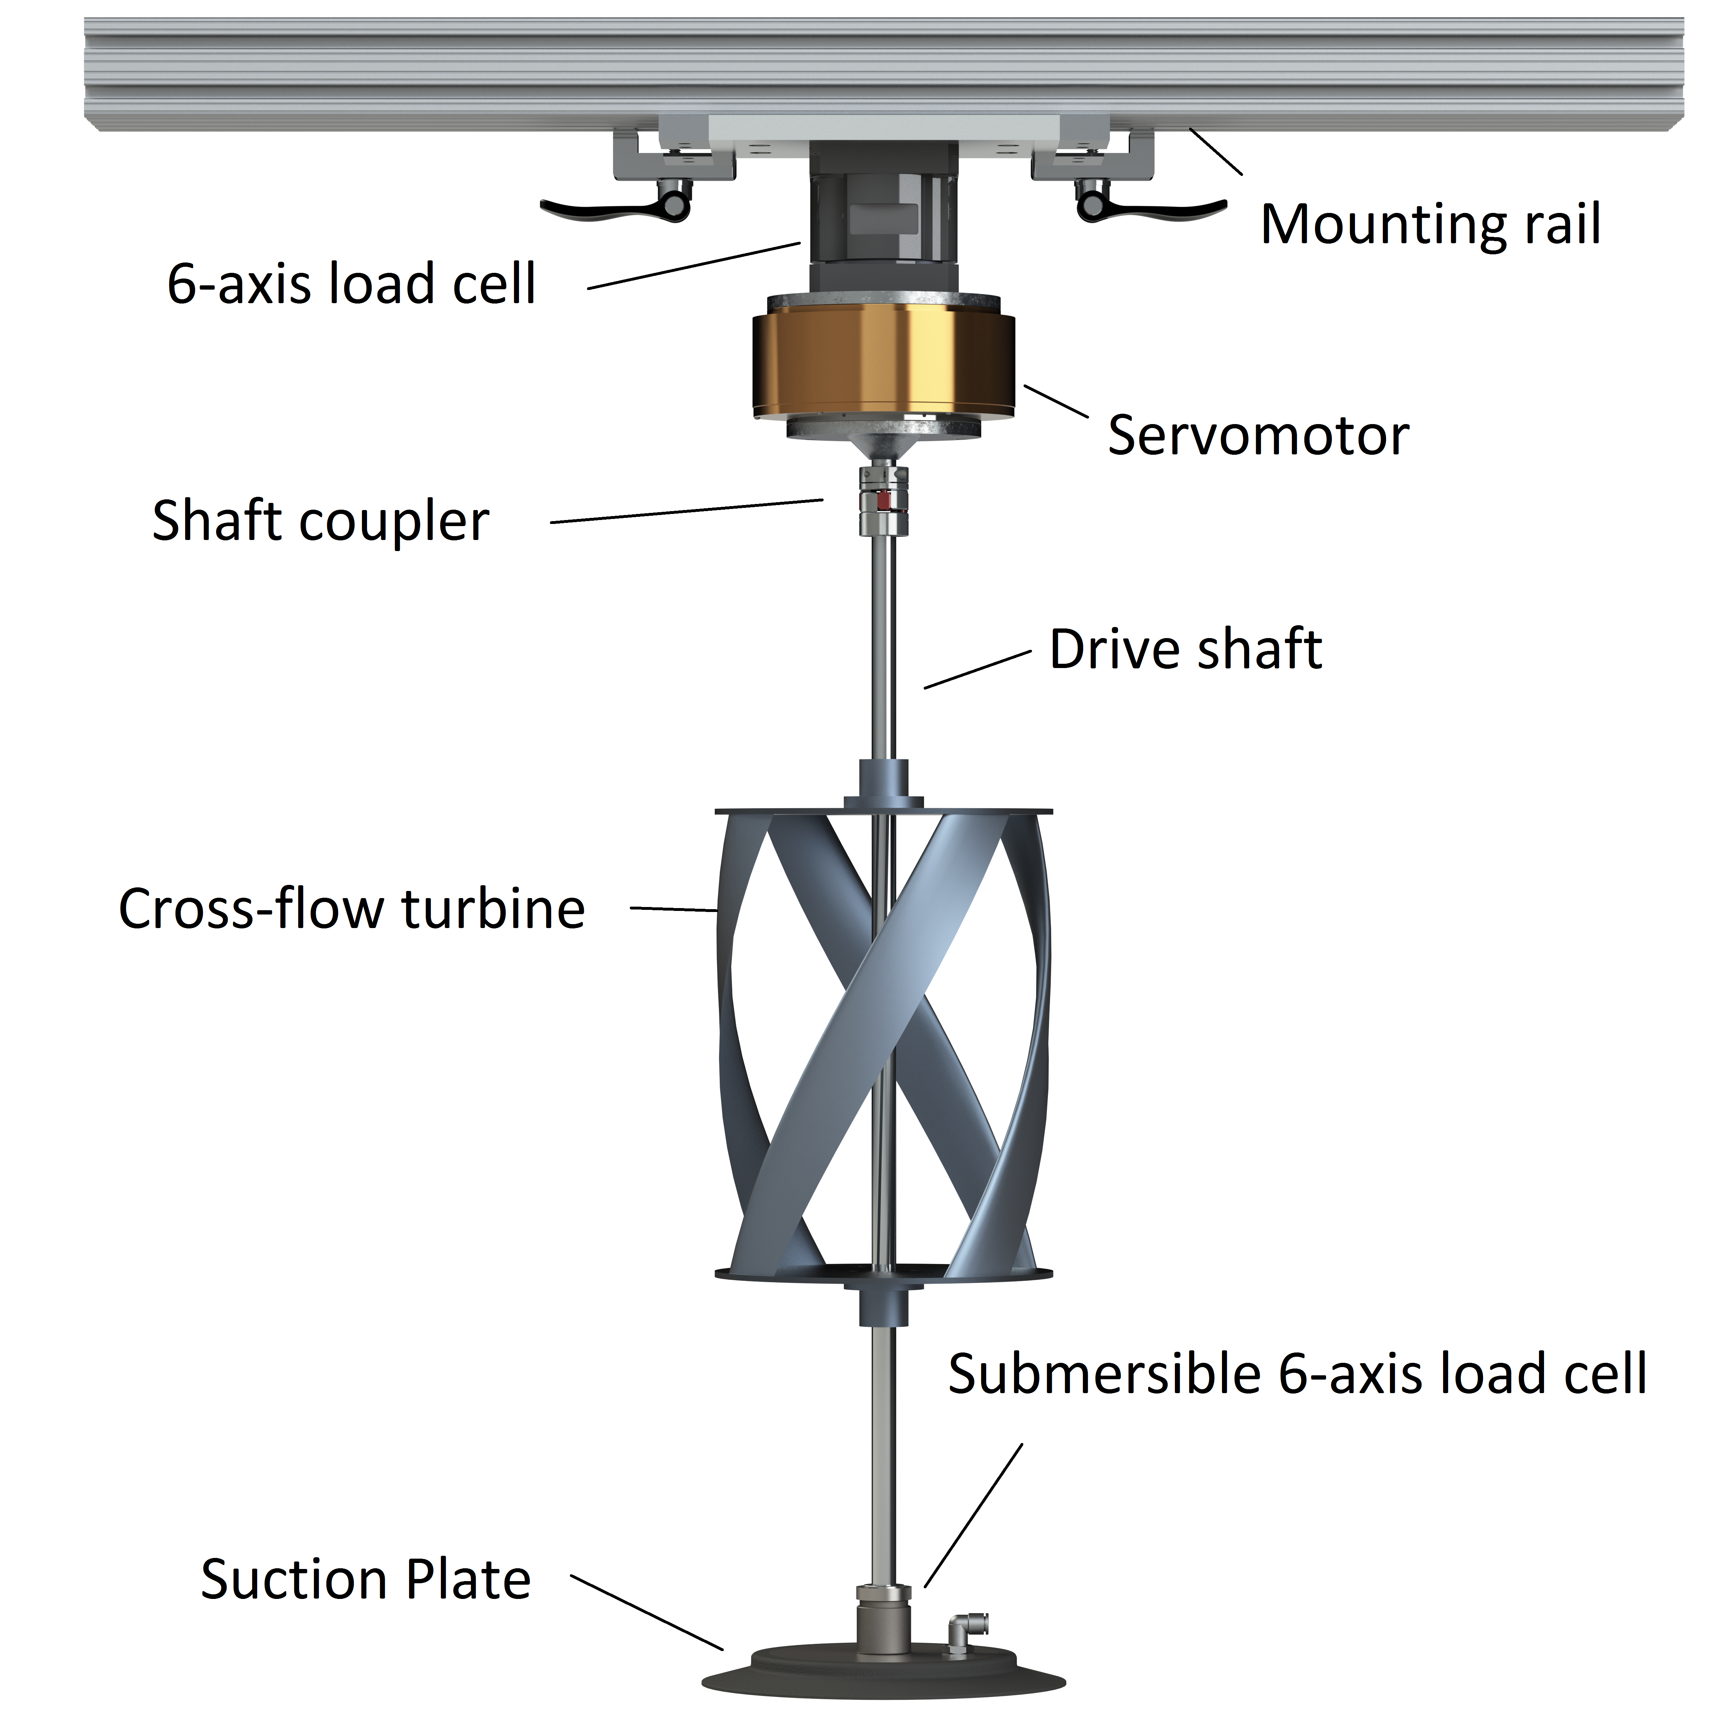
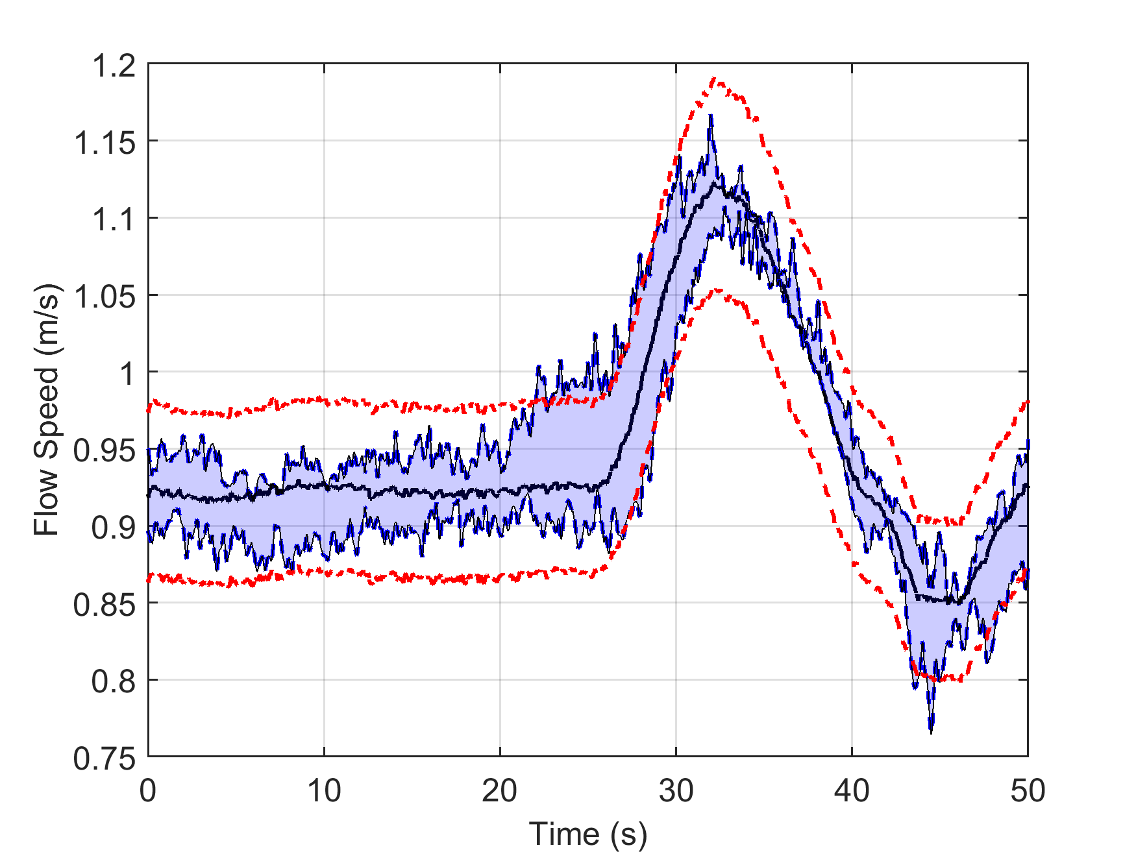
Approach-Transition
Transition to maintain controller (time-average) stability in unsteady inflow
Evaluate two cross-flow turbines with distinctive dynamics

Slide 19
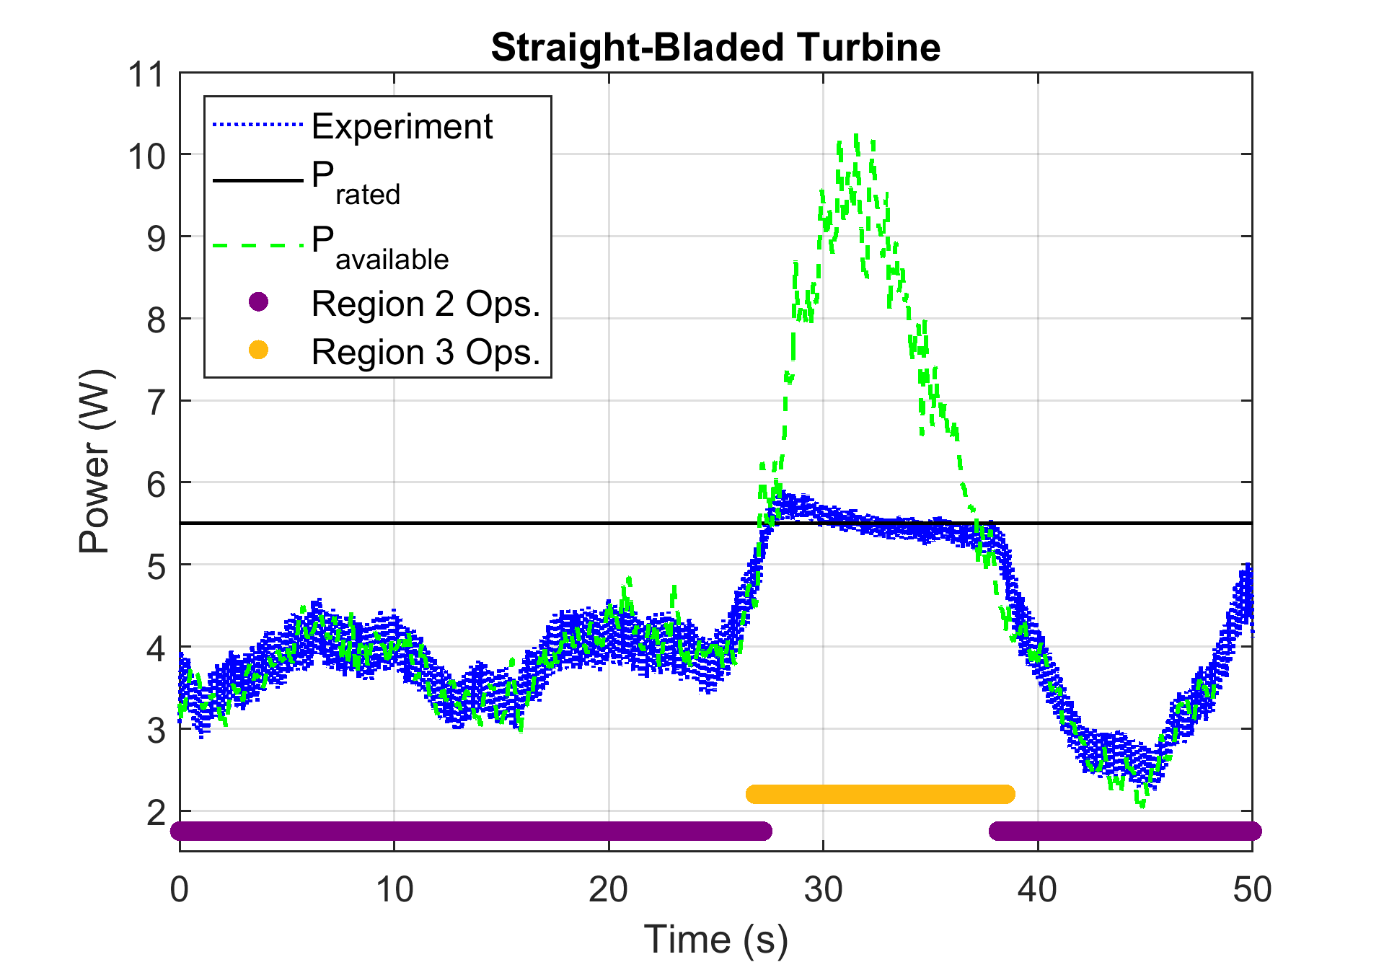
Results- Region 2 and 3
Set Point (W) | Mean Abs. Percentage Error
2.5 | 1.9 %
3.5 | 2.1 %
4.5 | 2.5 %
5.5 | 2.6 %
6.5 | 1.6 %
7.5 | 1.8 %

Slide 20
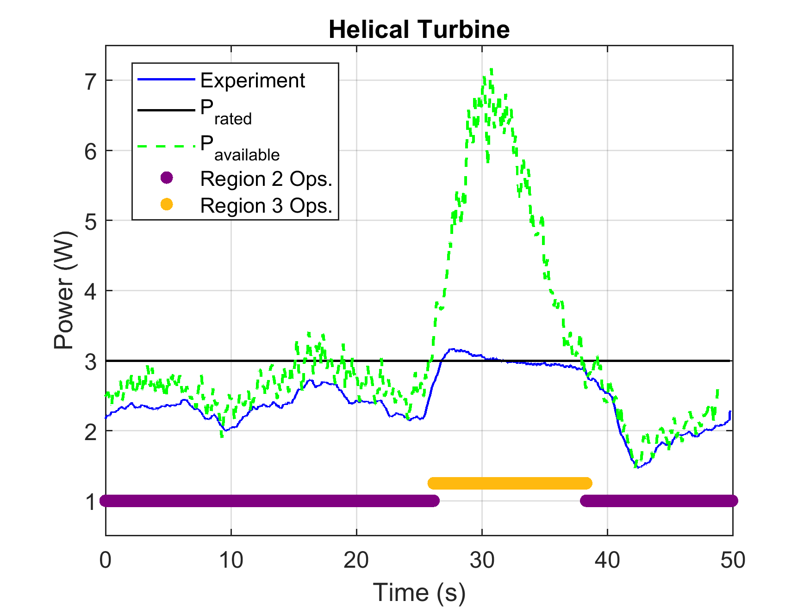
Results- Region 2 and 3
Set Point (W) | Mean Abs. Percentage Error
1.0 | 1.5 %
2.0 | 1.4 %
3.0 | 2.2 %
4.0 | 1.6 %
5.0 | 0.7 %

Slide 21
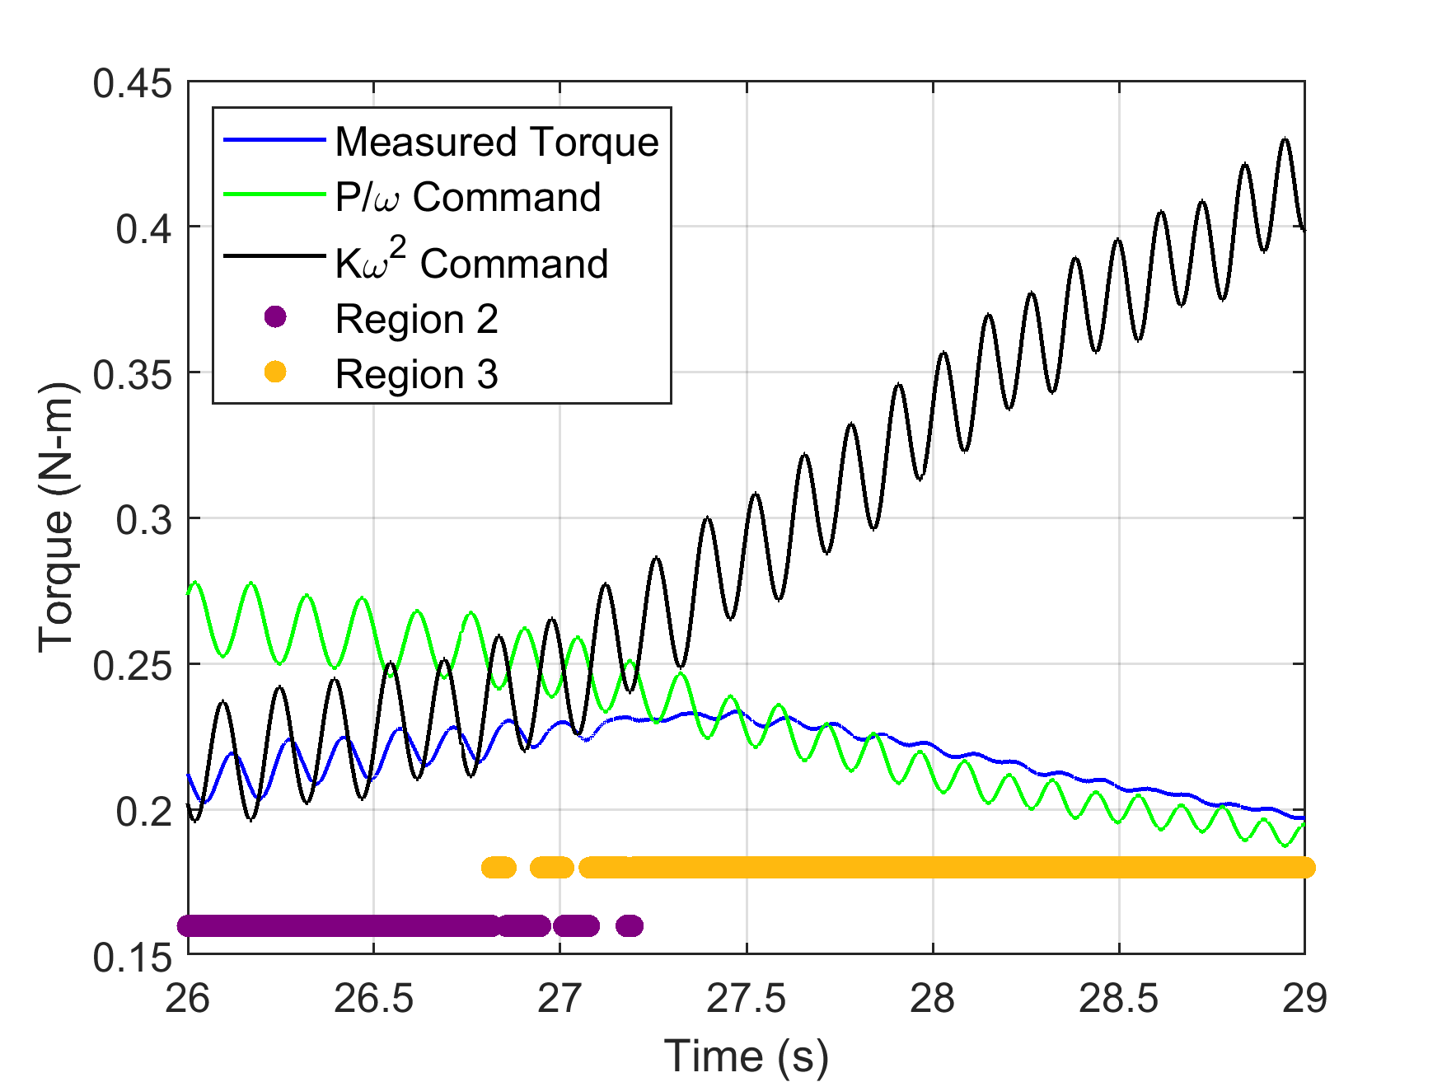
Results- Transition Behavior, Torque

Slide 22
Results- Region 2 and 3
Unmitigated intracycle variations
Steady-state error during high inflow accelerations

Slide 23
Results- Region 2 and 3
Steady-state error during high inflow accelerations

Slide 24
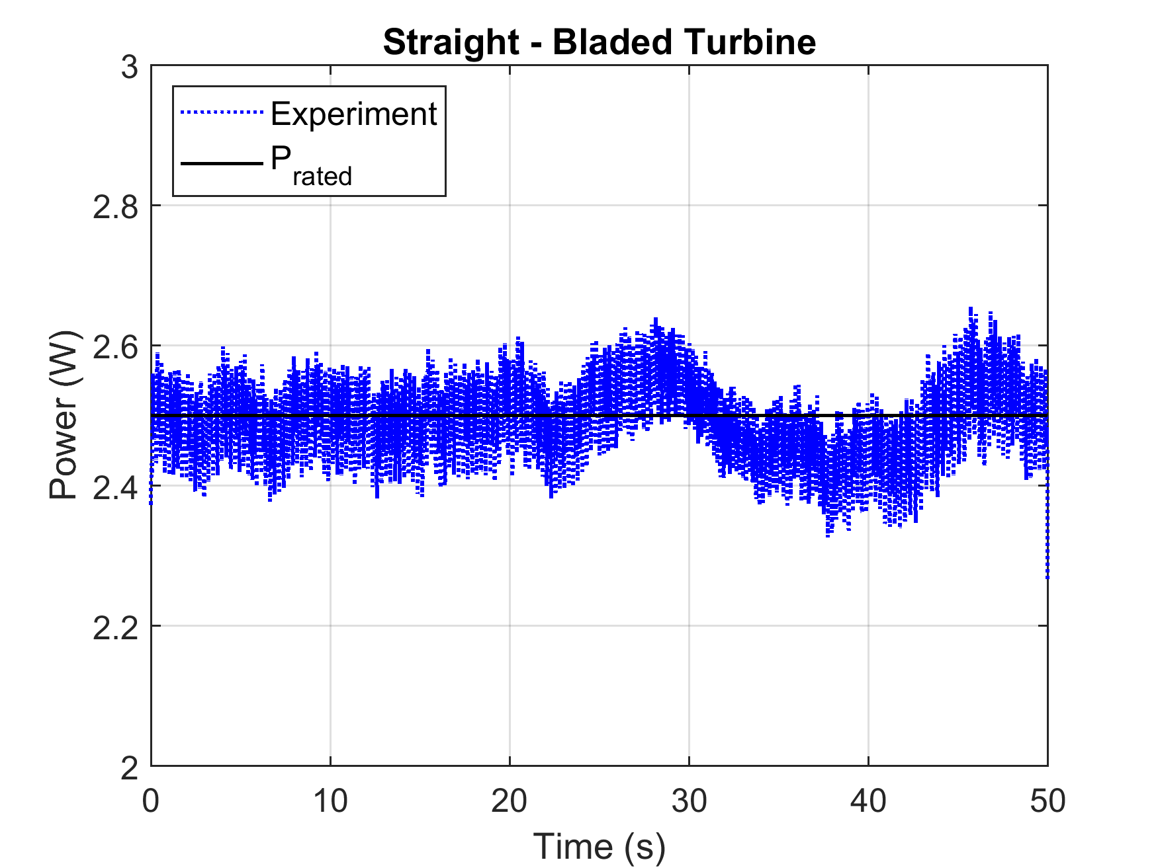
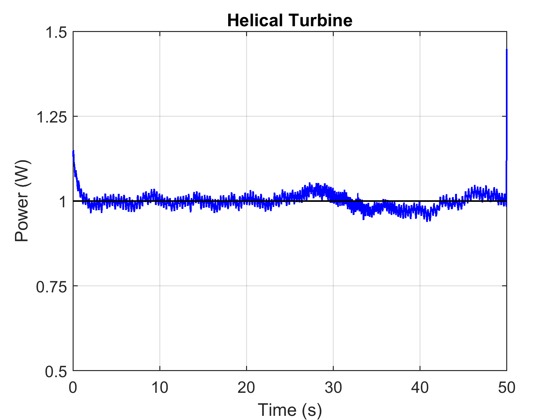
Results- Region 3 Only
Unmitigated intracycle variations
Steady-state error during high inflow accelerations

Slide 25
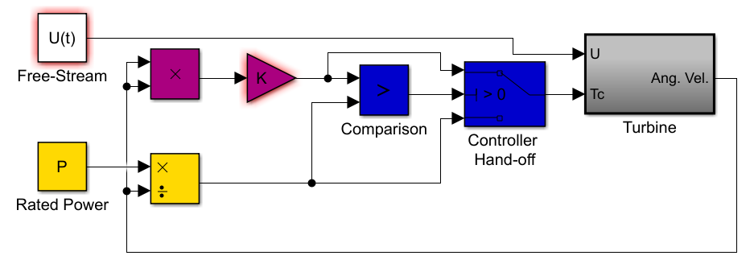
Results- Ideal Implementation
Simple simulation integrates dynamic equation for phase-resolved turbine model for input time series U.

Slide 26
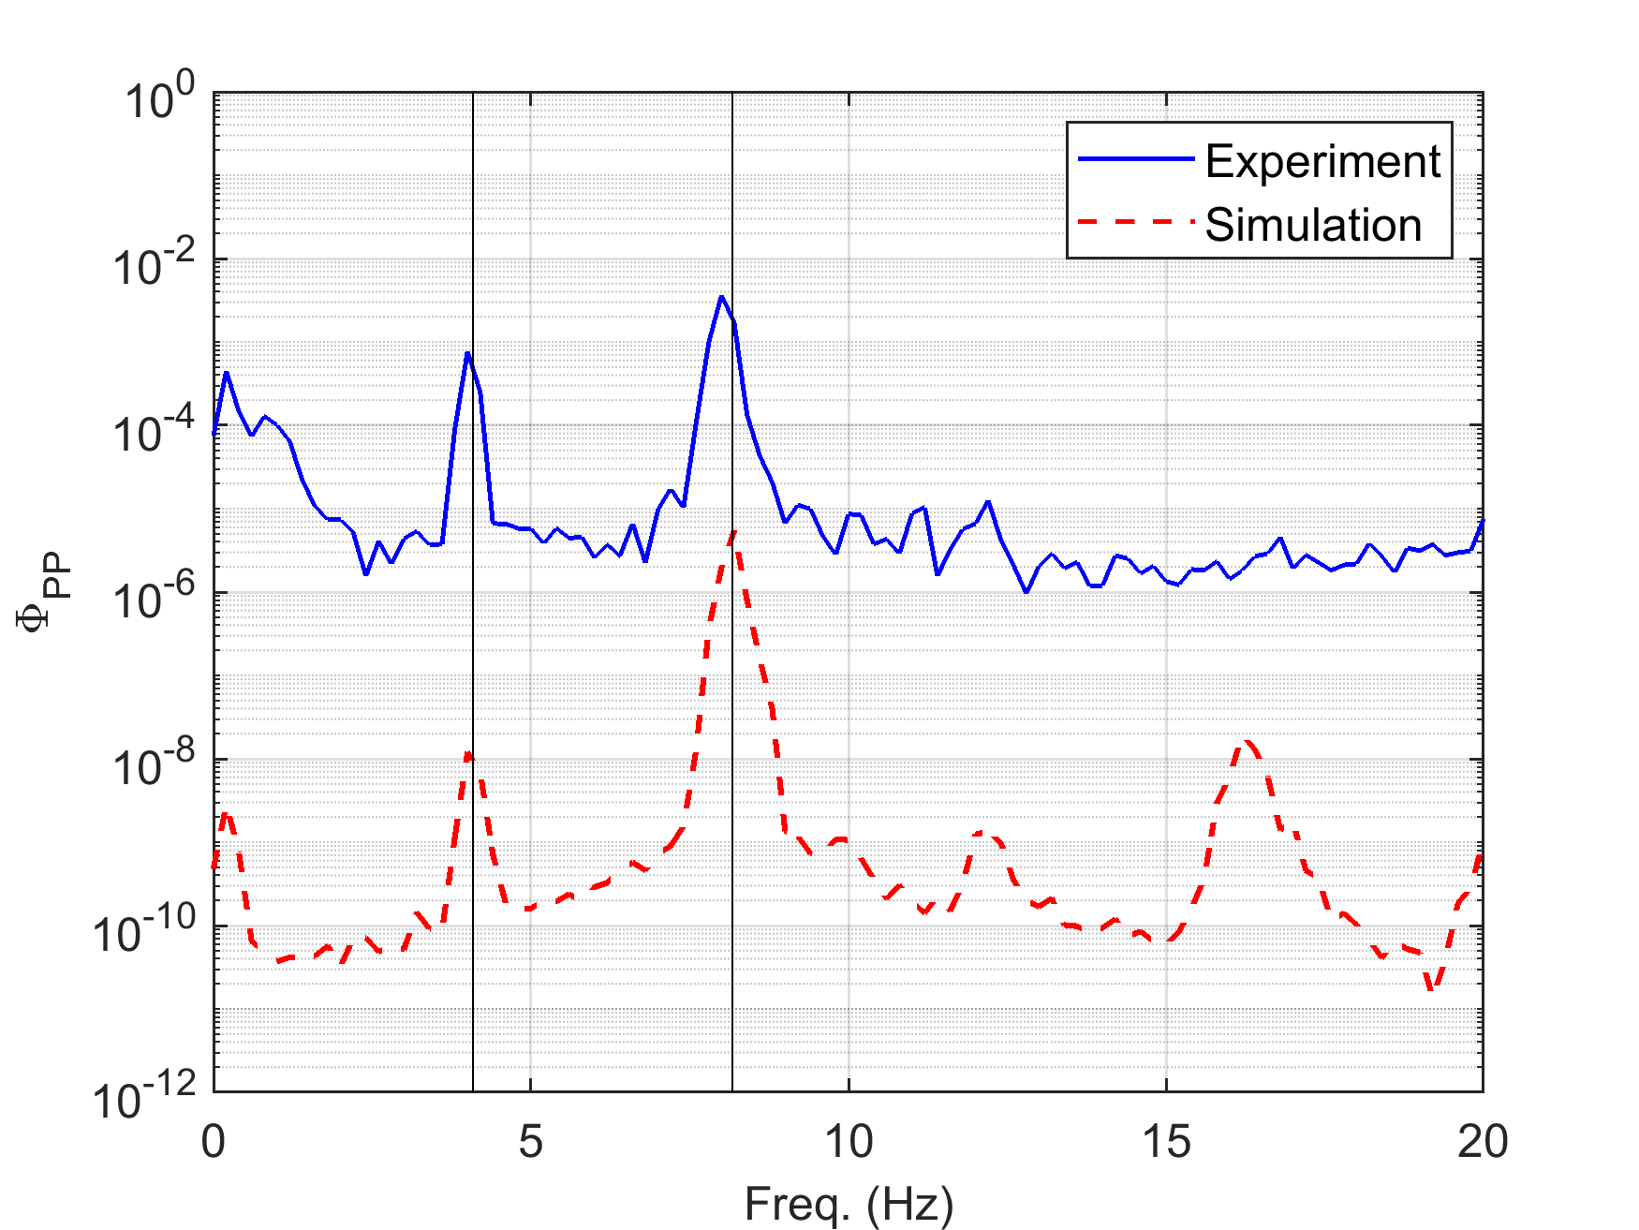
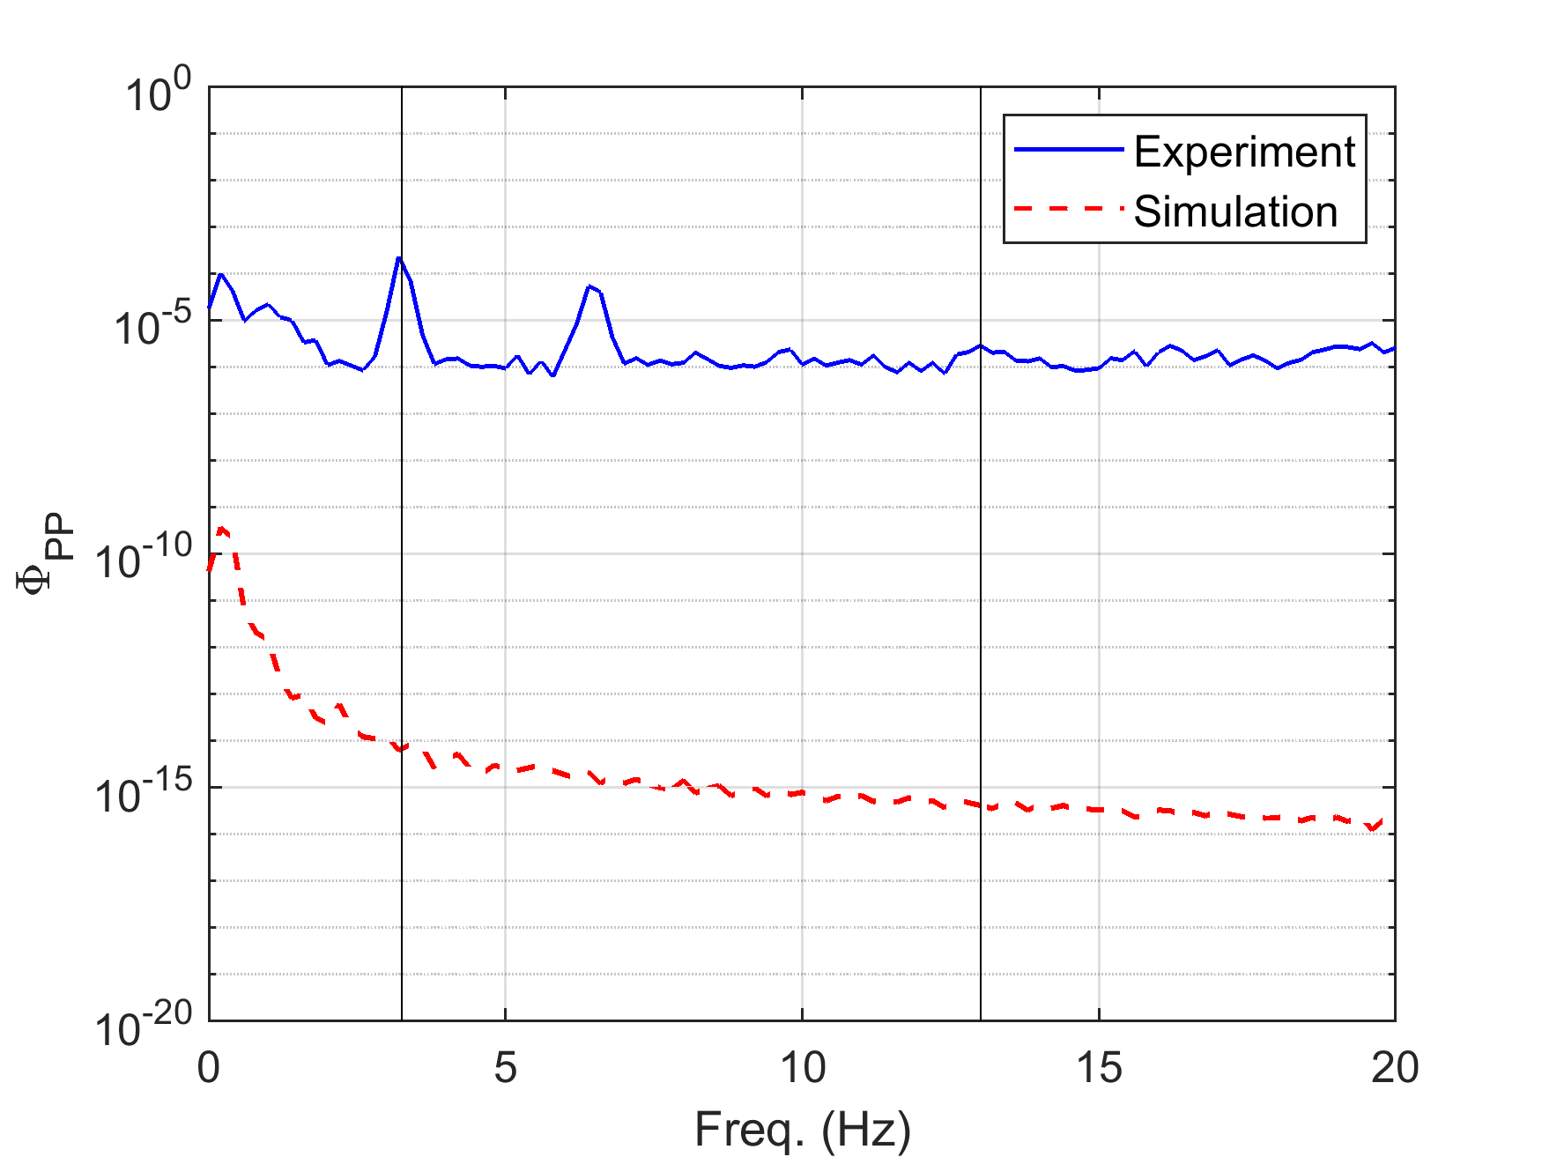
Results- Ideal Implementation
Straight-Bladed Turbine
Helical Turbine
Steady-state error significantly reduced in ideal implementation
Intracycle variations mitigated entirely
Intracycle variations remain
Purely resistive control torque cannot eliminate intracycle variations for all turbines. This limitation scales favorably with turbine radius and U velocity.

Slide 27
Results- Revisit Objectives
Develop a simple, effective Region 2 and Region 3 control law broadly applicable to cross-flow turbines at current technology levels
Transition stably, smoothly, and automatically between objectives
Mitigate intracycle variations when tracking power
Using minimal sensors
Without inflow measurement
Without a phase-resolved turbine model
Without “motoring” the turbine (i.e., τ_{c}>0)
Be device-agnostic

Slide 28
Agenda
Background
Performance Characterization
Controller Development
Extending to Field Scale
Conclusions
Notes:
Objective: to develop a performance curve for this turbine. A reliable performance curve allows for controls strategies to be accurately simulated and performance generalized to other flow conditions.

Slide 29
Extending to Field Scale
Simulation can be validated against laboratory-scale experiment, and then large devices can be simulated
→ under what circumstances will simulation and laboratory-scale experiment predict field scale performance?

Slide 30
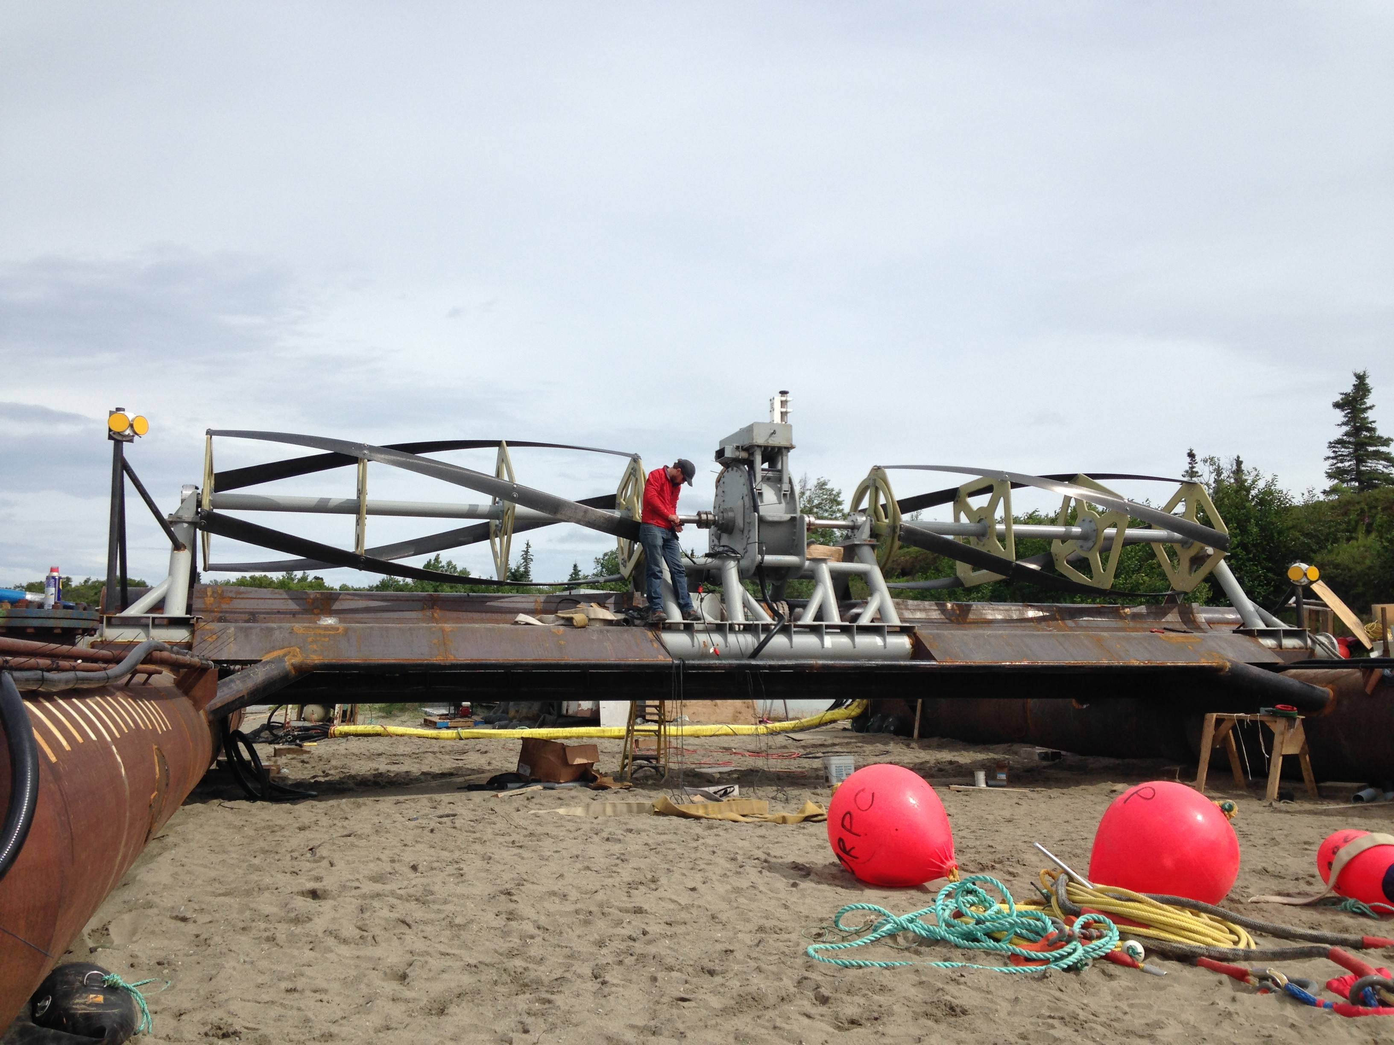
Extending- Effects of Turbulence

Slide 31
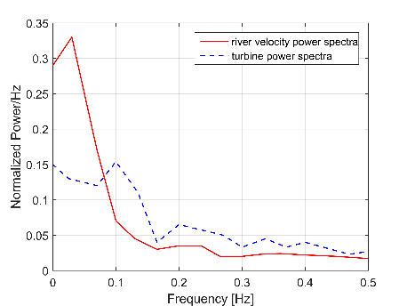
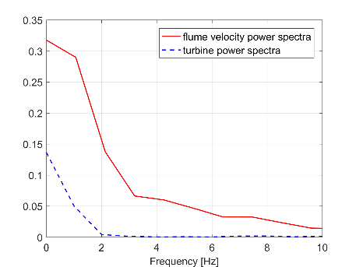
Extending- Effects of Turbulence
Mean flow velocity
Length scale of turbulent structure
Turbulence frequency content
RivGen rotor length = 11 m
Flume turbine rotor length = 0.24 m
U= 2 m/s, f=0.2 Hz → L=10 m
U= 1 m/s, f=2 Hz → L=0.5 m
→ Turbines act as low-pass filters of incoming turbulence, reacting to only a subset of the incoming structures approximating rotor length scale by Taylor’s Hypothesis

Slide 32
Extending- Effects of Turbulence
Turbines act as low-pass filters of incoming turbulence, reacting to only a subset of the incoming structures approximating rotor length scale by Taylor’s Hypothesis
Turbines are sensitive to “engulfing gusts”

Slide 33
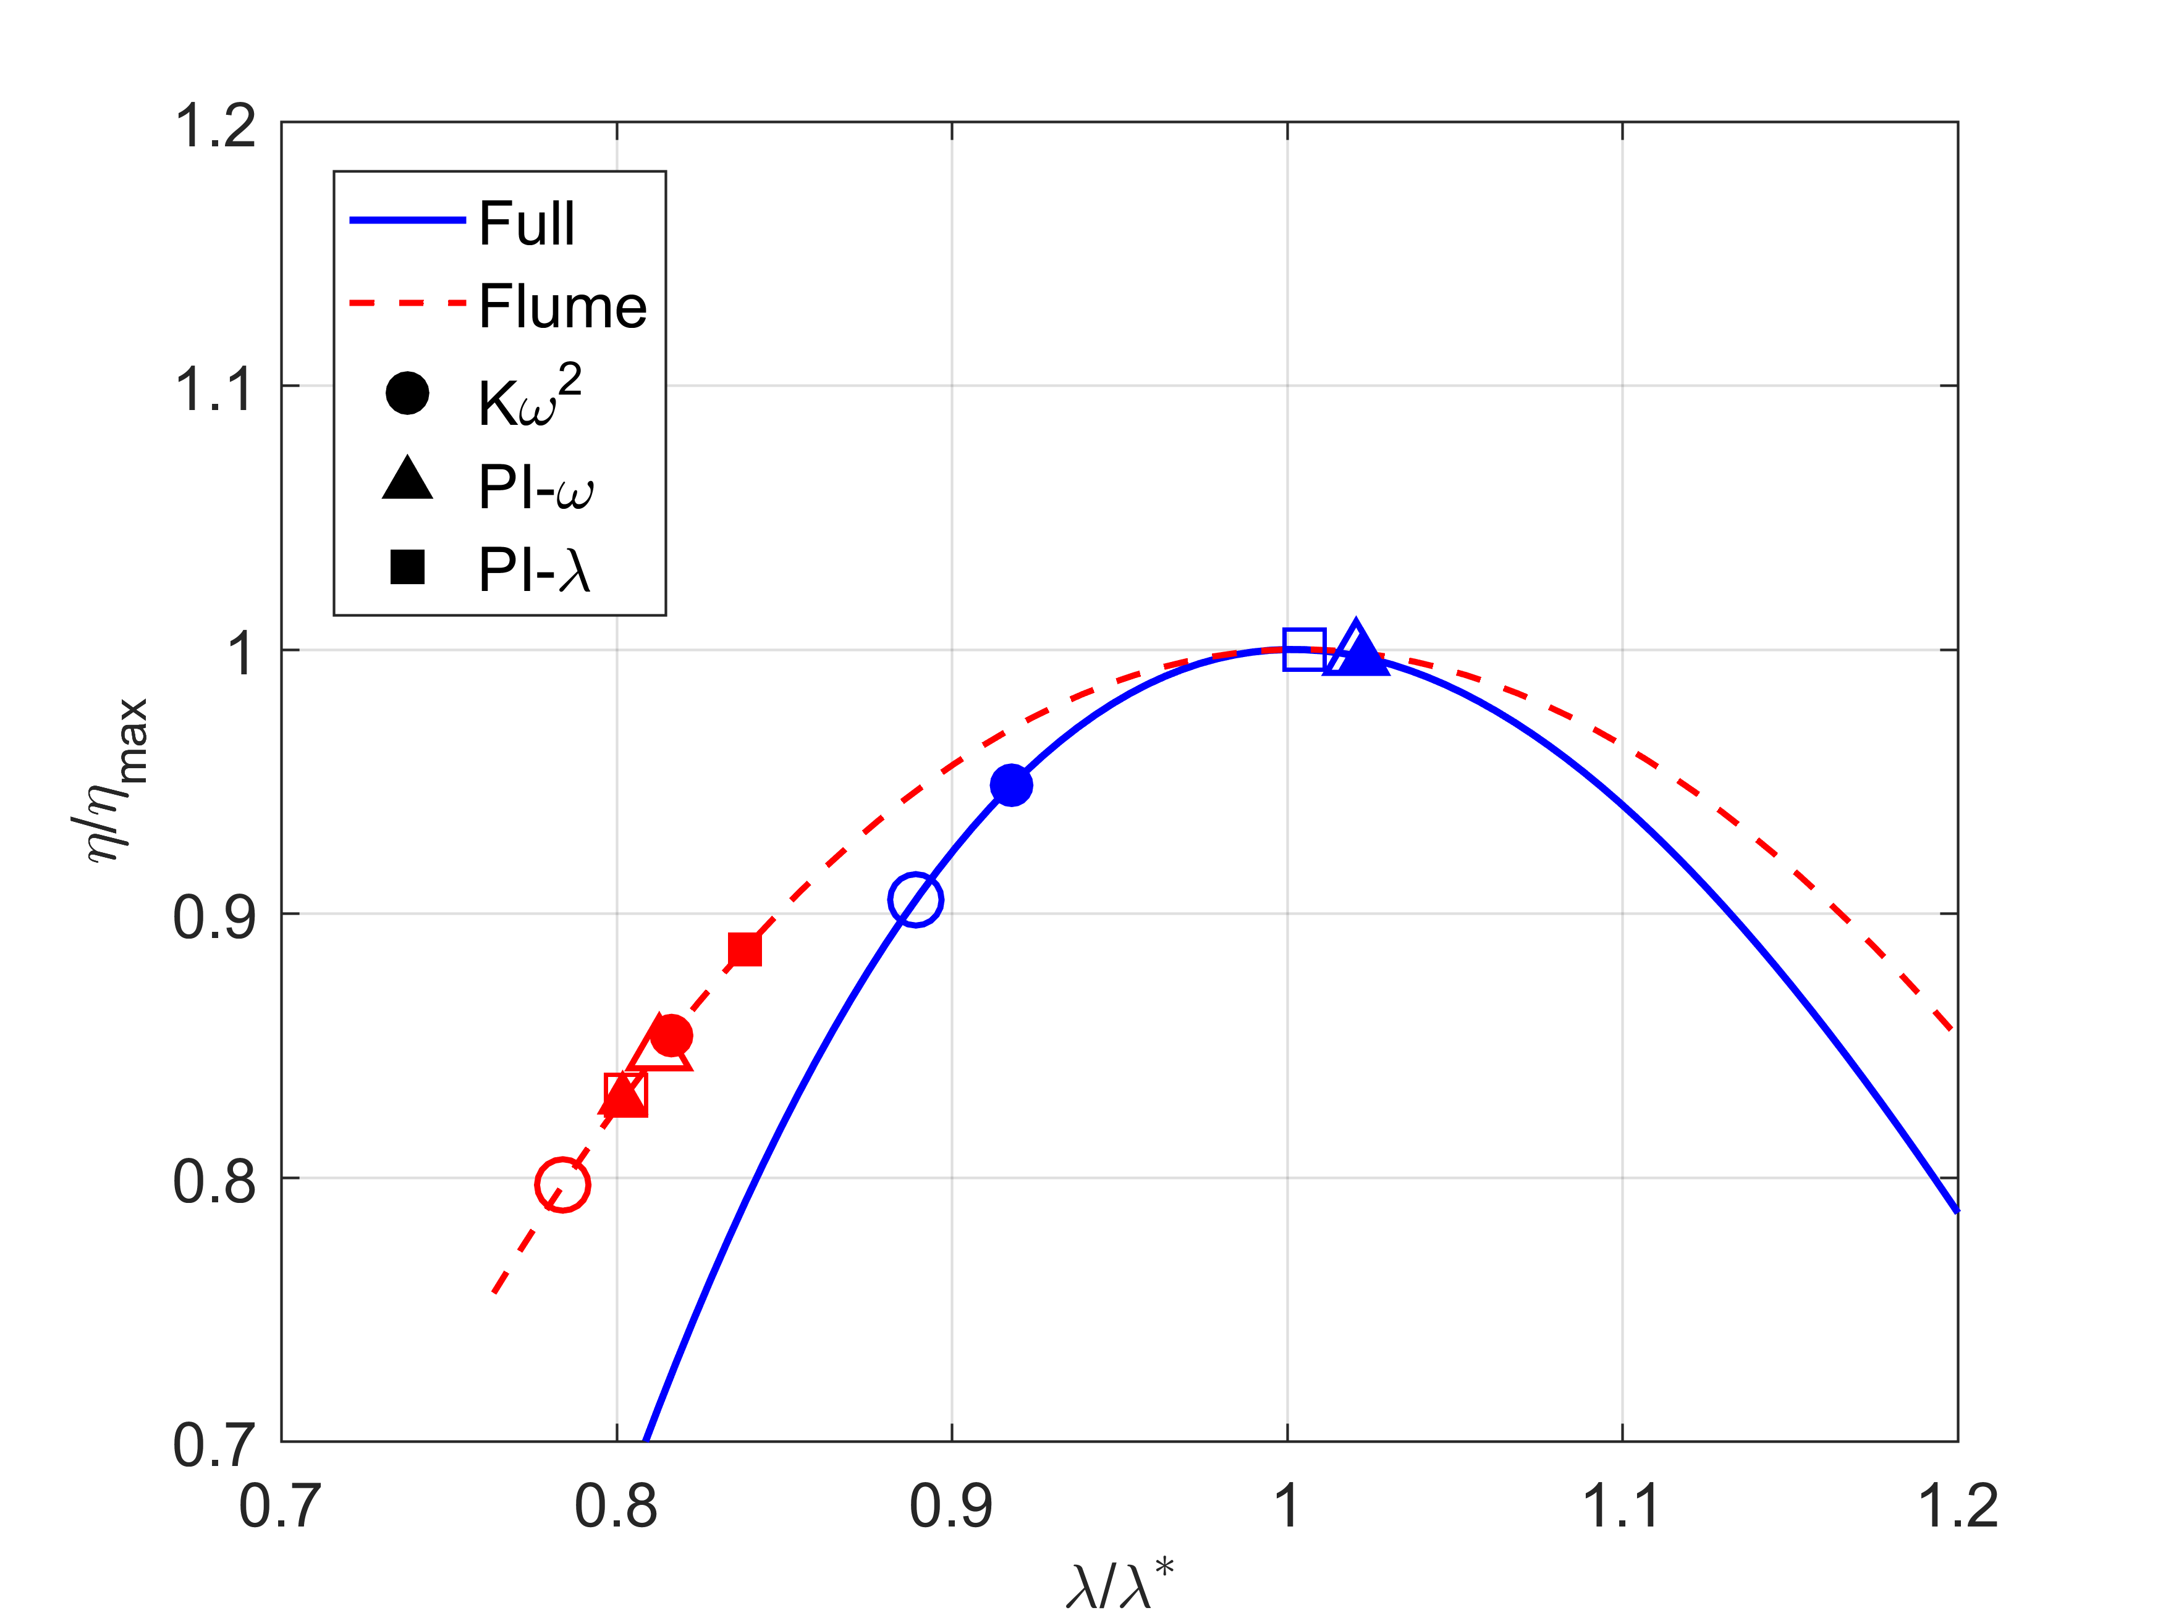
Extending- Operating Limits
Onset of non-minimum phase behavior (constant torque control stability limit)

Slide 34
Extending- Conclusions
Simulation can reasonably predict turbine controller performance provided that:
Turbulence is filtered to “engulfing” length scales.
Controller update rate is sufficiently fast, appropriate for in situ turbulence and intracycle variations
Implementation-specific dynamics are well-approximated by the simulation
- Simulation is unable to replicate high-frequency load oscillations (without phase-resolved modeling) or non-deterministic behavior near stall

Slide 35
Agenda
Background
Performance Characterization
Controller Development
Extending to Field Scale
Conclusions
Notes:
Objective: to develop a performance curve for this turbine. A reliable performance curve allows for controls strategies to be accurately simulated and performance generalized to other flow conditions.

Slide 36
Conclusions
Simple open-loop non-linear control laws can effectively meet Region 2 and 3 control objectives through a limited implementation
Controller performance can be anticipated by low-order simulation and extrapolated between device scales under particular circumstances

Slide 37
Opportunities for Future Study
Simple open-loop non-linear control laws can effectively meet Region 2 and 3 control objectives through a limited implementation.
Control objectives are met non-optimally and limited by real-system latency
Persistent periodic excitation suggests a model-predictive state estimator may improve Region 3 performance
Limitations adopted in this study may be overly restrictive for real implementations

Slide 38
Opportunities for Future Study
Controller performance can be anticipated by low-order simulation and extrapolated between device scales under particular circumstances
Assumption of isotropic, engulfing length scales is a fair estimate, but built on faulty assumptions
Cross-flow device response to anisotropic turbulence would be useful for siting

Slide 39
Acknowledgments
Work funded by Department of Energy under DE-EE0006397 and US Department of Defense Naval Facilities Engineering Command. Support and collaboration with Ocean Renewable Power Company, the Marine Renewable Energy Lab, and the Pacific Marine Energy Center is gratefully acknowledged.

