Slide 1
Design and Implementation of a Power Smoothing System for Cross-flow Current Turbines
Hannah Aaronson
Department of Mechanical Engineering
June 5th, 2019
Committee:
Dr. Brian Polagye, Department of Mechanical Engineering
Dr. Brian Johnson, Department of Electrical and Computer Engineering
Dr. Brian Fabien, Department of Mechanical Engineering
Dr. Brian Robert Cavagnaro, Pacific Northwest National Laboratory

Slide 2
Motivation
Cross-Flow Current Turbine
U∞
Free Stream Flow
Rendering courtesy of Hannah Ross
Notes:
Focus of presentation: fluctuating output power from cross flow current turbines
These are vertical axis turbines generating power from the flow of water in tidal channels, rivers, or ocean boundary currents
Research focuses on how to optimize the mechanical efficiency of a cross-flow turbine, or the amount of power it extracts from the flow
Typically done through small scale experiments
Typically focuses on optimizing turbine geometry and control strategy
One of the more efficient designs is a two, straight bladed turbine

Slide 3
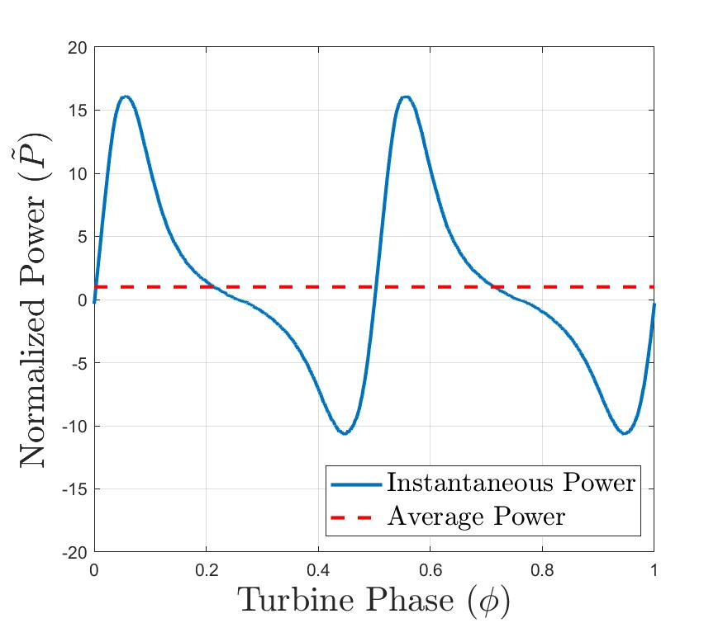
Motivation
Cross-Flow Current Turbine
Rendering courtesy of Hannah Ross
Efficient turbine designs output highly fluctuating instantaneous power
Problematic for integration with electric grids or direct use
Notes:
The major disadvantage to this design is that it causes the turbine to produce highly fluctuating instantaneous power within a single turbine rotation
This comes from the changing angle of attack on the turbine blades as it rotates
This instantaneous power can be characterized by very large peak power (15x larger than the average) and intermittent power draw, meaning that for part of the rotation the turbine is being motored
Fluctuating power is problematic for electrical integration: for a large-scale grid, such power would be expensive and inefficient to transport, would not adhere to grid standards or regulations. Utility companies would not be interested in purchasing this power
This would be an even larger problem for micro grids, or remote communities that are isolated from utility scale infrastructure.
In these communities, marine energy is typically more economically viable because they have a much higher cost of energy to begin with, so we’re more likely to start deploying this technology in these regions.
However, micro grids are much smaller and therefore more susceptible to stability and reliability issues cause by fluctuating power resources.
Conclusion- Great, we’re doing all these things to optimize total power from the turbine, but in doing so, we’ve created power that by itself, is pretty useless
Imagine if you were trying to turn on a light bulb or charge a battery with this power

Slide 4
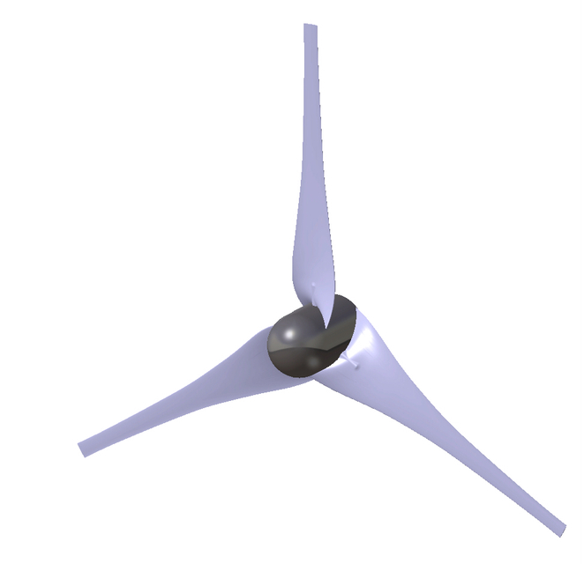
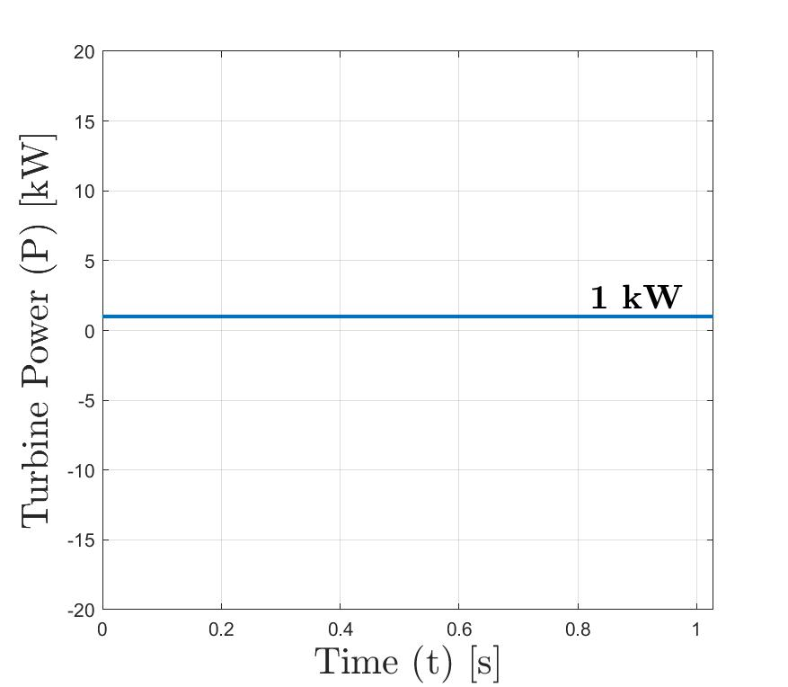
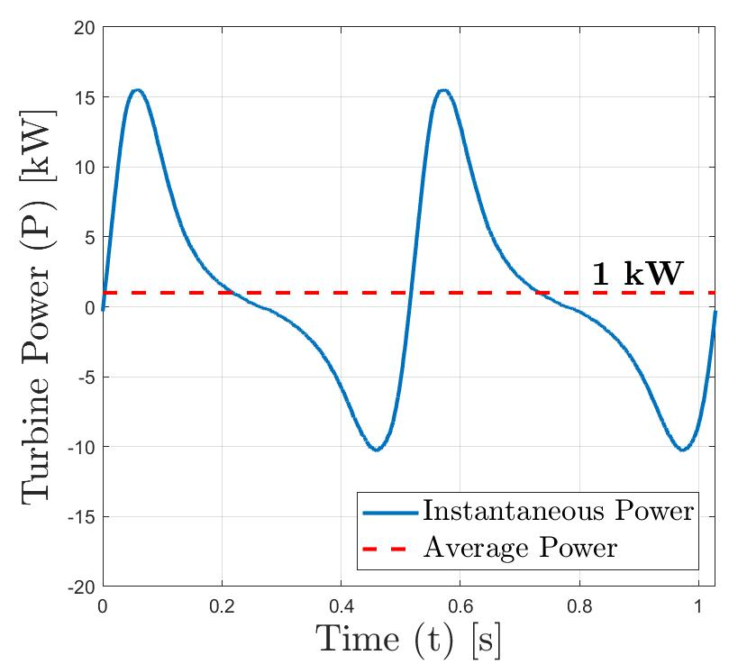
Objective
?
System
Design a system to take this highly fluctuating power and smooth it to a constant level
Power Smoothing System (PSS)
Notes:
The purpose of this project is to take this highly fluctuating power, and design a system that will smooth it to a constant level
The system will output power that could easily be electrically integrated with a power grid or used to power another device
Referred to power smoothing system (or PSS)
Short term power fluctuation is a known issue for other types of renewable energy, so this kind of system is nothing new
But what I’m showing here is a really aggressive and extreme example of short term power fluctuation specific to the very complex hydrodynamics associated with cross flow turbines, as compared to axial flow wind turbines, which produce pretty constant output power in time

Slide 5
System Environment
Turbine Control
Mechanical to electrical conversion
R. J. Cavagnaro, B. Strom, B. Polagye, and A. Stewart, “Power collection from multiple hydrokinetic generators utilizing advanced control,” In 12th European Wave and Tidal Energy Conference, Cork, IR, 2017.
Notes:
This system is first developed in simulation, using this power collection scheme developed by Rob
This models the mechanical power of the turbine all the way to the grid
This overall topology is pretty common and used for a lot of generator-based renewable devices including the wind industry, but it was developed to look specifically at this application and how mechanical power from a current turbine would translate to electrical power delivered to the grid
This simulation includes:
A generator, which modes the mechanical to electrical conversion of power, based on a time series of expected turbine speed and hydrodynamic torque, which come from turbine experiments
The motor drive, which uses a controller to regulate the amount of current in the three phase generator stator windings, which in this case is used to control turbine speed

Slide 6
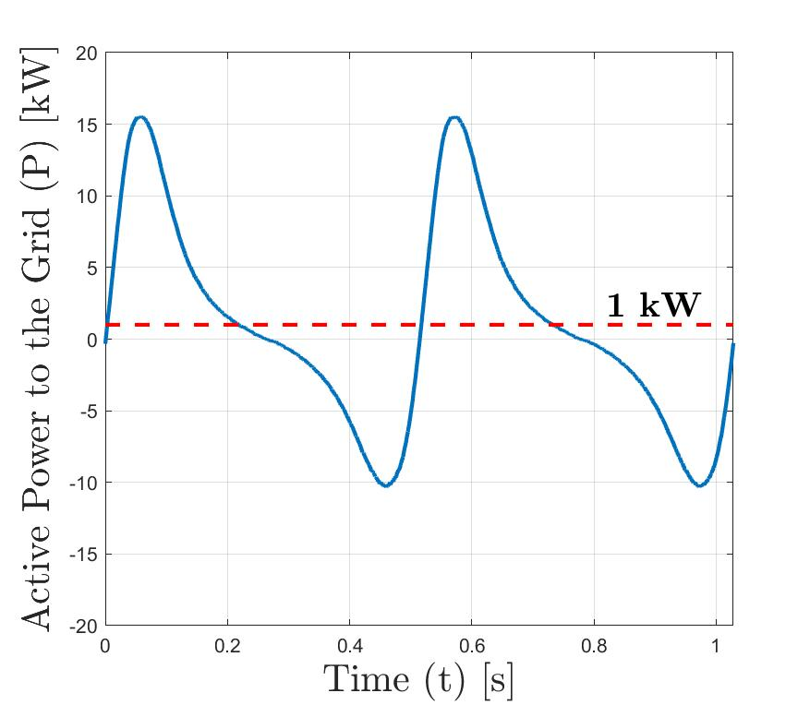
System Environment
Coupling between Generator and Grid
DC Bus Voltage Control
Step-up voltage
R. J. Cavagnaro, B. Strom, B. Polagye, and A. Stewart, “Power collection from multiple hydrokinetic generators utilizing advanced control,” In 12th European Wave and Tidal Energy Conference, Cork, IR, 2017.
Notes:
The DC bus, which acts as a coupling between the three phase current and voltage of the generator and that of the grid, which is necessary because these two environments operate at difference frequencies
The inverter, which uses a controller to hold the DC bus at a constant voltage. This also regulates the output current and voltage such that it’s operating at grid frequency
The transformer, which steps up voltage/steps down current so the electricity can be transmitted across long distances.
This system allows us to measure the electrical power integrated with the grid, which in this raw form is going to be highly fluctuating

Slide 7
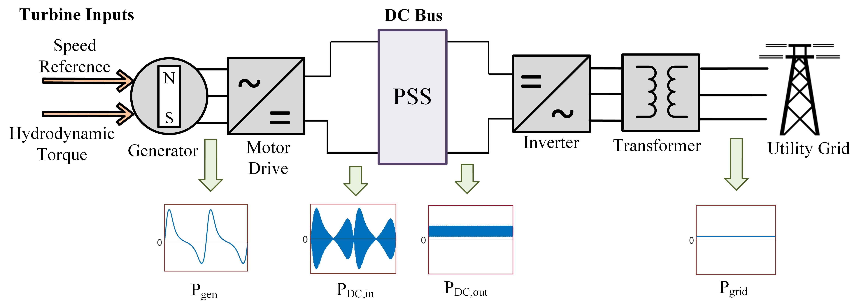
System Environment
Notes:
The DC bus is the easiest place to integrate a power smoothing system
Overview of system:
The power on the generator side is again highly fluctuating
It travels through this AC to DC rectifier, and comes out on the DC bus as having both this low frequency oscillation as well as this high frequency noise. This comes from these high frequency switches inside the motor drive which regulate generator current
The PSS is going to take this input power and remove low-frequency oscillations. The output of this system may still include high frequency noise
This noise will get filtered out as it travels through the inverter and transforming, yielding constant, smooth power to be integrated with the grid

Slide 8
Overview
Develop a small-scale PSS in simulation
Maximize reduction in oscillating power
Minimize power losses, size, and cost
2. Validate simulation using experimental bench-top system
3. Use linearized model to quickly scale-up system
4. Analyze performance and cost of full-scale system
Notes:
This system is going to be developed first in simulation, for a small-scale tidal turbine. The design objectives are to create a system which maximizes the reduction in oscillating power. We want to do this sufficiently while minimizing the power loss, size, and cost of the system itself.
After creating the initial design in simulation, I want to validate these simulation results experimentally and show that the system can be practically implemented.
Then, I can quickly scale-up the system using a linearized model
Then, implement a large-scale version of the system in simulation and analyze the performance

Slide 9
Overview
Develop a small-scale PSS in simulation
Maximize reduction in oscillating power
Minimize power losses, size, and cost
2. Validate simulation using experimental bench-top system
3. Use linearized model to quickly scale-up system
4. Analyze performance and cost of full-scale system
Notes:
Start by looking at how the system was designed in simulation

Slide 10
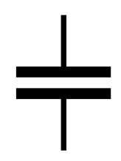
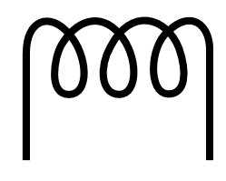
Power Smoothing System (PSS) Design
Part I: LC Low-Pass Filter
Remove high frequency oscillation
Part II: Bi-directional DC-DC converter
Remove low frequency oscillation
Capacitor (C)
Inductor (L)
Notes:
The PSS is a two part system that would be integrated onto the DC bus.
Part I is essentially just a low pass LC filter, which takes really high-frequency fluctuating current on the DC bus outputs this low amplitude, low frequency current.
Part II is a bi-directional DC-DC converter, which uses a controller to remove the residual power oscillations and output power that is constant with time
This system uses inductors and capacitors as short term energy storage components.
Capacitors store energy in an electric field, while inductors are coils of wire that store energy in a magnetic field

Slide 11
PSS Part I
Cutoff
Frequency
Low-Pass Filter Cut-off frequency (f_{c}):
Magnitude (dB)
$$f_{c}=\frac{1}{2π\sqrt{L_{1}C_{1}}}$$
Frequency (Hz)
Bode Plot of LC Filter
Notes:
Let’s take a closer look at the two parts of the system
Part I of the system is a low pass LC filter, which allows through all low frequency current while filtering all frequencies above the cut-off frequency, fc.
This frequency is determined by the sizing of the inductor and capacitor- the larger the components, the better it filters high frequency noise
This removes high frequency current on the DC bus and outputs low frequency current

Slide 12
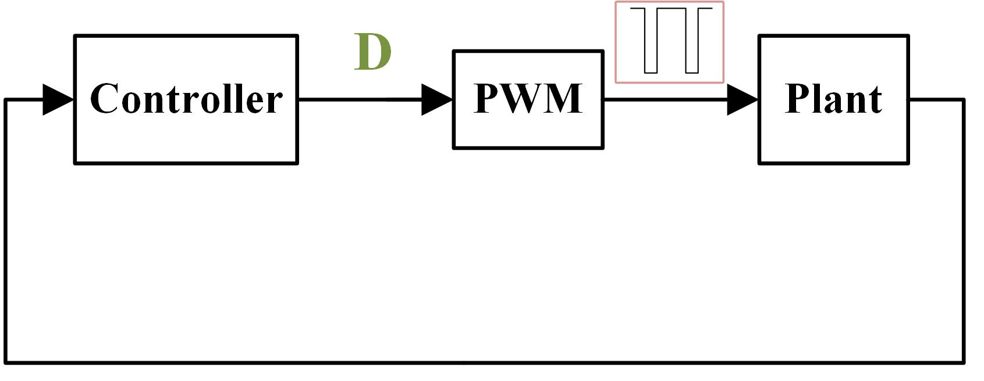
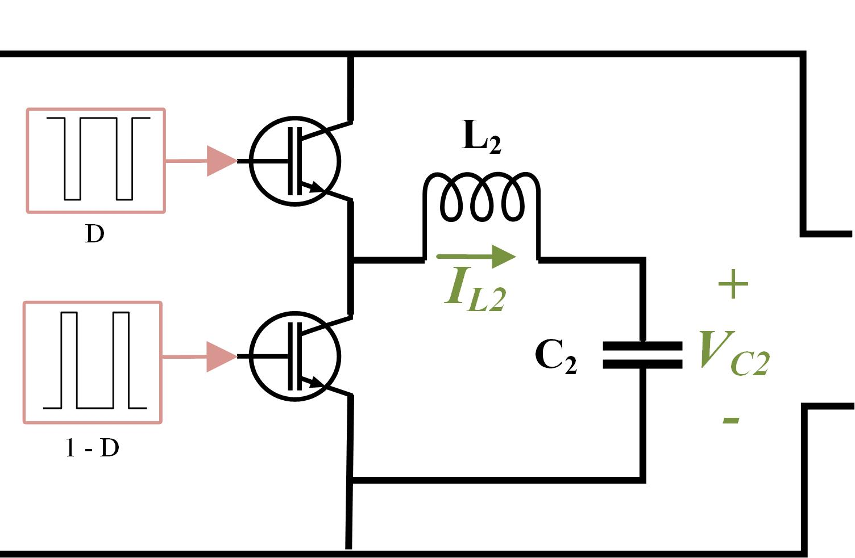
PSS Part II
I_{L}
V_{C}
PWM
Plant
D | → | L₂ and C₂ charging (storing energy)
1 – D | → | L₂ and C₂ discharging (dispersing energy)
Notes:
Part II is a closed loop system which consists of a controller and a plant
The plant is the entire physical circuit of inductors, capacitors, and switches
Physical measurements of current and voltage from the plant are used the inputs to the controller
The controller does some calculations to output a duty cycle D, and this duty cycle is used to create gating signals which control the switches on the converter, which is done through pulse width modulation (or PWM)
In power converters, the switches are firing very rapidly, for this system at a rate of 10 kHz
For each full switching period, the duty cycle dictates the percentage of time the top switch is on, as compared to the bottom switch, and this is determined by these complementary square wave signals.
When the gating signal is high, the switch is on, when the gating signal is low, the switch is off. Only one switch can be on at a time- the switches are alternating back and forth very rapidly
The switches control the amount of current that is allowed to travel through the inductor and capacitor
When the top switch is on, the capacitor and inductor are charging, and when the bottom switch is on, they are discharging.
By controlling the duty cycle, or the percentage of time the converter is in one state or the other, it is controlling how much energy is being stored or dispersed by these components.

Slide 13
Gating Signals
D = 0.7
Switch Cycle
Average
Notes:
The gating signals used to control the switches are created based on the duty ratio
As the duty ratio gets larger, the gating signal would spend more and more time in the “on” position
This gating signal regulate the amount of current traveling through the inductor. When the switch is on, the inductor is storing energy and current increases, and when the switch is off, inductor the inductor is dispersing energy and current decreases
This produces this high frequency “inductor ripple”, which will also cause high frequency noise on the output of the converter
However, this high frequency noise is going to be filtered out as the power travels through the inverter and transformer
The important thing is that the converter removes low frequency oscillation, which it is going to do by controlling the average current through the inductor
When duty cycle is constant, average inductor current will stay constant (as shown), but by slowly varying duty cycle in time, you can change the average current through the inductor, which will change the amount of energy it is storing

Slide 14
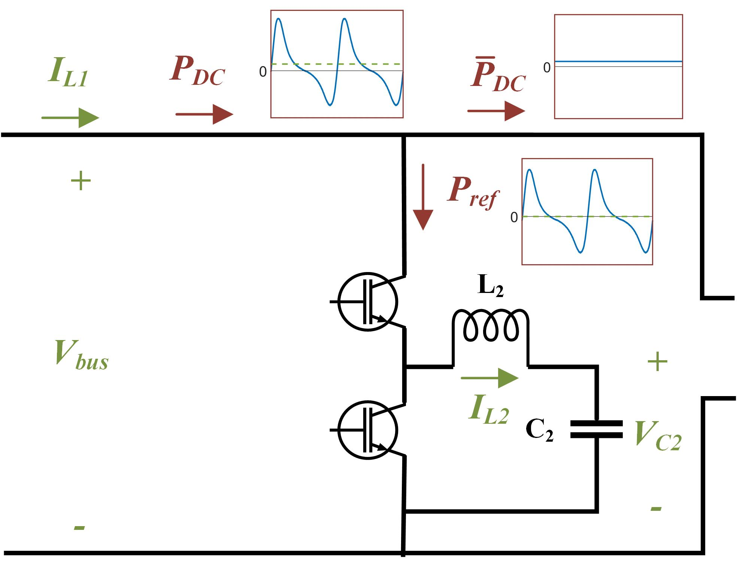
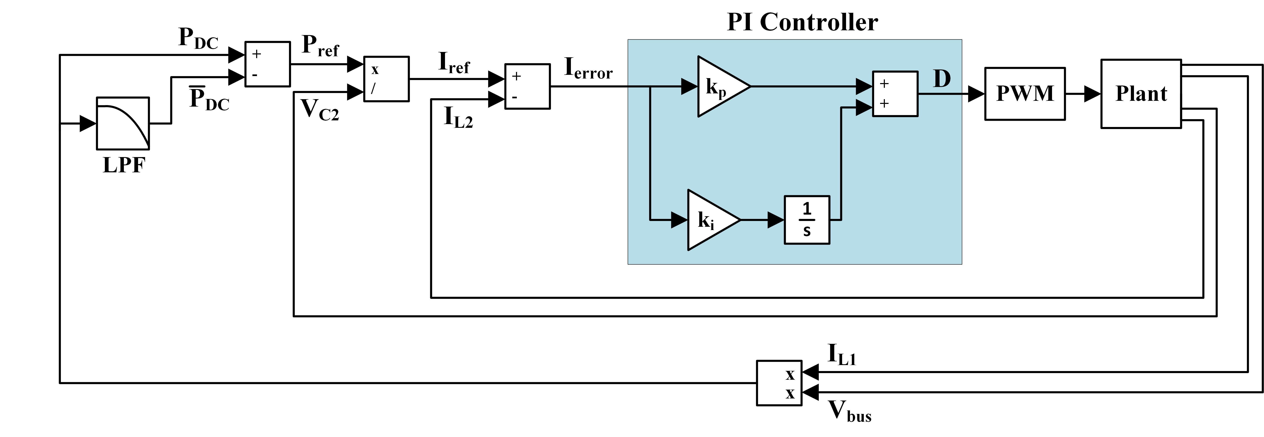
Controller Design
Term | Definition
P_{DC} | Instantaneous DC Bus Power
Plant:
 | Average DC Bus Power
P_{ref} | Reference Power
I_{ref} | Reference Current
I_{error} | Difference between measured and reference currentcurrent
D | Duty Ratio
k_{p} | Proportional Gain
k_{i} | Integral Gain
Controller Equations:
$$P_{DC}=I_{L1}V_{bus}$$
$$P_{ref}=P_{DC}−{\overline{P}}_{DC}$$
$$I_{ref}=\frac{P_{ref}}{V_{C2}}$$
$$I_{error}=I_{ref}−I_{L2}$$
$$D=I_{error}\left(k_{p}+\frac{k_{i}}{s}\right)$$
Controller:
J. Staiger, S. Bosch, and H. Steinhart, “Application of a buck-boost converter for highly dynamic power smoothing in industrial applications,” in Power Conversion and Intelligent Motion Conference, Nuremberg, DE, 2017.
Notes:
Step in detail through the controller design
The controller measures current and voltage on the DC bus, IL1 and Vbus, and calculates the incoming power Pdc
It then calculates a running average, Pdc bar, using a really heavy low pass filter, which is the constant power that should be on the output of the DC-DC converter.
The difference between the two is Pref, the power that needs to be absorbed by the PSS.
The power absorbed by the PSS is the capacitor voltage x it’s current. So if you measure this voltage, and you know what the power should be, by dividing the two you get what the current should be.
This is your reference current, which you compare to the actual current
The error between the two is fed into the PI controller, which uses proportional and integral gains to calculate the th duty ratio D.
The duty cycle is then used to create the gating signals which are used to control the switches.

Slide 15
Overview
Develop a small-scale PSS in simulation
Maximize reduction in oscillating power
Minimize power losses, size, and cost
2. Validate simulation using experimental bench-top system
3. Use linearized model to quickly scale-up system
4. Analyze performance and cost of full-scale system

Slide 16
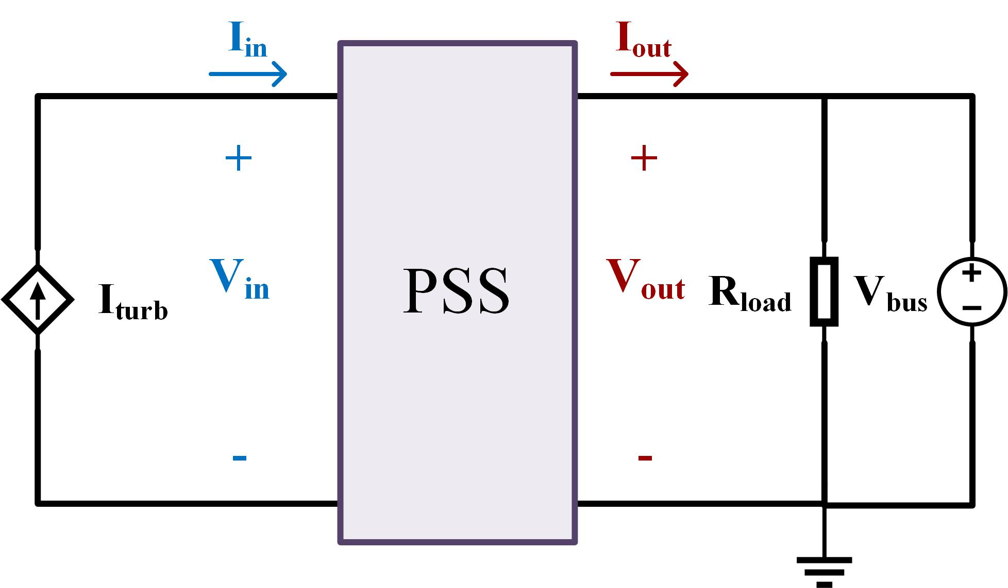
Lab-scale Experimental Set-Up
Environment used to test PSS is an abstraction of the DC bus
$$P=VI$$
$$V_{in}=V_{out}$$
Notes:
We’ve got a design for the PSS, now discuss the environment I used to experimentally validate my simulation
Last summer I spent about 6 months trying to come up with a motor drive turbine system which would output electrical power on the DC bus and I could implement the PSS directly onto an operating turbine.
The problem with this is that servomotors and drives at this scale aren’t really meant for regeneration. They don’t really operate efficiently enough to output any kind of useful generated power back out onto the DC bus.
So I switched gears and moved to sort of this emulated system, which essentially extracts out the DC bus from this full system
The generator and motor drive are replaced with this controllable current source input, matching the electrical power you would expect from a flume-scale turbine
This input current is determined from a combination of experimental and simulation results
The inverter, transformer, and grid are replaced with a constant voltage source, since that is essentially what this inverter is doing, it’s holding the DC bus at a constant voltage. A resistive load is added in parallel so the generated power from this source will have somewhere to go.

Slide 17
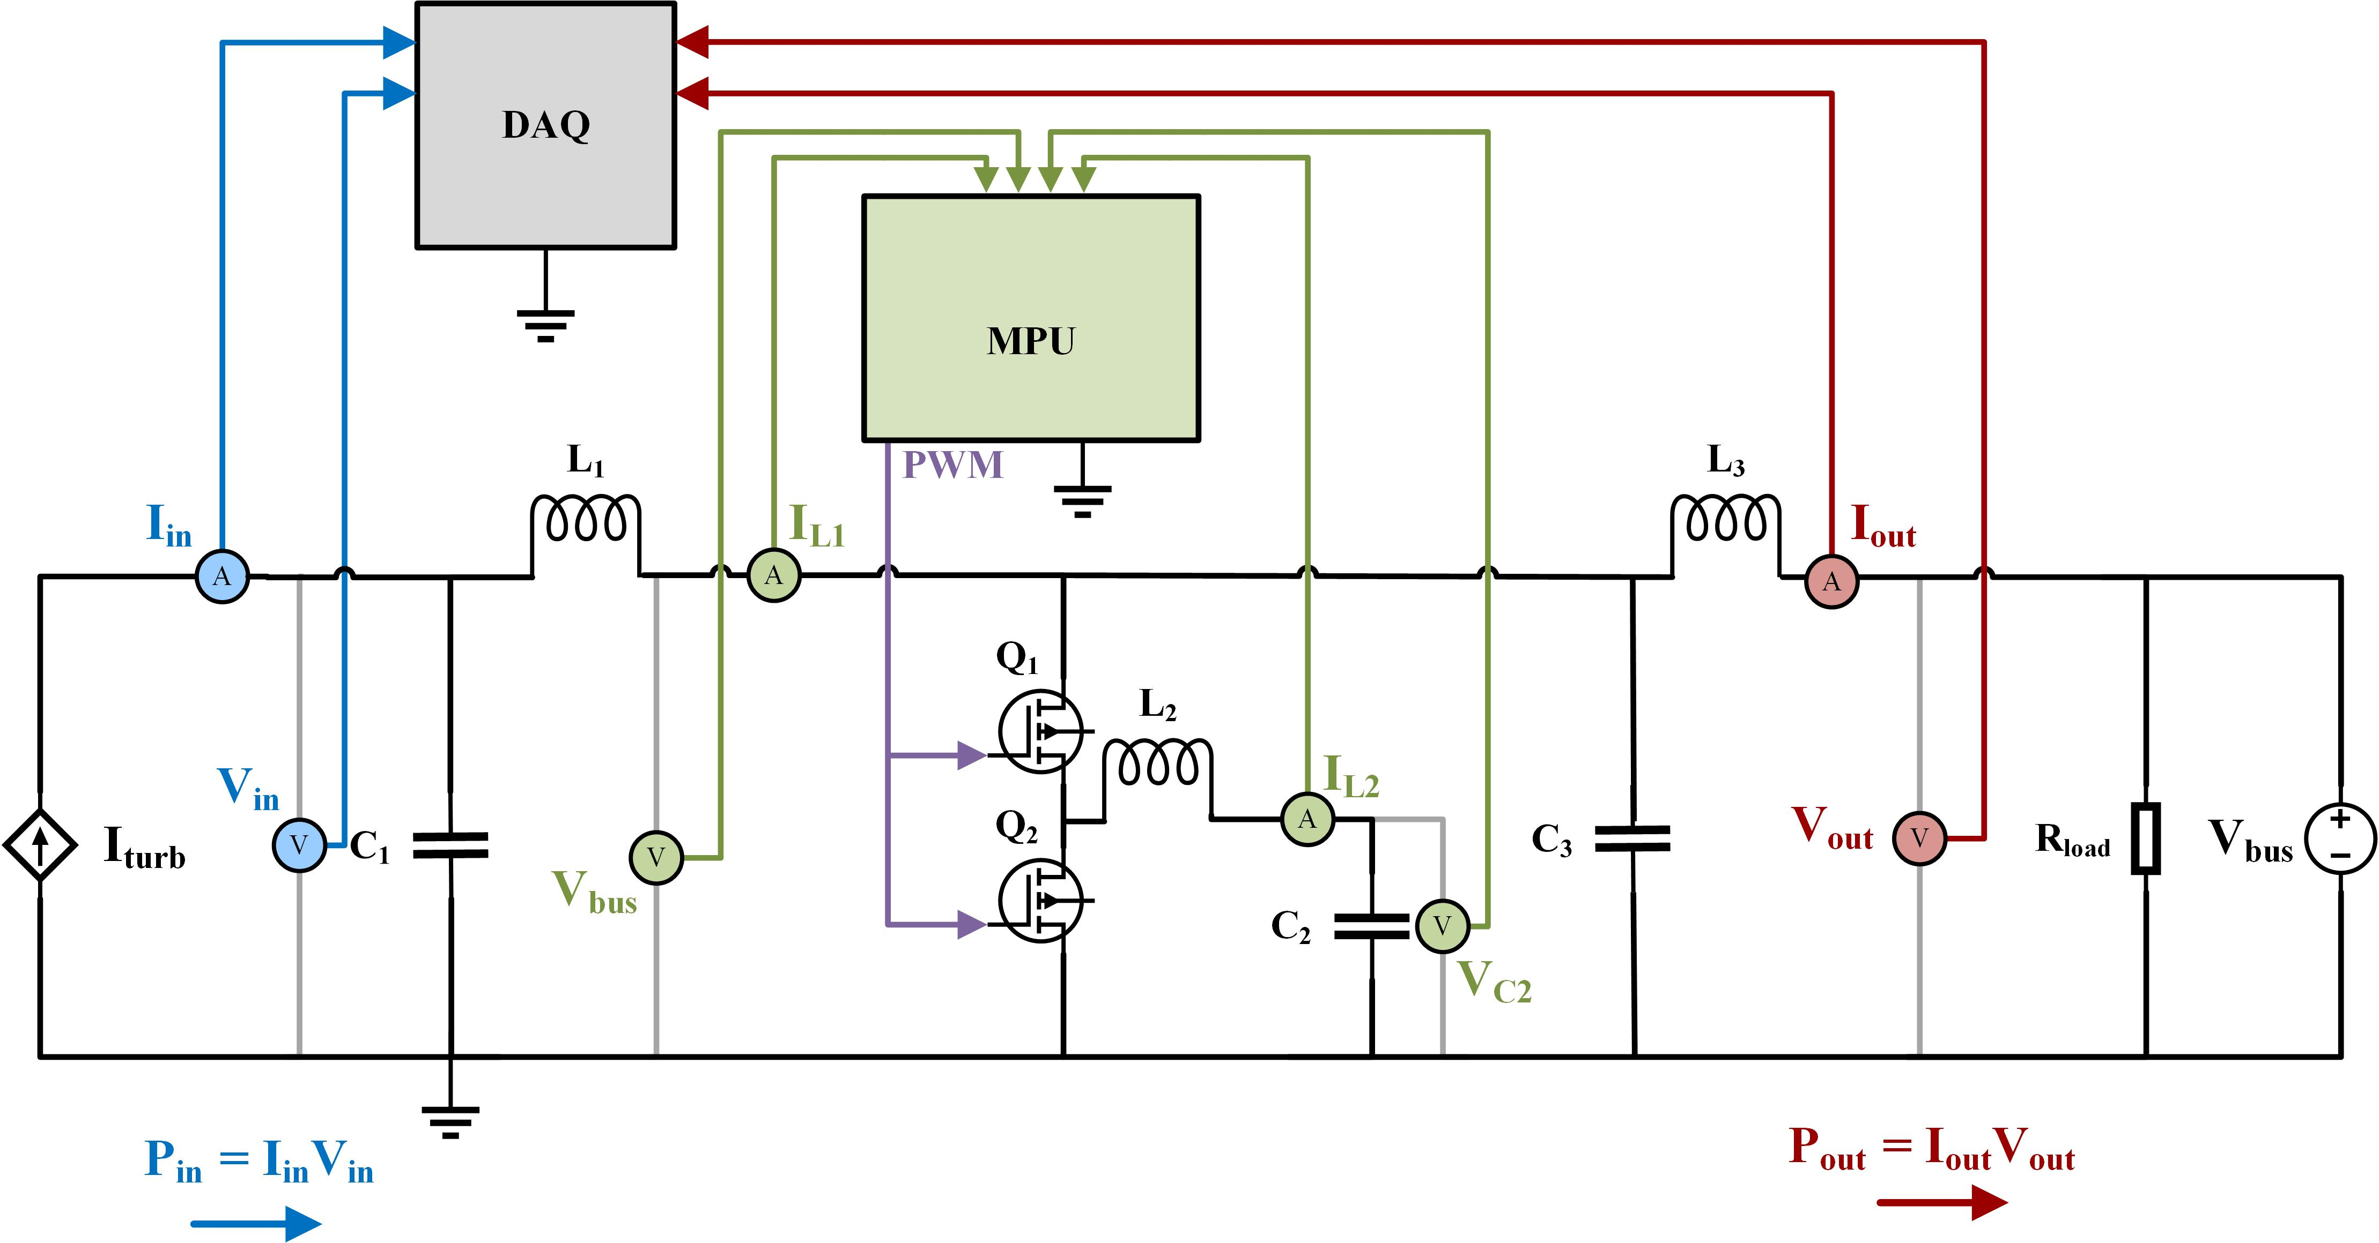
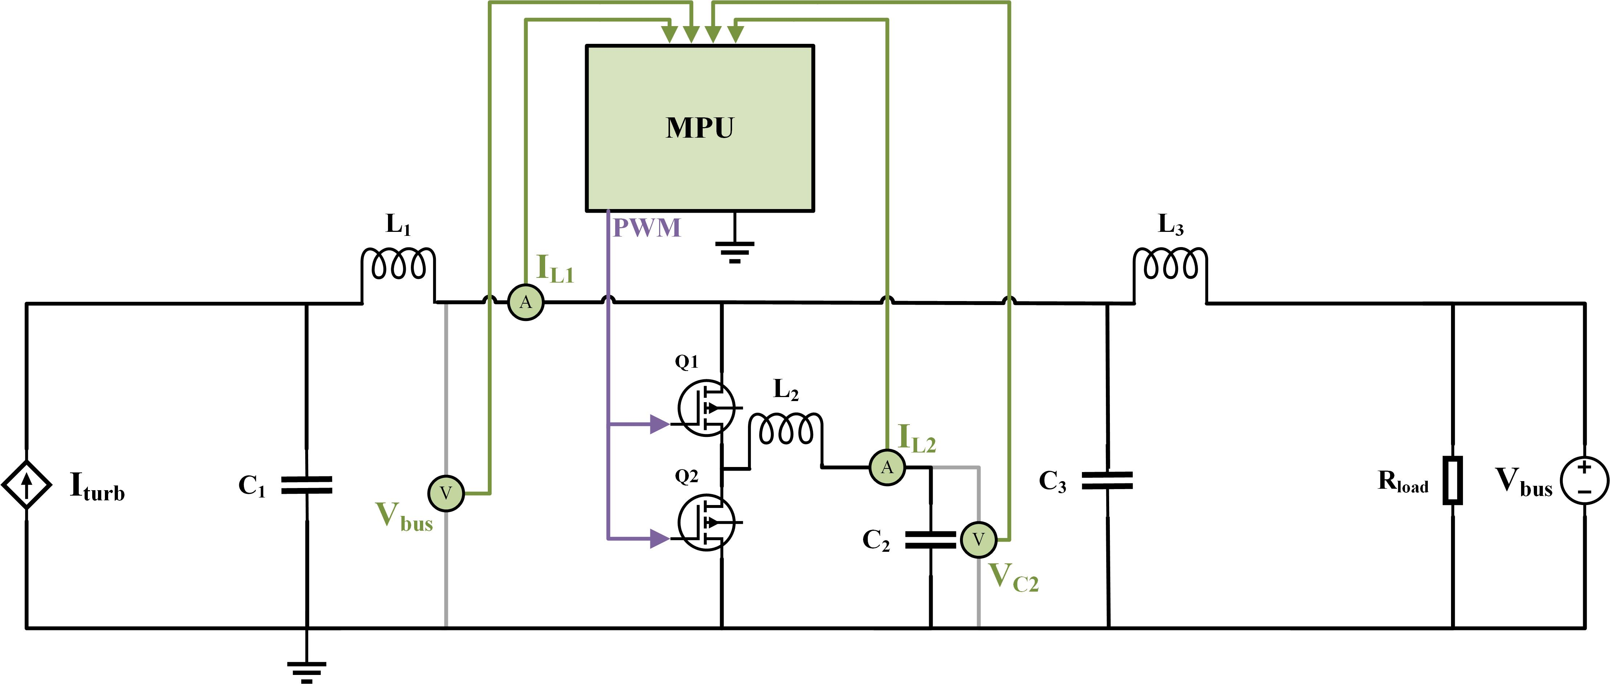
Experimental Power Smoothing System
Notes:
This is a full schematic of the system, we can see that there’s two main things going on
The first one is the micro controller (or MPU), which is used to create the gating signals.
The controller equations I listed earlier get complied onto the controller
These four sensors output some analog voltage, which is fed into the analog to digital converter pins on the microcontroller.
The MPU reads in the sensor values, does a few calculations to find the duty cycle, uses PWM to output a gating signal, and then this gating signal is used to control the system.
You end up with this full closed loop controller system.
Note the addition of an LC filter on the output of the system, this is added to filter out high frequency switching noise introduced by the power converter. This allows for easier observation of the performance of the PSS in the time domain
In a real system, this would happen from the inverter and transformer, so I wanted to mimic that effect here and look at only the low frequency output of the system.
The other aspect is the data acquisition part, which is what I’m using to actually measure the performance and efficiency of the system.
A current and voltage sensor on the input to the system measures the input power and a current and voltage sensor on the output measures the output power
These four sensors are read into a data acquisition device (or DAQ), and the input and output power are compared

Slide 18
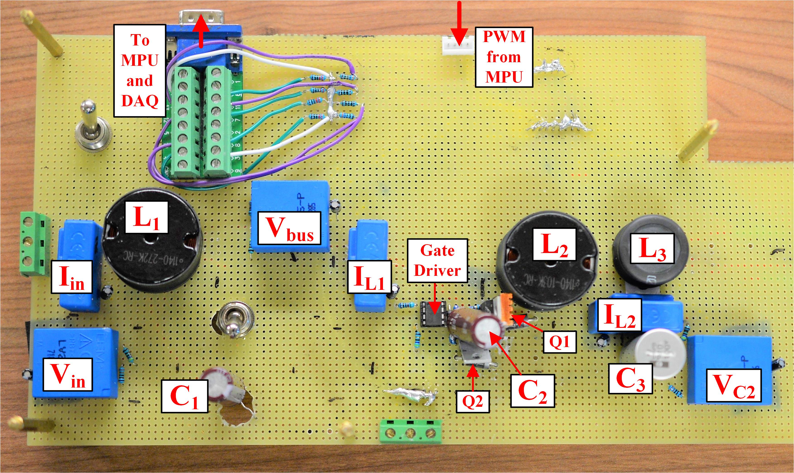
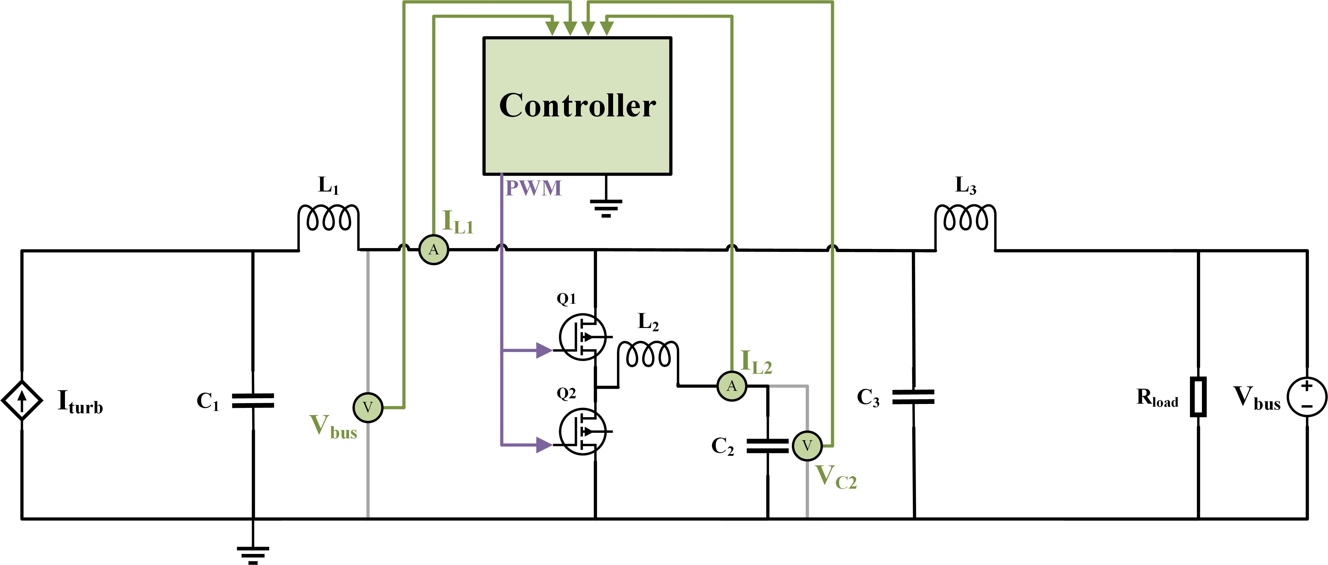
Lab-scale Power Smoothing System
Hardware
Simulation
Matlab Simulink
Discrete time solver (1e-6)
Controller in a triggered subsystem
Includes all component internal series resistance (ESR)
Notes:
This is what the actual system looks like in hardware
A simulation essentially recreates this schematic in Matlab Simulink
Run using a discrete time solver
The controller was implemented inside of a triggered subsystem, which essentially captures the effect of real-time controller delay, or how a controller would function in real life, since it can’t be continuously sampling the sensors and instantaneously calculating duty cycle
Simulation includes all inductor and capacitor internal series resistances to create a more realistic model

Slide 19
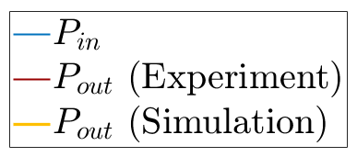
Results: Output Power
Full Turbine Rotation
No PSS
PSS Part I
PSS Part II
10 W
Notes:
Let’s take a look at the results
First, in blue, we have the input power to the system. Before the PSS is turn out, input power is going to equal output power
Then, we switch on PSS Part I, which removes the high frequency switching noise and outputs this nice low amplitude, low frequency sine wave
Then, we switch on PSS Part II, the controller kicks in and we remove all remaining oscillation in power, outputting this nice clean constant power in time
If we look at a close up comparison between simulation and experimental results, we see that we’re actually getting pretty good agreement between the two models.

Slide 20
Results: Output Power
Full Turbine Rotation
No PSS
PSS Part I
PSS Part II
Hardware Complications
Sensor noise
Switch-node ringing
Non-zero turn-on and turn-off times of converter switches
10 W
Efficiency
$$η=\frac{{\overline{P}}_{out}}{{\overline{P}}_{in}}$$
$$P_{out}=V_{out}I_{out}$$
$$P_{in}=V_{in}I_{in}$$
 | Simulation | Experiment
PSS Part I | 100 % | 99.7 %
PSS Part II | 99.8 % | 89.5 %
Notes:
The main difference between the experimental and simulation is what looks like this really high frequency noise in the experimental set-up,
This is a combination of sensor noise and switch node ringing, which is essentially a voltage overshoot every time one of the switches goes to on. This come from parasitic inductance which is essentially unwanted inductance that builds up naturally in the physical circuit
Simulation efficiency is the ratio of average output power of the average input power.
Simulation results show really high efficiencies in simulation, almost 100%
In experiment, we see about a 10 percent efficiency drop. The majority of this is coming from switching losses in the converter. In simulation, the switches are assumed to turn on and turn off instantaneously, but in real life, there is some non-zero amount of time that it takes them to turn on and off, which creates power losses
These issues are essentially an artifact of implementing this on a protoboard, I think if you were to scale this up and use better circuit design practices you could pretty easily achieve higher efficiency and better performance

Slide 21
Controller Performance
Simulation
Experiment
Average RMS Error per Cycle [mA]
Simulation | Experiment
7.1 | 32.5
Notes:
To understand exactly why there is a difference in the performance between the simulation and experiment, let’s take a look inside the controller.
Ideally, the controller is going to calculate a reference current and the true current will perfectly match it. In reality, there is always going to be some small amount of error
In simulation, the measured current almost perfectly tracts the reference current
In experiment, again these issues like sensor noise and converter ringing lead to a larger error between the measured and reference current, which is likely a contributing factor to the slightly reduced performance of the experimental system.

Slide 22
Overview
Develop a small-scale PSS in simulation
Maximize reduction in oscillating power
Minimize power losses, size, and cost
2. Validate simulation using experimental bench-top system
3. Use linearized model to quickly scale-up system
4. Analyze performance and cost of full-scale system
Notes:
The simulation I’ve been talking about so far models the full dynamics of the system, which is both the low frequency power oscillation + the high frequency converter switching dynamics
This model is the most accurate representation of the system, but is also time consuming and computationally expensive
Instead, I am going to present a linearized model, which is going to capture the important low frequency dynamics of the system while omitting the high frequency dynamics, allowing it to run much faster
This system can be used to easily resize the system- if you want to scale up the system and apply it to a large-scale turbine, the linearized model could be used to quickly try different inductive and capacitive components to find ones that are able to appropriately smooth power

Slide 23
Linearization
Refresher:
Objective:
Create switch-averaged model
Reduce switching converter (“Plant”) to a system of six differential equations
$$KCL: \sum{I_{in}−\sum{I_{out}}}=0$$
$$V_{L}=L\frac{dI_{L}}{dt}$$
$$KVL: \sum{V}=0$$
$$I_{c}=C\frac{dV_{c}}{dt}$$
Configuration A
(D)
Configuration B
(1-D)
$${\dot{I_{L2,A}=}\frac{1}{L_{2}}(V}_{C3}−V_{C2}−R_{L2}I_{L2})$$
$$\dot{I_{L2,B}=}\frac{1}{L_{2}}(−V_{C2}−R_{L2}I_{L2})$$
Combine equations using Duty Cycle:
$${\dot{I_{L2}=}\frac{1}{L_{2}}(DV}_{C3}−V_{C2}−R_{L2}I_{L2})$$
Notes:
The goal here is to reduce this entire “plant” or physical circuit of inductors and capacitors, into a matrix of differential equations
The concept of linearizing a power converter feels a little counter intutitive to me, because switches are inherently non-linear, they’re either on or their off.
One way to break this down is by looking at the two states: Configuration A is when the top switch is on and the bottom switch is off, and Configuration B is the opposite, where the top switch is off and bottom switch is on
The state variables, or the dynamics that you care about, are inductor currents and capacitor voltages.
You can write a differential equation for each of these six state variables for each of the two configurations, using some basic electrical engineering laws
As an example, I’ve written the equation for the inductor L2 for each of the two states
But how are these states related? We know that the converter spends some percentage of time in Configuration A, and some time in Configuration B. This amount of time is dictated by the duty ratio.
So you can calculate an equation modeling the average dynamics of the inductor by multiplying all the terms in equation A by D, and all the terms in equation B by 1-D. This gives an equation modeling the average inductor current over an entire switch cycle.

Slide 24
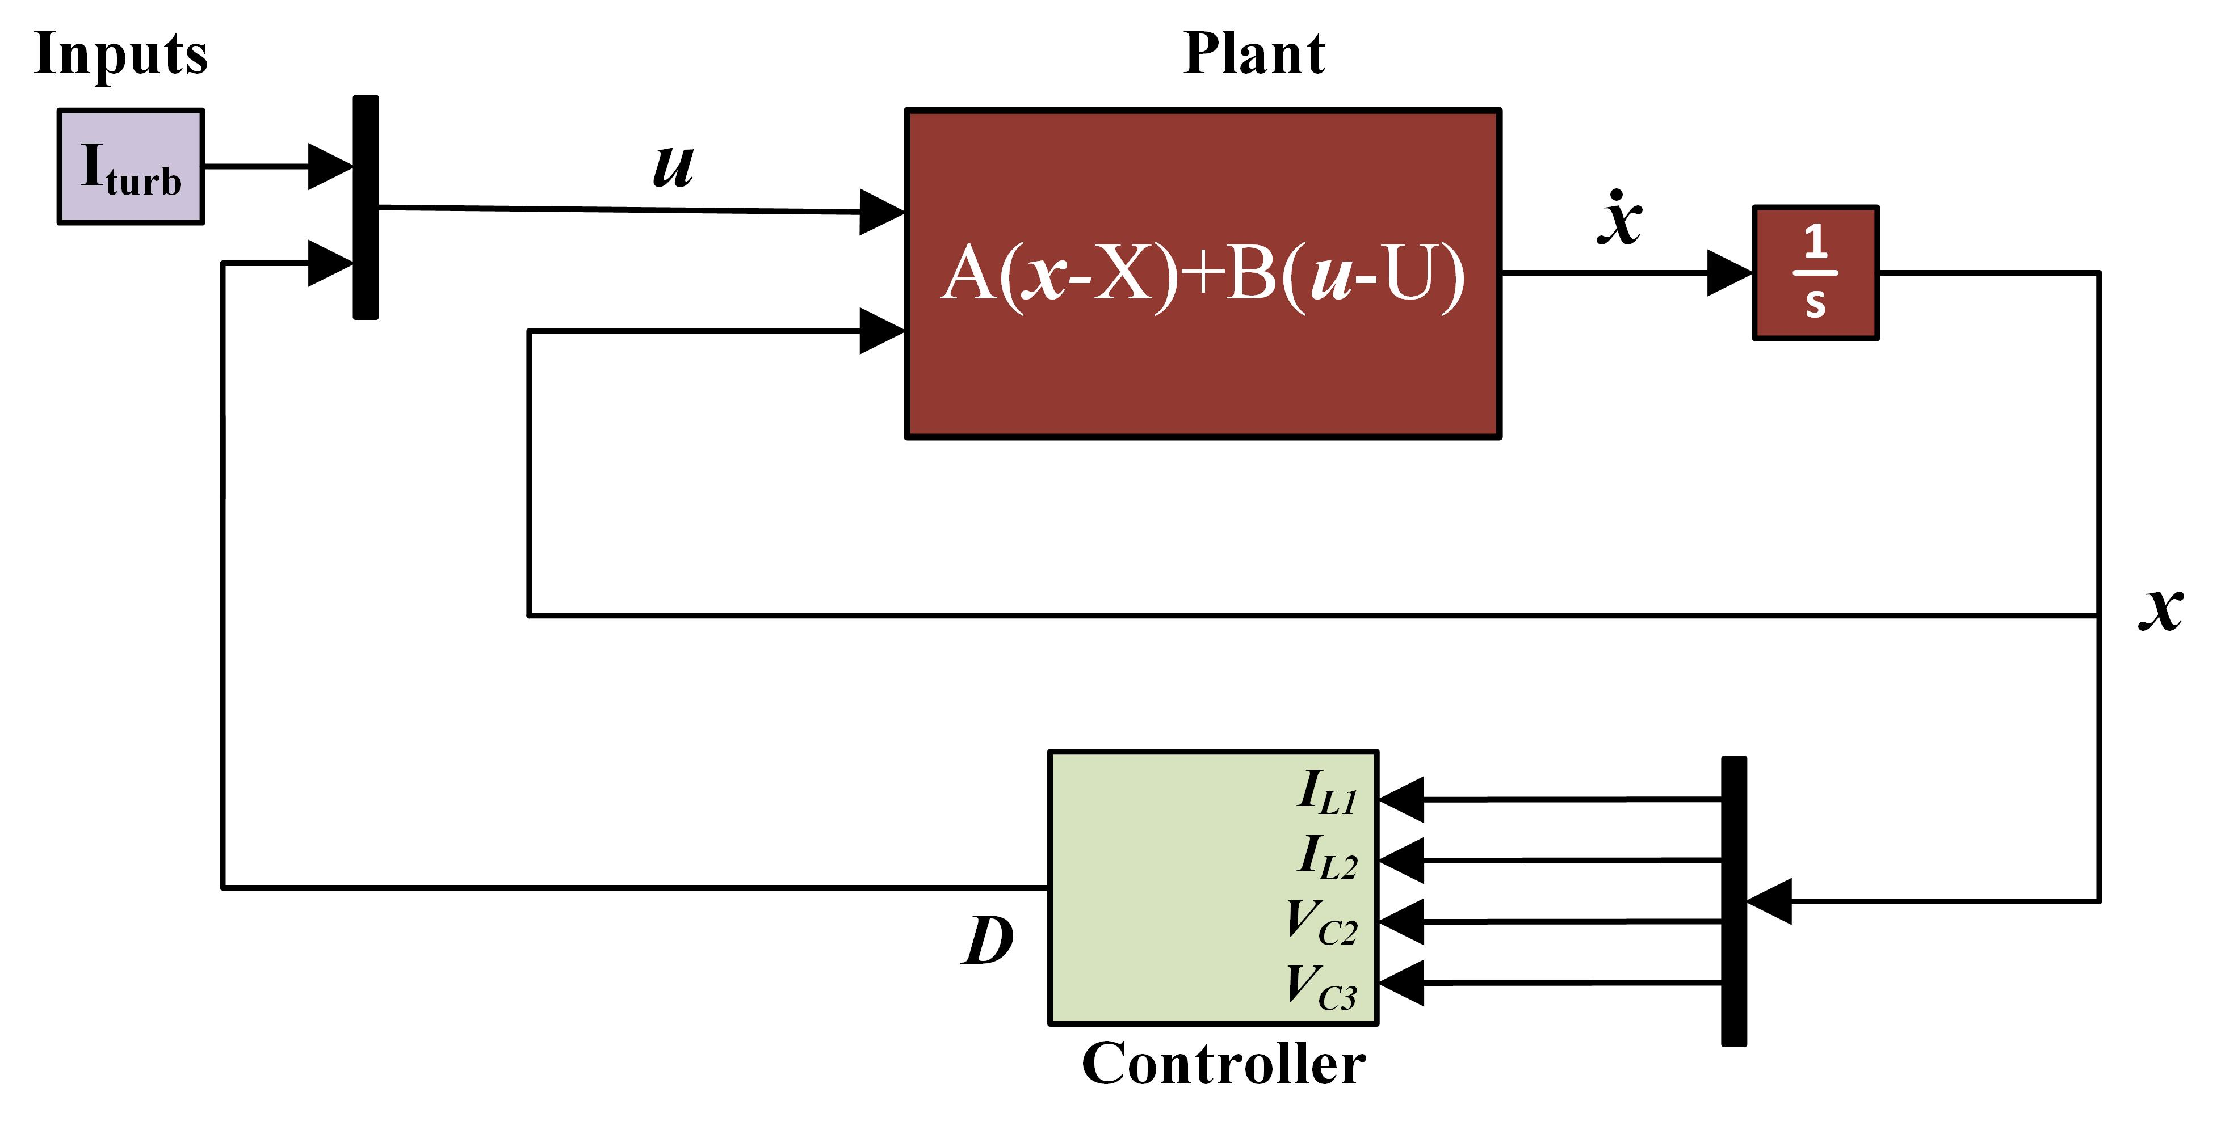
Linearization
State Equations
System Inputs
Linearized System
$$\dot{x}=\left[\begin{matrix}\dot{I_{L1}} \\ \dot{I_{L2}} \\ \dot{I_{L3}} \\ \dot{V_{C1}} \\ \dot{V_{C2}} \\ \dot{V_{C3}}\end{matrix}\right]=\left[\begin{matrix}{\frac{1}{L_{1}}(V}_{C1}−V_{C3}−R_{L1}I_{L1}) \\ {\frac{1}{L_{2}}(DV}_{C3}−V_{C2}−R_{L2}I_{L2}) \\ {\frac{1}{L_{3}}(V}_{C3}−V_{bus}−R_{L3}I_{L3}) \\ {\frac{1}{C_{1}}(I}_{turb}−I_{L1}) \\ {\frac{1}{C_{1}}I}_{L2} \\ {\frac{1}{C_{3}}(I}_{L1}−DI_{L2}−I_{L3})\end{matrix}\right]$$
$$u=\left[\begin{matrix}I_{turb} \\ D\end{matrix}\right]$$
$$\dot{x}=A\left[x−X\right]+B[u−U]$$
Jacobian Matrices
$$A=\left[\begin{matrix}\frac{∂f_{1}}{∂x_{1}} & … & \frac{∂f_{1}}{∂x_{N}} \\ & : & \\ \frac{∂f_{N}}{∂x_{1}} & … & \frac{∂f_{N}}{∂x_{N}}\end{matrix}\right]\left|\begin{aligned} \\ \\ \\ \\ X \\ U\end{aligned}\right.$$
$$B=\left[\begin{matrix}\frac{∂f_{1}}{∂u_{1}} & … & \frac{∂f_{1}}{∂x_{M}} \\ & : & \\ \frac{∂f_{N}}{∂u_{1}} & … & \frac{∂f_{N}}{∂u_{N}}\end{matrix}\right]\left|\begin{aligned} \\ \\ \\ \\ X \\ U\end{aligned}\right.$$
Notes:
We do this for all six state variables, and come up with this matrix x dot.
The inputs, u, to the system are the input current and the duty cycle. These are things that are changing with time.
Now, you can put it into this standard form x dot = Ax + Bu
These matrices A and B are calculated by taken the Jacobian of this matrix x dot, with respect to the state variable and the system inputs.
X and U are the equilibrium points and initial conditions or of the system.
In our closed loop system, we essentially replace the physical converter with this set of equations.
Now we have a closed loop system using purely equations.

Slide 25
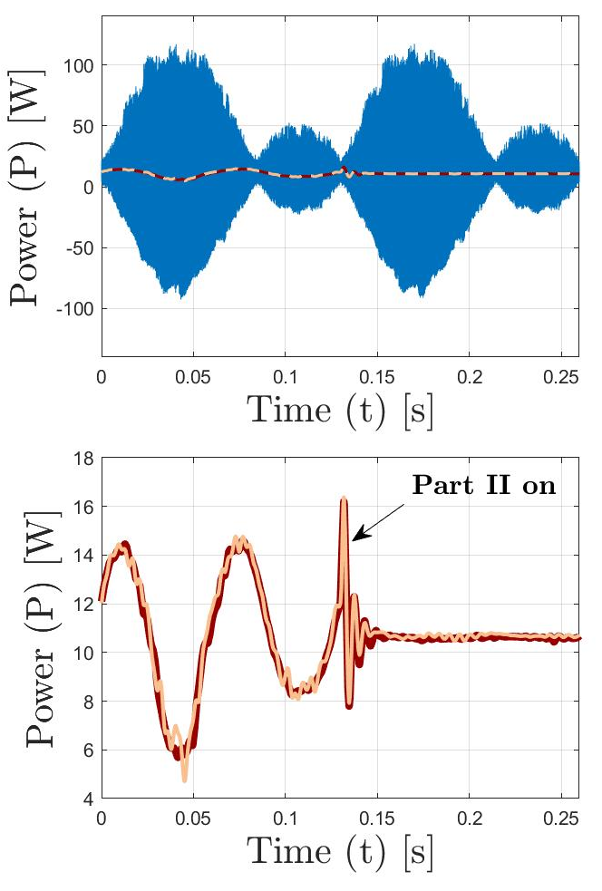
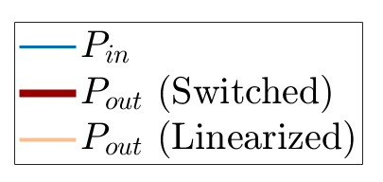
Linearization Results
Linearized model accurately captures switched averaged dynamics
Use to quickly size a new system- runs 10x faster than switching converter model
Notes:
If we look at the power coming out of the system, we see that the state space model almost perfectly captures the dynamics of the system, it even captures the transient that occurs when PSS Part II switches on.
The high frequency switching dynamics are not modeled by the linearized model, but these are filtered out in the real system anyway, so they end up not affecting the final result. This is why the linearized model works so well
What you end up with is this system which can be run at least 10x faster than the switched model but still captures all of the important dynamics that you care about.

Slide 26
Overview
Develop a small-scale PSS in simulation
Maximize reduction in oscillating power
Minimize power losses, size, and cost
2. Validate simulation using experimental bench-top system
3. Use linearized model to quickly scale-up system
4. Analyze performance and cost of full-scale system
Notes:
Finally, we’re going to use this linearized model to quickly scale up the system such that it can be used for a full-scale turbine

Slide 27
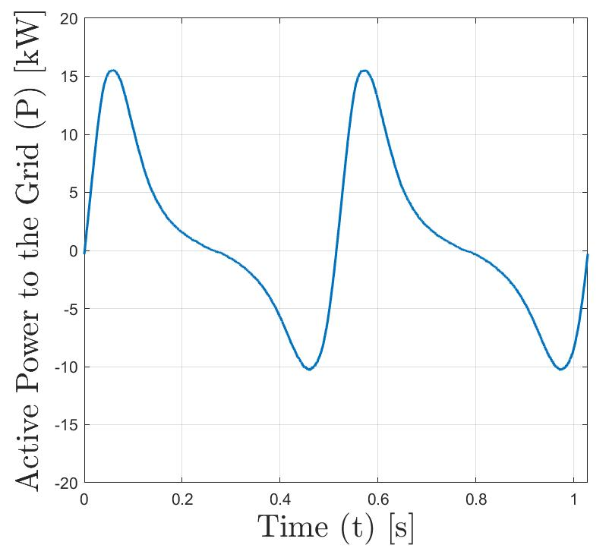
Full-Scale System
Notes:
So now we want to look at how they system performs for a full-size turbine.
To do this, we go back to this full generator-to-grid power collection scheme
The output power integrated with the grid has this awful peak to average ratio

Slide 28
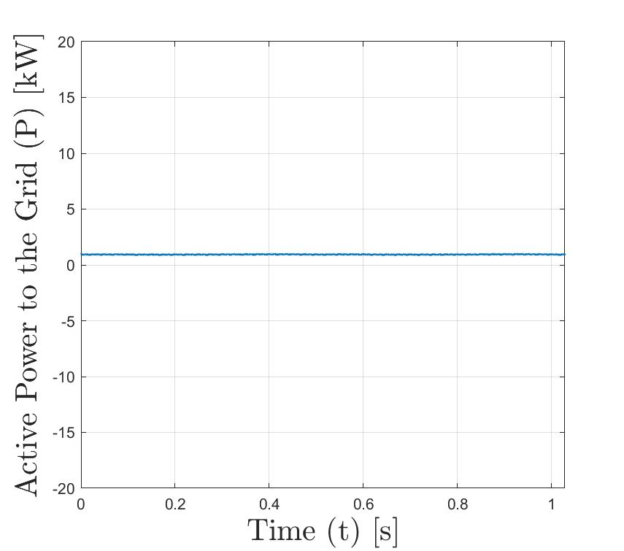
Full-Scale System
PSS
Total Cost: $4600
Efficiency: 97%
Notes:
Then we’re add the scaled-up PSS to the DC bus
Now we simulated the system, and the final output power delivered to the grid is constant in time
The goal of this system is to allow the turbine geometry and control strategy to be designed with only to purpose of optimizing average output power; the amount of fluctuation this creates is not a concern because it can be handily dealt by placing this system on the back end of the device
The cost of the system, based on available off the shelf components, is just under $5000. This is one disadvantage of using supercapacitors, which is that they are very expensive. But, better than having completely useless power
The efficiency of the system is quite high, around 97%
Now you have this really nice, constant output power you could easily integrate with the grid or use to power another device

Slide 29
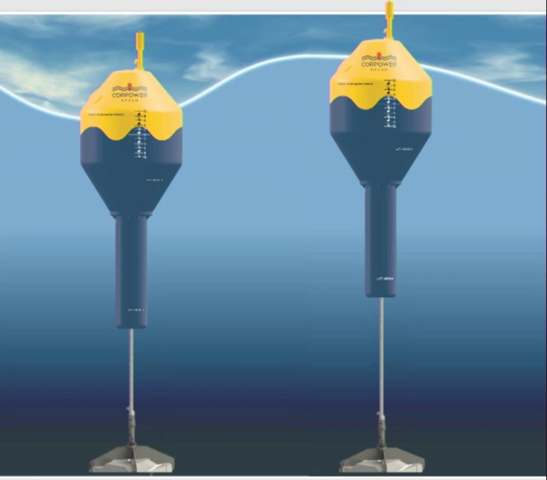
Other Applications
Smooth disturbances from turbulence
$P∝U_{∞}^{3}$
Smooth variable output power from wave energy converters
Notes:
Lastly, I want to talk about some other applications, because although I’ve kind of outlined a very specific instance for which I’m using this power smoothing system (a cross-flow turbine utilizing intracycle control), I think the system could be used for some other applications as well
Short term power fluctuation is an issue encountered by other renewable energy industries
In the wind and marine energy industry, output power is the cube of wind speed, so turbulent gusts can cause huge power spikes
In the literature, I’ve seen similar systems to what I’ve described here used to smooth these power fluctuations from turbulence, but in general these fluctuations are much less severe than what we’re seeing from cross flow turbines
It might be interesting to see if such as system could be used to smooth power fluctuation from both fluctuation in mechanical power in cross flow turbines and from turbulence
The other interesting one would be for wave energy converters, where power output varies as a function of wave height. This would have a slightly longer time scale (more like 10 seconds as opposed to 1 second), but I think the system could be re-sized and used for this application.

Slide 30
Thank you!
A special thanks to the following for their help with:
Project and Life Guidance
Brian Polagye
Robert Cavagnaro
System Design
Brian Johnson
Hardware Implementation
Corey Crisp
Rahul Mallik
Ryan Elliot
Turbine Stuff
Ben Strom
Hannah Ross
My Sanity
Labmates, roommates, climbing and skiing buddies, etc!

Slide 31
Questions?

Slide 32
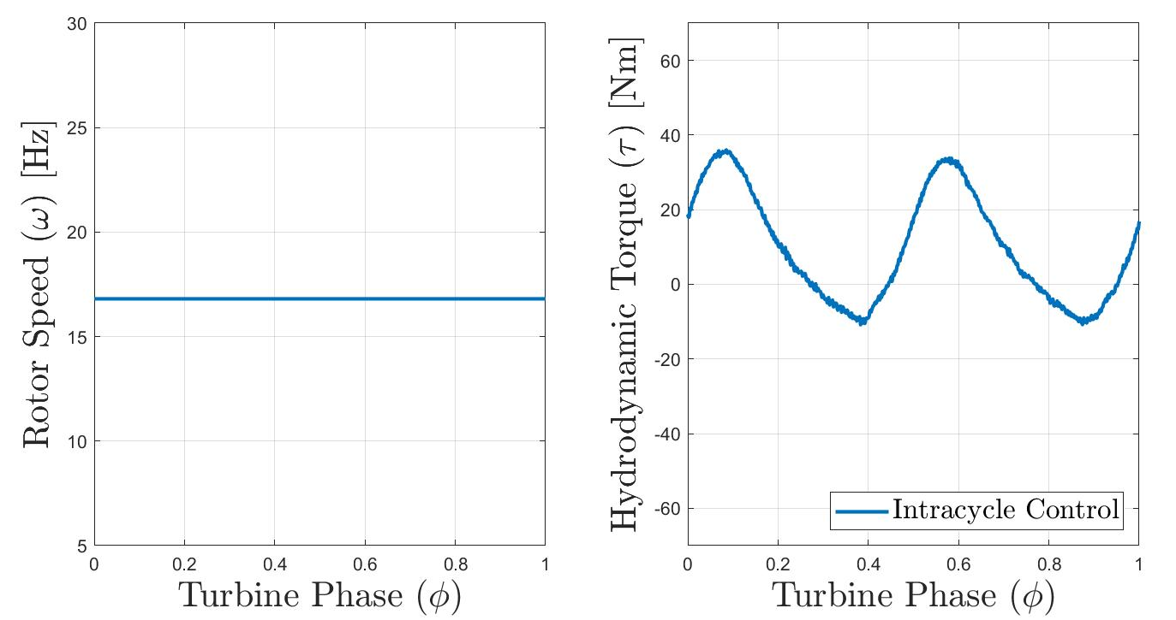
Turbine Mechanical Power
How to maximize the conversion efficiency of cross-flow turbines?
Turbine Design
Control Strategy
Constant velocity control
Small number of straight blades
Rendering courtesy of Hannah Ross
Mechanical Power: $P_{mech}=τω$
Notes:
Marine energy is expensive- how do we make it less expensive?
Increase the conversion efficiency, or the amount of power available in the flow that the turbine is able to extract
This is a major area of research in the lab, and there’s two main ways to do this: optimizing the design or geometry of the turbine, and optimizing how you’re controlling the turbine.
On the design side, studies have typically found that two-bladed turbines with straight blades have the highest efficiency.
On the control strategy side, constant velocity control is the most common, which regulates the turbine speed to maintain some optimal tip speed ratio based on the speed on the incoming flow
As the turbine is rotating, the angle of attack of the blades changes based on turbine angular position, which creates this angular-dependent hydrodynamic torque
Mechanical power is speed x torque, so this creates time-varying power
The frequency and magnitude of power oscillation is dependent on the number of blades.
This type of fluctuation in output power just isn’t really seen from axial turbines, so this problem is something kind of specific to cross-flow turbines.

Slide 33
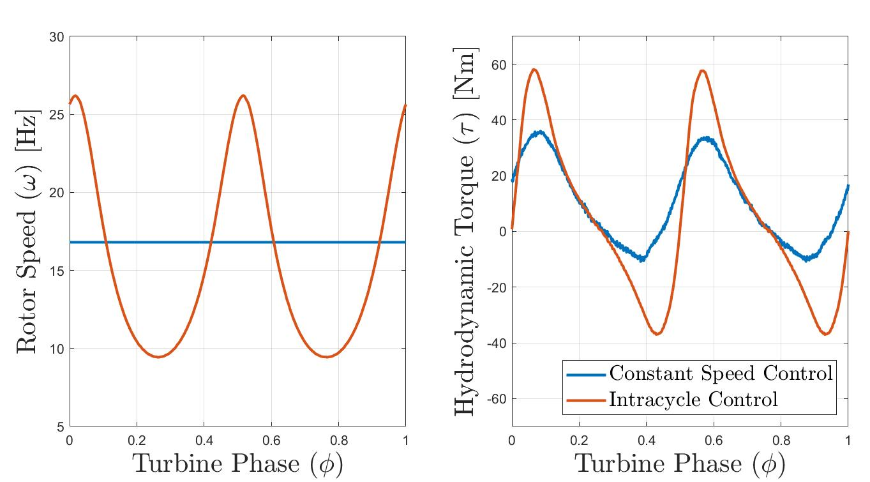
Turbine Mechanical Power
How to maximize the conversion efficiency of cross-flow turbines?
Turbine Design
Control Strategy
Constant velocity control
Small number of straight blades
Intracycle control
Boost mechanical power by up to 59%
Rendering courtesy of Hannah Ross
Mechanical Power: $P_{mech}=τω$
B. Strom, S. L. Brunton, and B. Polagye, “Intracycle angular velocity control of cross-flow turbines,” Nature Energy, vol. 2, 2017.
Notes:
A more complicated control scheme is intracycle control
Instead of keeping speed constant with time, you vary it in the semi-sinusoidal fasion with in a single rotation
This can boost mechanical power efficiency by almost 60%, which is amazing
But, this has some downsides in terms of power quality

Slide 34
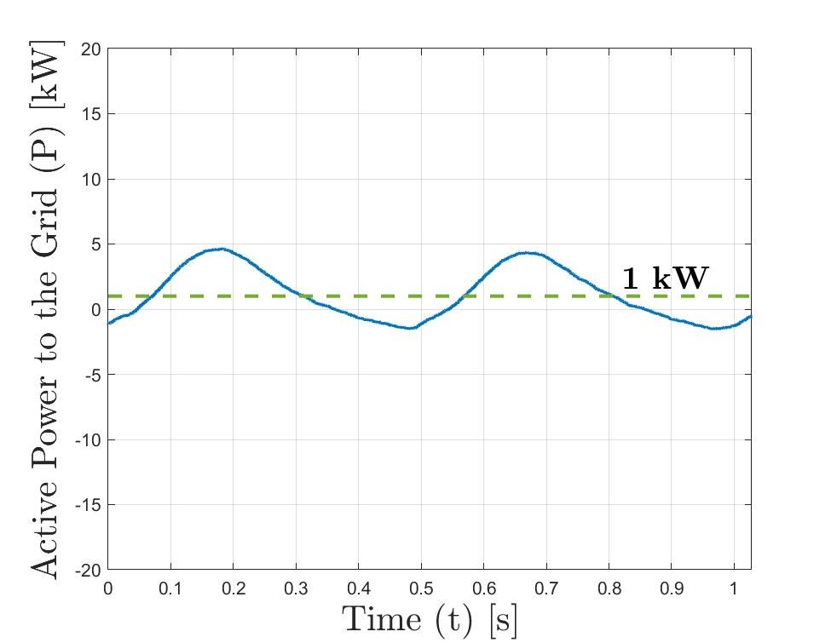
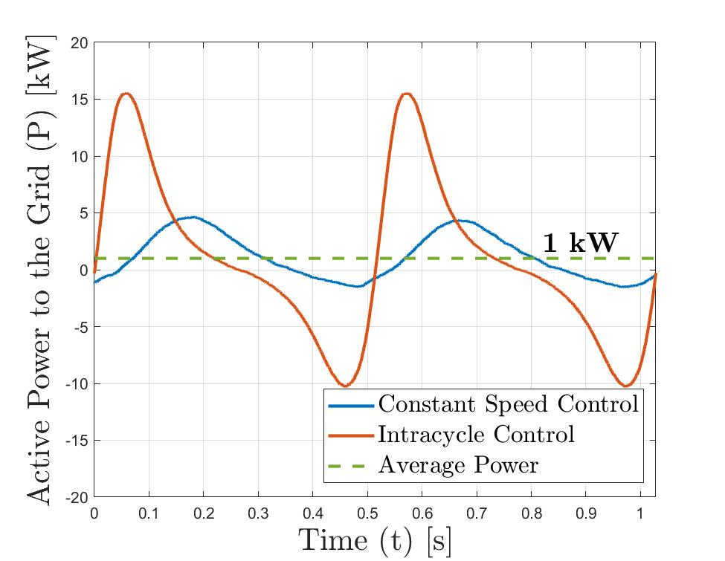
Turbine Electrical Power
How does this mechanical power translate to electrical power?
Peak power is 15x average power for intracycle control
Incompatible with direct use
R. J. Cavagnaro, B. Strom, B. Polagye, and A. Stewart, “Power collection from multiple hydrokinetic generators utilizing advanced control,” In 12th European Wave and Tidal Energy Conference, Cork, IR, 2017.
Notes:
For intracycle control, the problem just gets worse- peak power is 15x average power
This is almost certainly violating grid regulatory standards
The infrastructure used to connect the turbine to the grid, such as the inverter, transformer, and transmission lines, would have to be rated to these ridiculously high currents in comparison to the average power that the turbine is actually producing, which would make the system a lot more expensive and inefficient.
Utility companies aren’t going to want to buy this power
Turbine designs and control strategies that maximize average power output create instantaneous power that, on it’s own, is pretty useless

Slide 35
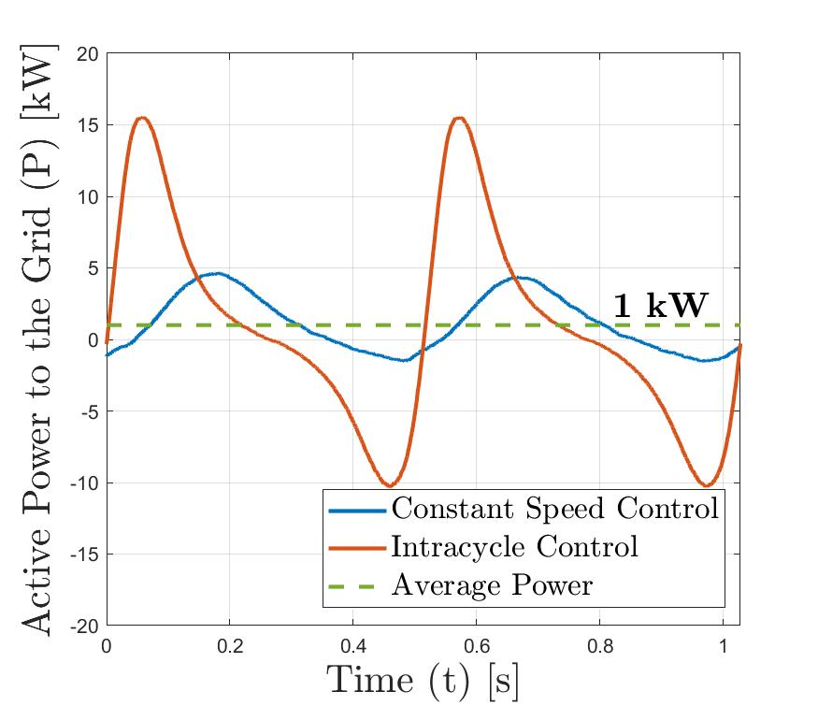
Turbine Electrical Power
How does this mechanical power translate to electrical power?
Peak power is 15x average power for intracycle control
Incompatible with direct use
R. J. Cavagnaro, B. Strom, B. Polagye, and A. Stewart, “Power collection from multiple hydrokinetic generators utilizing advanced control,” In 12th European Wave and Tidal Energy Conference, Cork, IR, 2017.
Notes:
For intracycle control, the problem just gets worse- peak power is 15x average power
This is almost certainly violating grid regulatory standards
The infrastructure used to connect the turbine to the grid, such as the inverter, transformer, and transmission lines, would have to be rated to these ridiculously high currents in comparison to the average power that the turbine is actually producing, which would make the system a lot more expensive and inefficient.
Utility companies aren’t going to want to buy this power
Turbine designs and control strategies that maximize average power output create instantaneous power that, on it’s own, is pretty useless

Slide 36
Controller Gains
Open Loop Transfer Function:
$$G_{c}\left(s\right)=K_{p}+K_{i}\frac{1}{s}$$
$$\left.l\left(s\right)=G_{iu}(s)G_{c}(s\right)$$
(1)
$$G_{iu}\left(s\right)=\frac{1}{sL+R_{L}}$$
Complementary Sensitivity Function:
$$T\left(s\right)=\frac{l(s)}{1+l(s)}=\frac{K_{i}}{L}\frac{(1+\frac{K_{p}}{K_{i}}s)}{(s^{2}+\frac{1}{L}(R_{L}+K_{p})s+\frac{K_{i}}{L})}$$
(2)
Canonical Second Order System:
Equating (2) and (3):
$K_{i}=ω_{o}^{2}L_{2}$
$$K_{p}=2ζω_{o}L_{2}−R_{L}$$
$$T\left(s\right)=T_{o}ω_{o}^{2}\frac{(1+ω_{z}s)}{(s^{2}+2ζω_{o}s+ω_{o}^{2})}$$
(3)

Slide 37
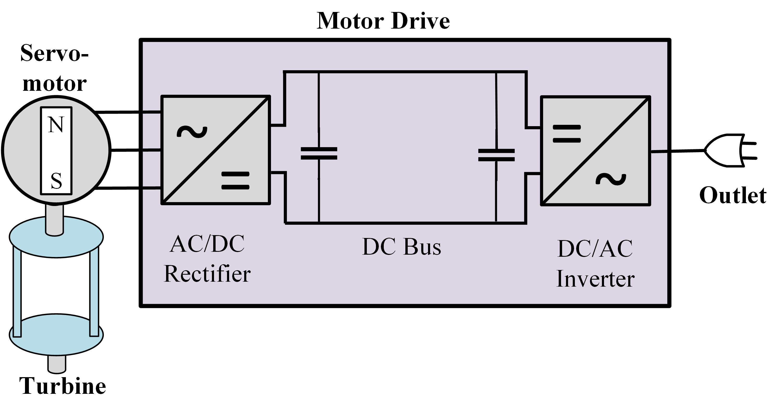
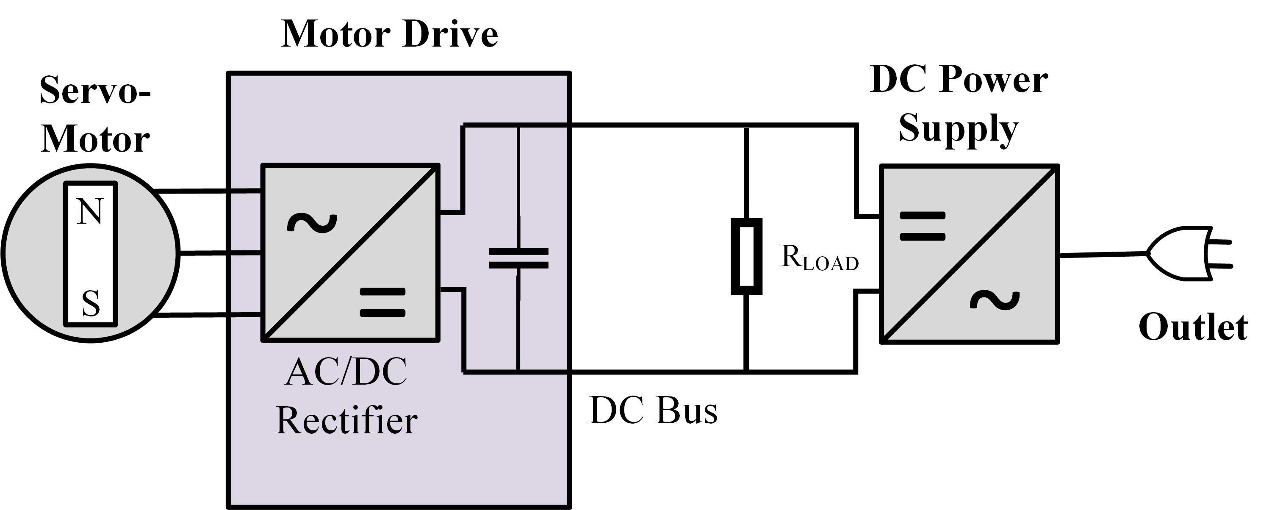
Turbine System
Typical System
Modified System

Slide 38
Turbine Set-Up
Load Cell
Servomotor
Turbine Parameters
Shaft
Parameter | Small-Scale | Full-Scale
U∞ (m/s) | 1 | 2
D (m) | 0.172 | 0.857
H (m) | 0.234 | 1.168
A (m²) | 0.04 | 0.04
Turbine
U∞
Small-Scale Turbine Speed
TSR (-) | 2.16
ω (Hz) | 4
Bearing
Load Cell
Vacuum Plate

Slide 39
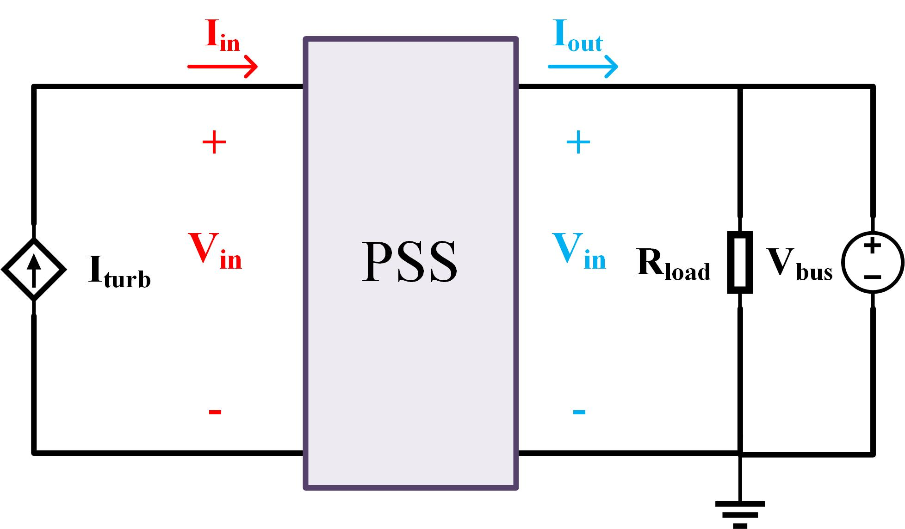
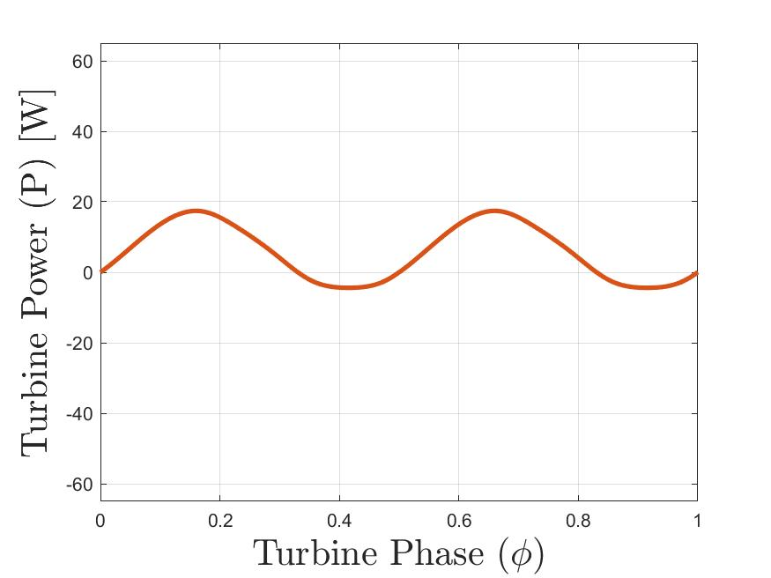
System Input Current
How to estimate the DC bus current, I_{turb}?
Experimental Turbine Data
+ Simulation
$$P_{mech}=τω$$
$ω$held constant
Notes:
How do we know what this input current is, Iturb? Like I said, there’s not really a good way to measure this completely experimentally, so I had to kind of use this combination of experimental and simulation data.
We have turbine speed and time-varying hydrodynamic torque data from flume experiments, which we know is equal to the mechanical power of the turbine.
I took Rob’s power collection simulation and scaled down all the generator parameters to match a small-scale servomotor, then plugged in this experimental data as the input
From there I could measure the electrical current on the DC bus, which becomes this current source input into the emulated system.

Slide 40
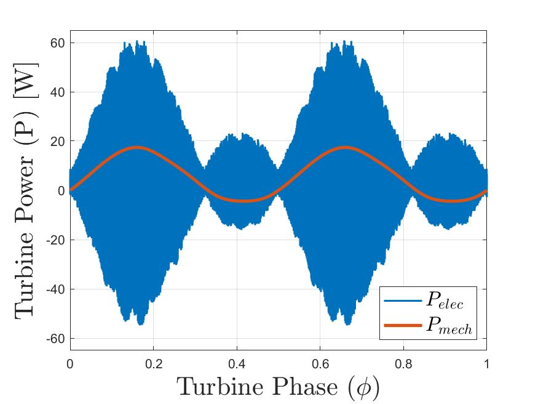
System Input Current
How to estimate the DC bus current, I_{turb}?
Experimental Turbine Data
+ Simulation
$$P_{mech}=τω$$
$$P_{elec}=I_{turb}V_{bus}$$
$ω, V_{bus}$ held constant
Notes:
The resulting electrical power on the DC bus varies at the rate of turbine rotation, but also includes this really high frequency switching from the motor drive

Slide 41
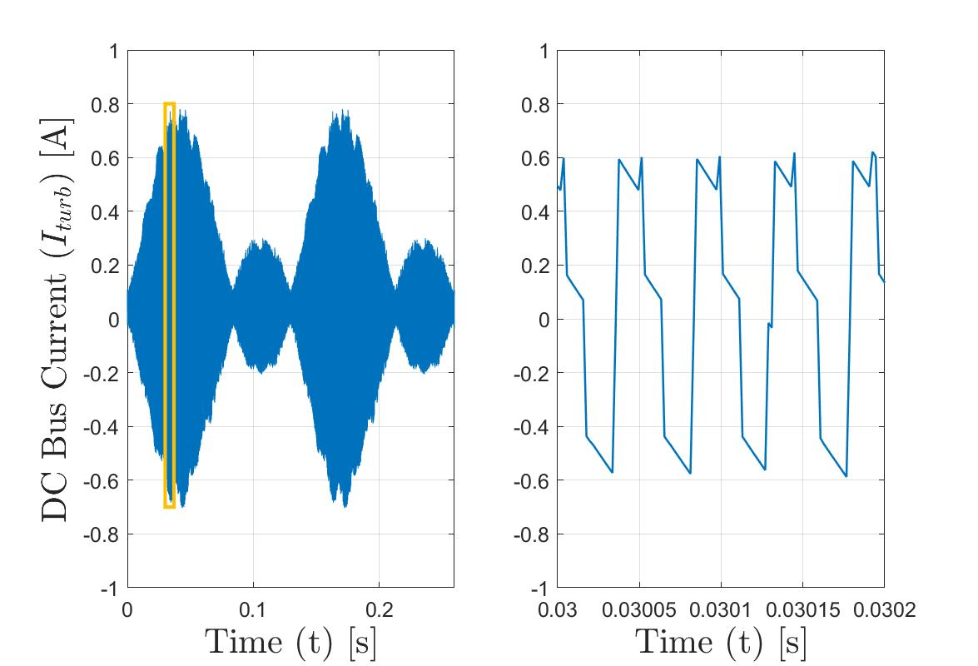
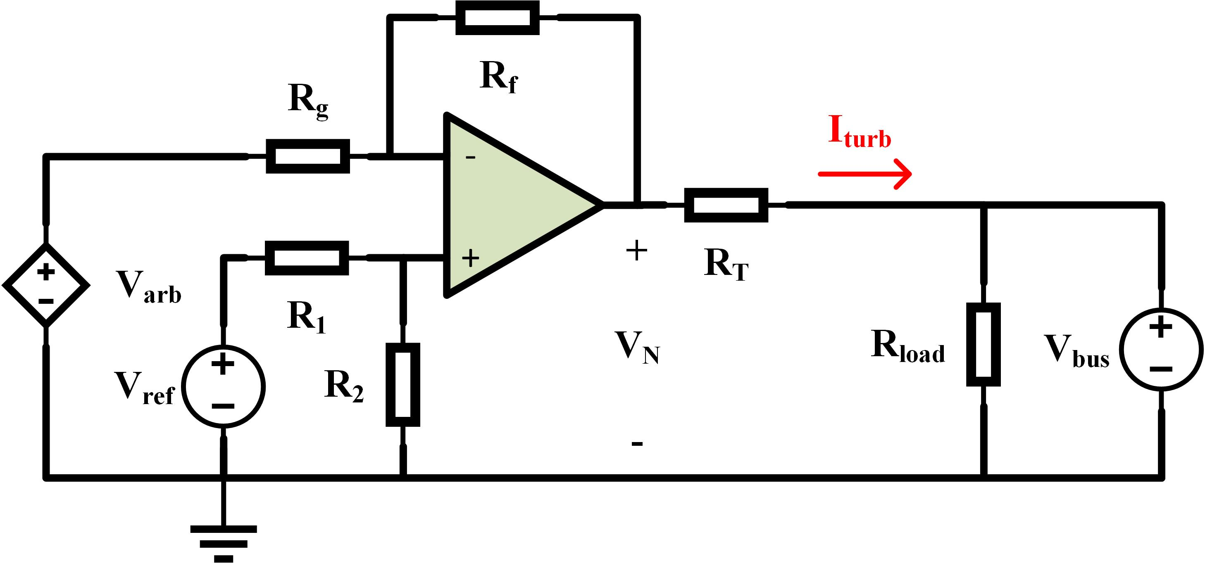
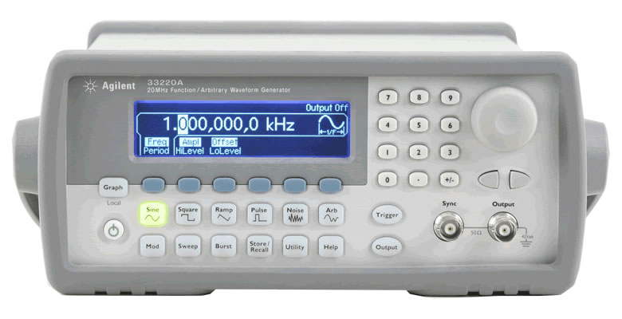
Lab-scale Experimental Set-Up
How to achieve this fluctuating input current?
Arbitrary Function Generator
High power operational amplifier
$$I_{turb}=\frac{1}{R_{T}}\left(V_{N}−V_{bus}\right)$$
$$V_{N}=−\frac{R_{f}}{R_{g}}V_{arb}+\left(\frac{R_{f}}{R_{g}}+1\right)\left(\frac{R_{1}}{R_{1}+R_{2}}\right)V_{ref}$$
Arbitrary Function Generator
Notes:
Take a closer look at this DC bus current. So if we zoom in on it, we see it’s this highly fluctuating waveform, as I’ve mentioned before.
So how do I produce such a rapidly changing current?
I used an arbitrary function generator, which you can store up to 64,000 data points
However, this function generator outputs a voltage, not a current, and is also only able to output like half a Watt, not like 10 W which is what I need for the system
So I used a high power operational amplifier to amplify this signal and a constant voltage to output this high power voltage, which is used along with this circuit equivalent to produce the correct nput current, Iturb
This input current is achieved through a combination of an arbitrary function generator and a high power operational amplifier

Slide 42
Bench-Top System Parameters
Controller Parameters
Small-Scale Set-Up Components
 | Value | Unit
f_{sw} | 10 | kHz
ω_{o} | 483 | rad/s
ξ | 0.4 | [-]
K_{p} | 2.17 | H/s²
K_{i} | 2340 | Ω
 | Value | Unit
R_{f} | 30 | kΩ
R_{g} | 2 | kΩ
R₁ | 10 | kΩ
R₂ | 10 | kΩ
V_{ref} | 10 | V
R_{L} | 10 | Ω
R_{load} | 50 | Ω
V_{bus} | 80 | V
Controller bandwidth:
ω_{o} = 10f_{turb}
Small-Scale PSS Component Components
PSS Part I Cut-off Frequency:
$f_{c}=\frac{1}{2π\sqrt{LC}}=150 Hz$
Energy Stored in a Capacitor:
$$E=\frac{1}{2}CV^{2}=1.25 J$$
 | Value | Unit | ESR [Ω]
L₁ | 2.7 | mH | 700
L₂ | 10 | mH | 1700
L₃ | 1.8 | mH | 700
C₁ | 390 | μF | 44
C₂ | 910 | μF | 26
C₃ | 390 | μF | 44

Slide 43
Full-Scale System Parameters
Controller Parameters
 | Value | Unit
f_{sw} | 10 | kHz
ω_{o} | 122 | rad/s
ξ | 0.4 | [-]
K_{p} | 3.10 | H/s²
K_{i} | 478 | Ω
Controller bandwidth:
ω_{o} = 10f_{turb}
f_{turb} = 1.94 Hz
 | Size | Rating | ESR [Ω] | Cost
L₁ | 32 mH | 10 A | 28 | $43
L₂ | 32 mH | 10 A | 28 | $43
C₁ | 1.93 F | 480 V | 12 | $3969
C₂ | 0.05 F | 480 V | 28 | $557
 |  |  | Total Cost | $4611
PSS Part I Cut-off Frequency:
$f_{c}=\frac{1}{2π\sqrt{LC}}$ = 0.65 Hz
Energy Stored in a Capacitor:
$$E=\frac{1}{2}CV^{2}=220 J$$

Slide 44
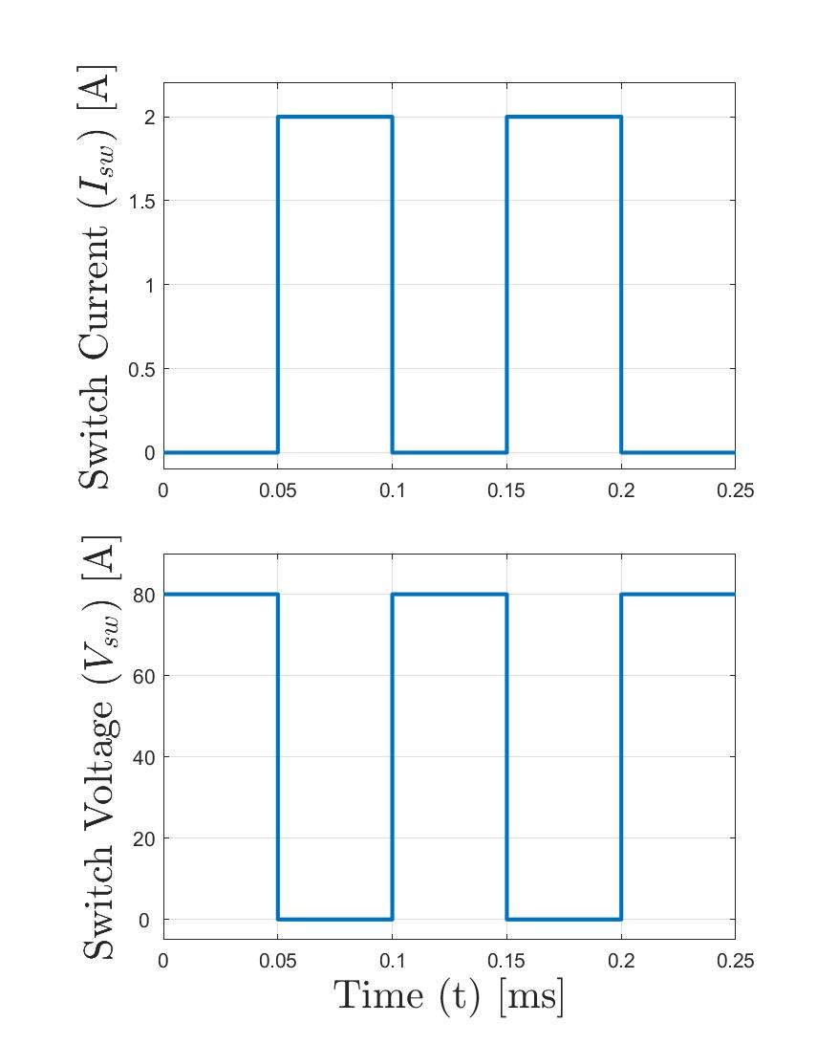
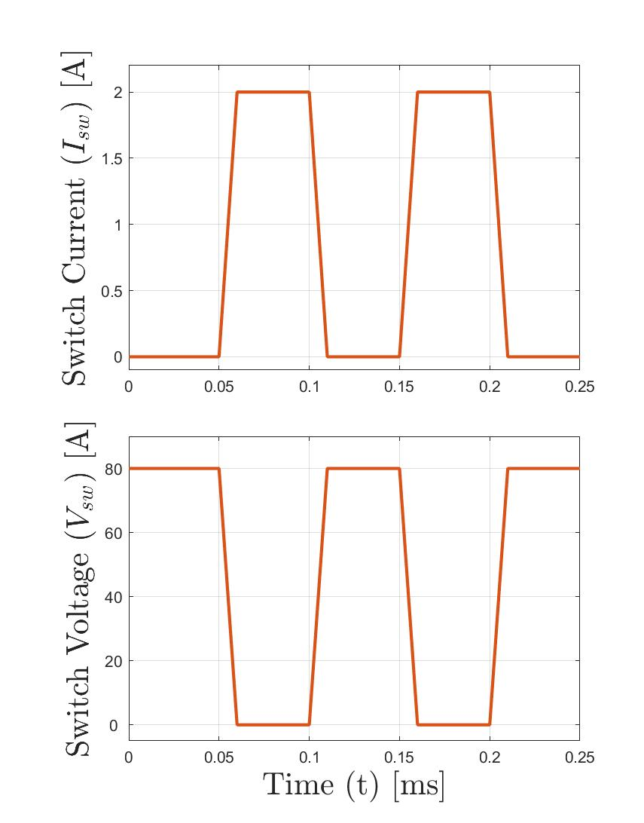
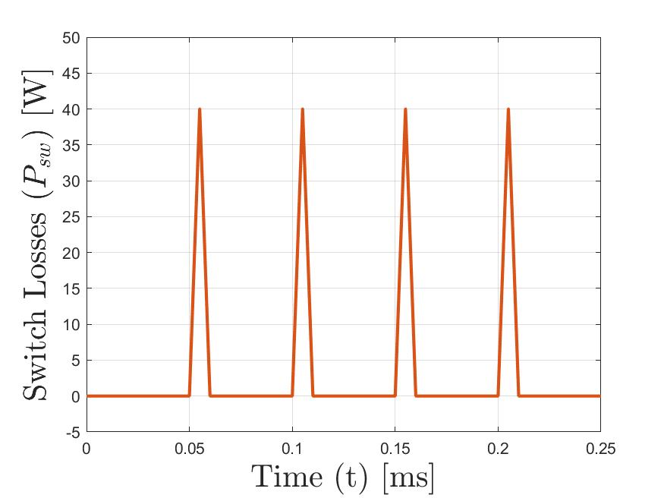
Switching Losses
Ideal Switch
Real Switch
Real Switch Losses
$$P_{sw}=I_{sw}V_{sw}$$
$P_{sw}=0$ for ideal switch
Switching losses not modeled in simulation

Slide 45
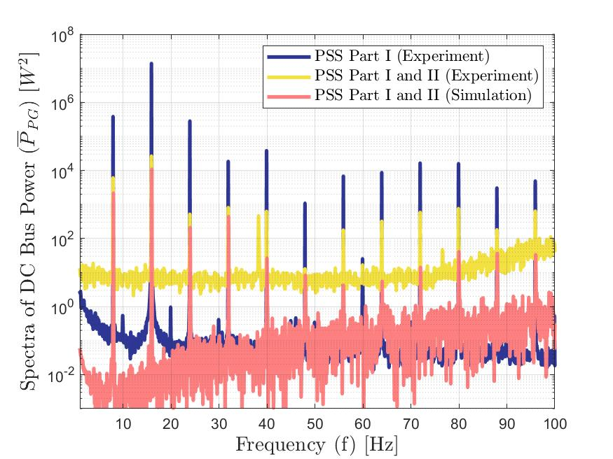
Power Quality Improvement
RMS of Oscillating Power in the Time Domain Power
$$P_{rms,tot}=\sqrt{\frac{\sum_{i=1}^{L}{{\left(P_{i}−\overline{P}\right)}^{2}}}{L−1}}$$
RMS in the Frequency Domain
Low Frequency Spectra of a Periodogram
$$P_{PG}=\frac{2}{L}{\left|FFT(P)\right|}^{2}$$
$$P_{rms,low}=\sqrt{\frac{\sum_{i=2}^{N}{P_{PG,i}}}{L−1}}$$
Oscillating Power = $P−\overline{P}$
 | P_{rms,tot}
 | Simulation | Experimental
No PSS | 31.9 | 31.9
PSS Part I | 2.37 | 2.18
PSS Part II | 0.056 | 0.65
Percent Reduction | 99.8 % | 98.5 %
P_{rms,low}
Simulation | Experimental
2.37 | 2.37
2.37 | 2.17
0.034 | 0.125
98.0 % | 94.7 %
< 100 Hz
Notes:
The next metric is looking at how well does the system actually smooth power
The main metric I’m using here is root means square, essentially the amount of variance away from the average
We can easily do this in the time domain using this equation, which I’m sure looks pretty familiar
So if we compare input and output power, both simulation and experiment show over a 98% decrease in the amount of oscillating power
The experimental system is about an order of magnitude worse as compared to the simulation.
As we mentioned earlier, this difference is caused by high frequency switching noise in the experiment.
But, the point of the PSS, and what we care about, is how well it removes low frequency power oscillations at the rotational rate of the turbine
To do that, look at things in the frequency domain, which we can do using an FFT
I’m using a specific kind of frequency analysis called a periodogram, which is a way at looking at signal power at a given frequency. This is computed by squaring a single sided fast fourier transform, then normalizing by the number of data points in the time series.
You can calculate the root means square of a signal over a specified number of frequencies by summing the period gram across the range of frequencies of in interest,
If you do this across the entire range of frequencies, you calculate back the same exact value you get from this equation.
But here, we only want to look at low frequency oscillations, so we only look at the period gram from 0 to 100 Hz.
From the periodogram, we see that most of the “power” of the signal is concentrated at the blade pass frequency and its harmonics, which we would expect. Introducing PSS Part II has this obvious effect of reducing the amount of signal power at those frequencies.
If we calculate RMS at just across low frequencies, we see that the simulation and experiment start to look a lot more similar.
The experiment still performs worse than the simulation, but only by a factor of like 3 or 4. So in terms of removing low frequencies power oscillations, which is what we really care about, the experiment performs decently well.
The high frequency stuff, sensor noise and switch node ringing, etc is an artifact of implementing such a small scale system on a protoboard. I think if you were to build a larger scale system using a printed circuit board or some better circuit design practices you could mitigate a lot of these issues.

Slide 46
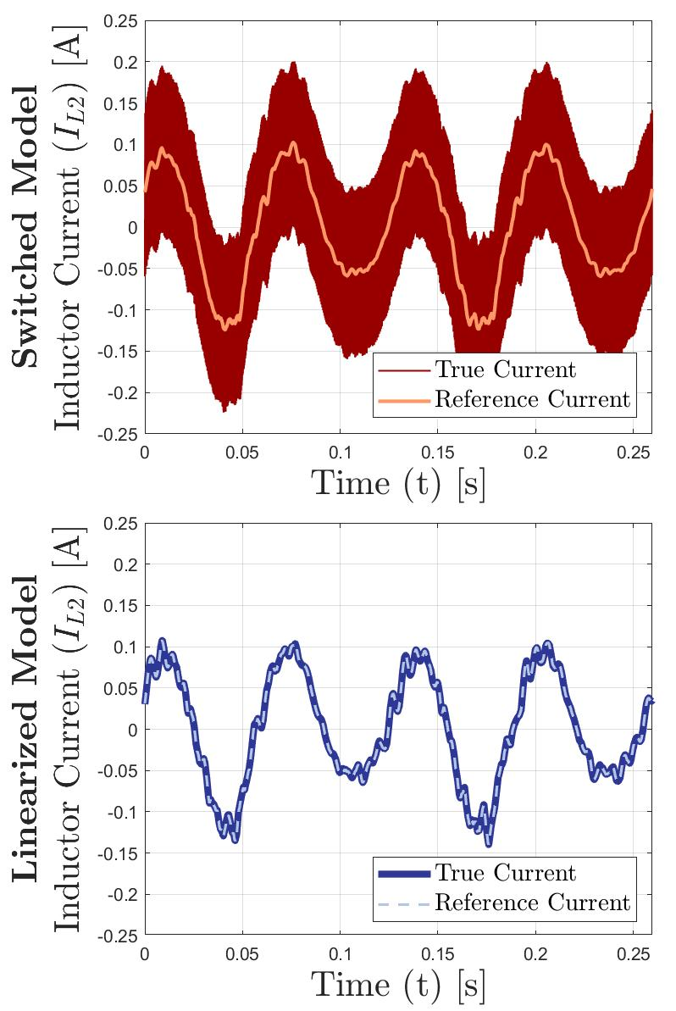
Linearization Results
Notes:
How does this linearized compare to the full switched model? Again it actually does surprisingly well.
If we look at the power coming out of the system, we see that the state space model almost perfectly captures the dynamics of the system, it even captures the transient that occurs when PSS Part II switches on. I think this is actually pretty impressive.
The only real difference between the two models is the current through the inductor. For the switched model, the inductor includes this ripple current that happens at the frequency of the converter.
The linearized model only calculates the average switch cycle averaged inductor current.
But remember, even in this full switched model, we don’t actually care about this ripple current. We’re purposefully sampling this waveform at it’s average value anyway, because we know the dynamics at this high frequency doesn’t matter. This is why the output of the two systems are basically the same
What you end up with is this system which can be run at least 10x faster than the switched model but still captures all of the important dynamics that you care about.
This is a really great place to start if you are resizing the system for a new application, so you can quickly trial and error some of the component values and controller parameters to make sure they are sized to appropriately smooth the incoming current.

Slide 47
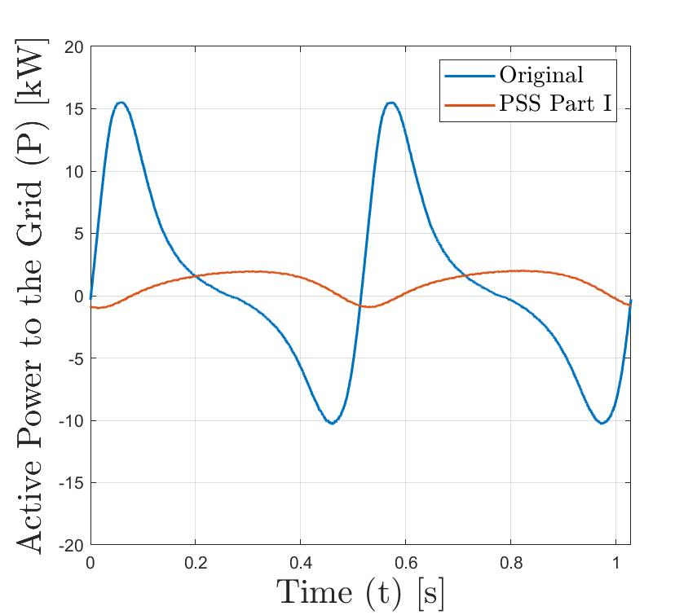
Full-Scale System
PSS Performance
 | Efficiency (η) [%] | RMS of Oscillating Power (P_{rms,low}) [W]
No PSS | 100 % | 7130
PSS Part I | 97.3 % | 964
Notes:
When we add in PSS Part I, in this case I’ve sized these components such that they are actually doing a decent amount of energy storage, as we can see by the peak to average ratio being significantly reduced

Slide 48
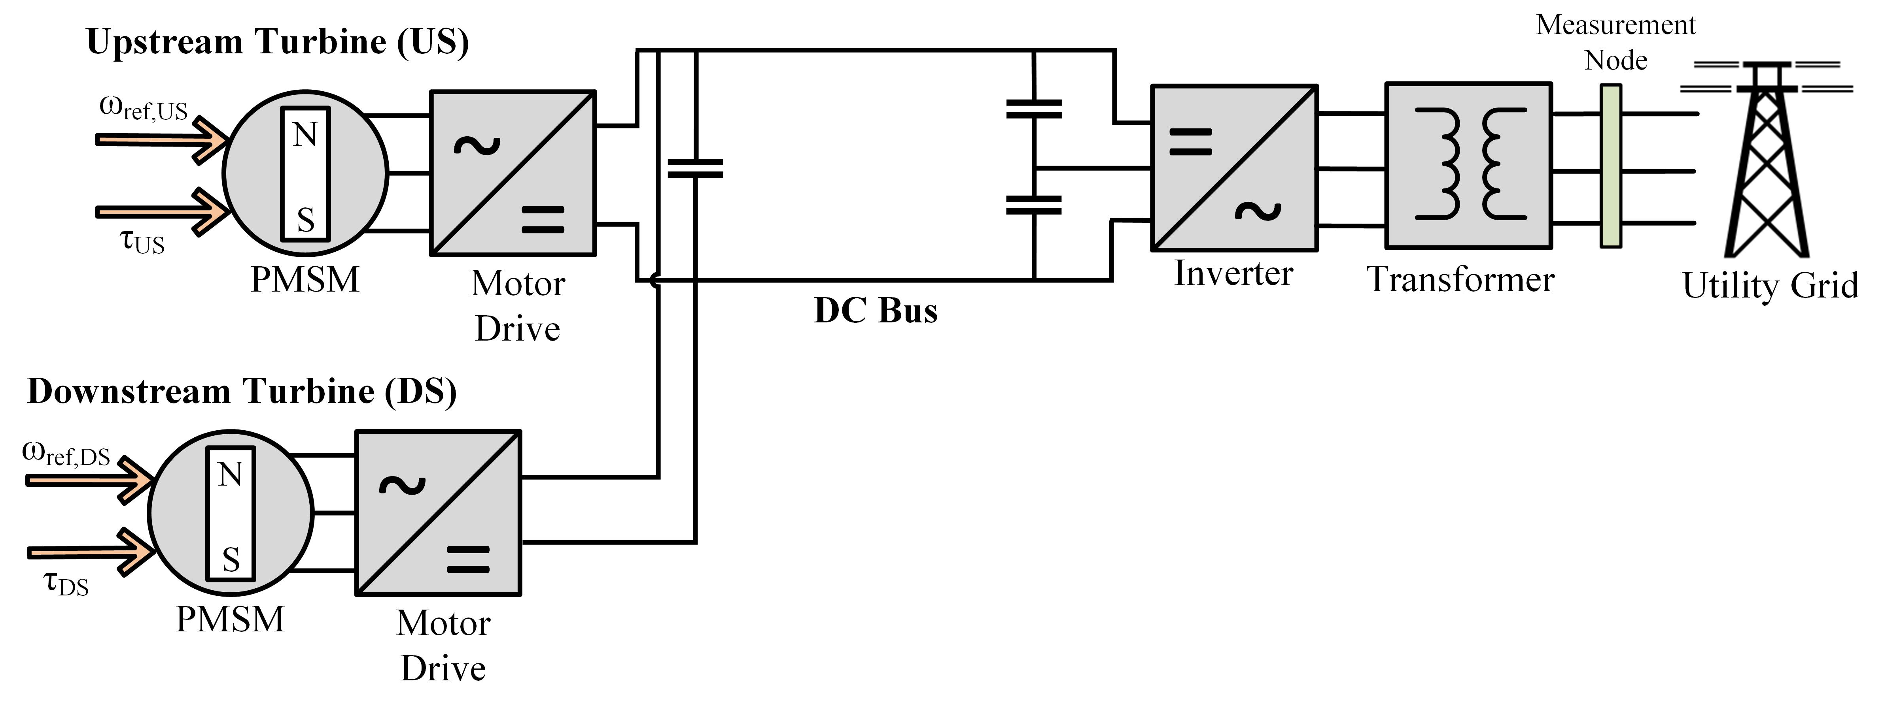
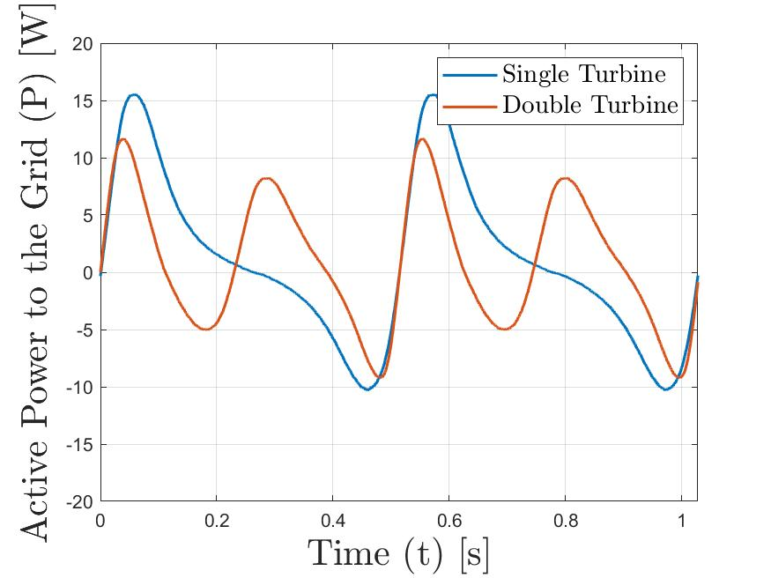
Double Turbine System
Notes:
This single turbine system is kind of a worst case scenario of raw power that you would see from a turbine.
However, if you combine two turbines on the DC bus, and operate them both synchronously using intracycle control, you can actually improve the efficiency of the entire water-to-wire system.
The reason for this is that you have much lower peak currents traveling through this inverter and transformer, which means that you have lower power losses.

Slide 49
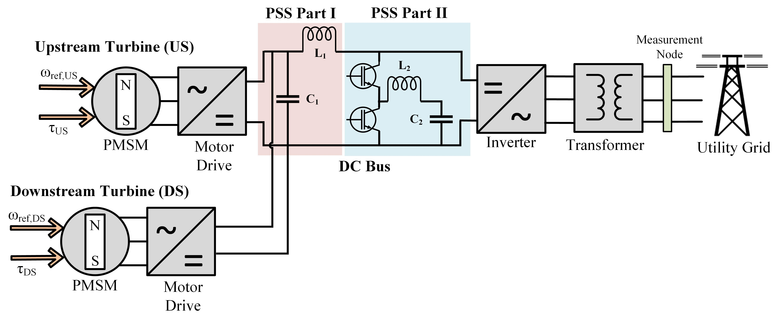
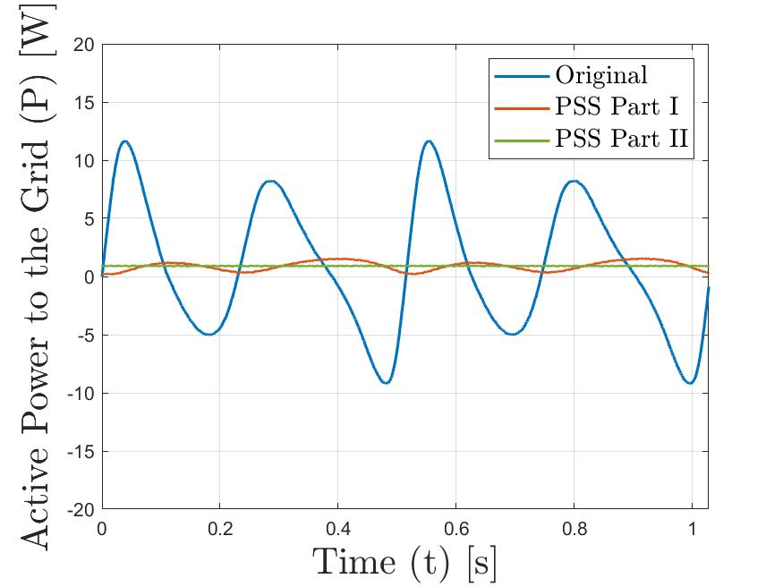
Double Turbine System
PSS Performance
 | Efficiency (η) [%] | RMS of Oscillating Power (P_{rms,low}) [W]
Single Turbine | 97.0 % | 15.1
Double Turbine | 98.3 % | 12.3
Notes:
So, I wanted to look at how the PSS performs for this system
For this simulation, two half-sized turbines were used, to keep the total power in the system the same
I also kept all of the components and controller parameters the same to give a more apples to apples comparison, but the lower peak currents from this double turbine system suggests that you could likely downsize some of these components, which would reduce the overall size and cost of the system as well as resistance losses.
Overall we see a slight improvement in the output power quality as well as an improvement in the efficiency of the PSS for the double turbine case
This improvement in efficiency comes from the lower peak currents in the system- we know that power losses occur from the internal series resistances of the components in the system, and are equal to I^2*R. So lower currents means lower losses and higher efficiency

Slide 50
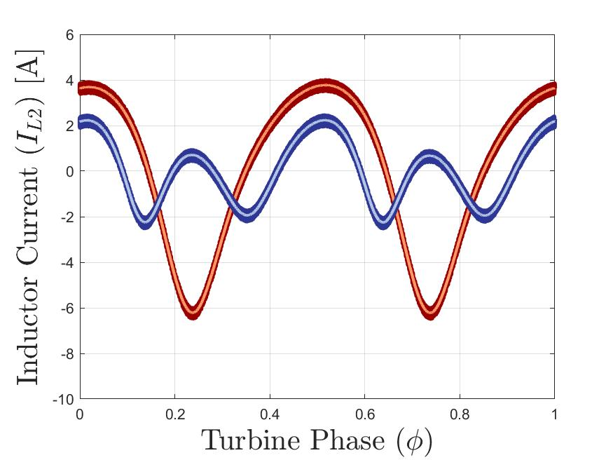
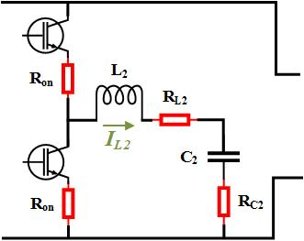
Full-Scale Efficiency
PSS Efficiency
Single Turbine | Double Turbine
97.0 % | 98.3 %
Why is efficiency better for the double turbine system?
Power Loss from Internal Series Resistance (ESR)
$$P=I^{2}R$$
Average I² per Turbine Rotation [A²]
Single Turbine
Double
Turbine
Single Turbine | Double Turbine
11.2 | 1.95
Reference Current
True Current
Notes:
Why is there an improvement in the double turbine case?
We can look at the currents that are being commanded through the converter switches and output inductor and capacitor.
We know that all of these components have some small unavoidable resistance, which can be modeled as a resistor in series with the component.
Power losses through these components are proportional to the square of the current going through them.
If we compare the currents going through these components over the course of a single turbine rotation, we see that the single turbine case has much higher peak currents. It’s average value of I^2 per cycle is almost 6x as large as the single turbine case.
These higher currents lead to higher power losses, and thus why there is lower efficiency for the single turbine case.
The overall point that I’m trying to make here is that even for this worst-case scenario of a single turbine using intracycle control, which has this atrocious peak to average power, the PSS works very well and maintains high efficiency.
Anything you do above that to improve your raw power quality, such as combining turbines or using constant velocity control, is going to allow you to downsize the system and improve it’s performance and efficiency

Slide 51
Alternative Design
Part I LC filter used to remove high frequency switching noise on DC Bus
Instead, estimate power on the generator side, which doesn’t have switching noise
$$V_{emf}=pλ\dot{θ}\left[\begin{matrix}cos⁡(pθ) \\ cos⁡(p(θ−\frac{2π}{3})) \\ cos⁡(p(θ+\frac{2π}{3}))\end{matrix}\right]$$
p = number of pole pairs
λ = flux linkage
Θ = rotor position
$\dot{\text{Θ}}$ = rotor speed
Notes:
The last thing I want to talk about is one alternative design concept, which Brian Johnson has been helping me with over the last month or so.
Part I of the system is this LC filter which removes really high-frequency switching noise from the current on the DC bus
You don’t want this switching noise to be included in your measurements on the DC bus because then the reference current through this inductor is going to have high frequency noise, and its going to be impossible for your controller to track this reference.
An alternative idea, which is more on par with existing papers I’ve seen out there on this subject, is that instead of measuring the incoming power on the DC bus, measure it on the generator side using the back EMF voltage of the generator and the three phase current measurements on the stator windings.
These measurements do not include high-frequency noise, so they give this nice estimate of what the low frequency power in the system looks like.
The back EMF voltage can be estimated based on the measured rotor speed and position

Slide 52
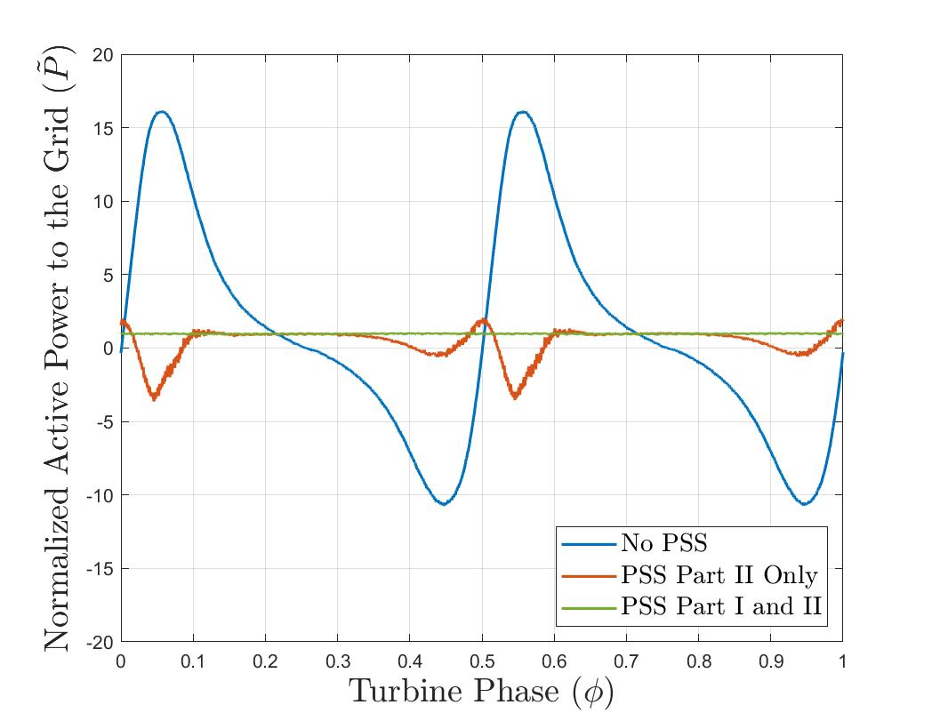
Alternative Design Results
Good performance for part of turbine rotation
Poor performance when power changes most rapidly
Area of future work, could work for less aggressive systems
Advantages | Disadvantages
Decreased number of components | No longer self-contained on DC Bus
Decreased number of sensors
Notes:
This works quite well for part of the cycle where power is changing slowly, but not very well for the part of the cycle where power is changing quickly.
My hypothesis is that there is some kind of delay or inefficiency between the generator side measurements and the DC bus, which throws off the system during these large power swings.
It’s possible that this could work for a less aggressive system, maybe one which has power that doesn’t fluctuate as much, or you could find a way to predict this delay or inefficiency to get better results. I think could be an interesting area of future work.
The main advantage of going to this system is that you get rid of an inductor, so there is a decreased number of components, and you can get ride of a current and voltage sensor on the DC bus, since you are using existing measurements from the motor drive.
I would say that the main disadvantage is that the system is no longer completely self contained on the DC bus
Before, you had this system that you could build entirely separately from the rest of the system, then kind of drag and drop it onto the DC bus
With this method, you need access to motor drive measurements, so you would have to find a way to access those measurements and carry them to the PSS

Slide 53
Energy Storage Components
Capacitor
Inductor
+
V_{C}
-
L = Inductance
= Capacitor Voltage
C = Capacitance
I_{L} = Inductor Current
Stores energy in electric field
Stores energy in magnetic field
Resists change in current
$$E=\frac{1}{2}CV_{c}^{2}$$
Resists change in voltage
$$V_{L}=L\frac{dI_{L}}{dt}$$
$$I_{c}=C\frac{dV_{c}}{dt}$$
High power density
53
Notes:
In the system, capacitors and inductors are used as the main short term energy storage components
Most of the energy storage is coming from the capacitors, which store electricity in an electric field
The amount of energy the capacitor can store is based on the size of the capacitor, or its capacitance, and the voltage across the capacitor
Capacitors resist changes in voltage, and the higher the capacitance, the more energy it is able to store and the more it resists change in voltage
Capacitors have incredibly high power density, which means they can be charged and discharged very rapidly, which is perfect for this application
Inductors are coils of wire which store energy in a magnetic field
They resist changes in current, and again the larger the inductance, the more energy they can store and the more they resist changes in current

